Slide 1
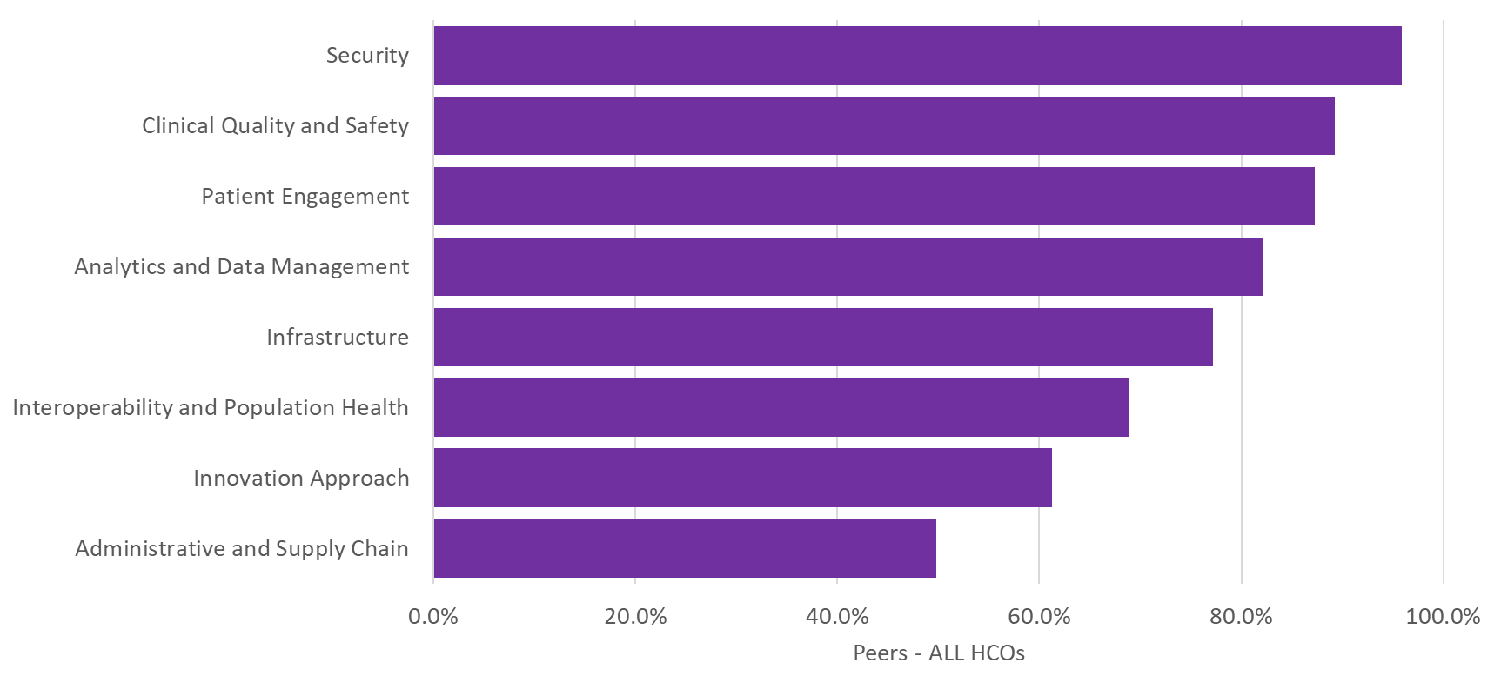
(PRI-01) The following lists the various sections of the Digital Health Most Wired survey. To what extent do you project each of the following areas will be a priority for your organization during the next 12-months?

Slide 2
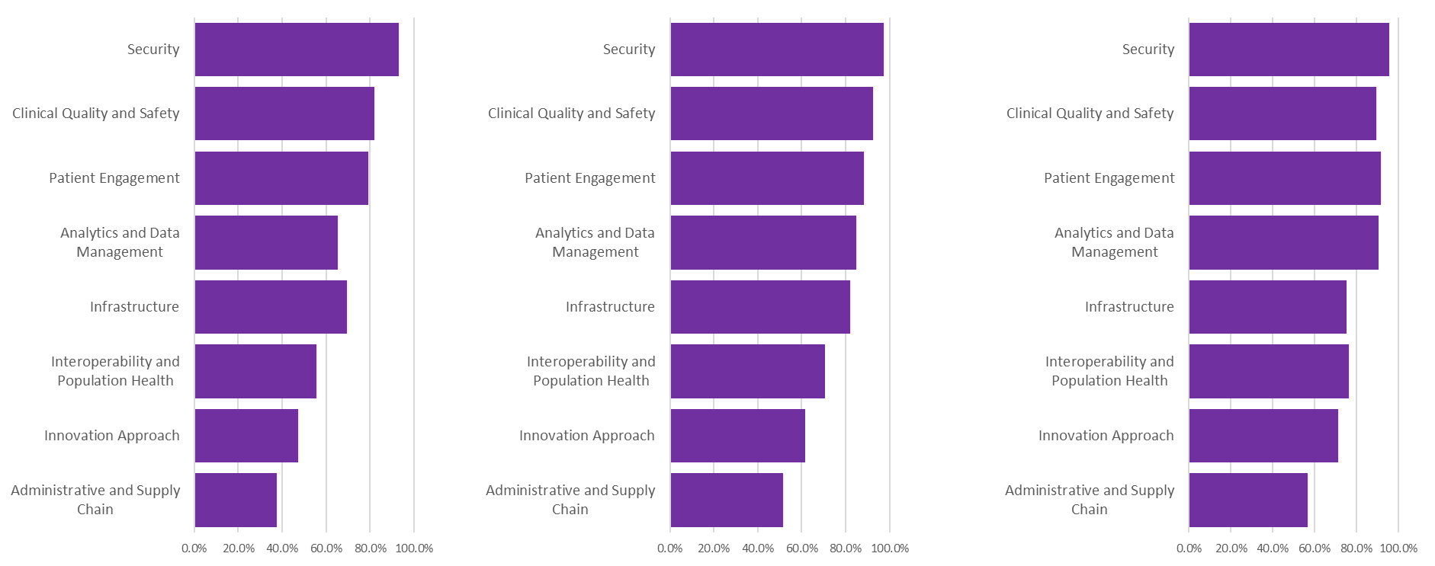
(PRI-01) The following lists the various sections of the Digital Health Most Wired survey. To what extent do you project each of the following areas will be a priority for your organization during the next 12-months?
Small HCOs
Medium HCOs
Large HCOs

Slide 3
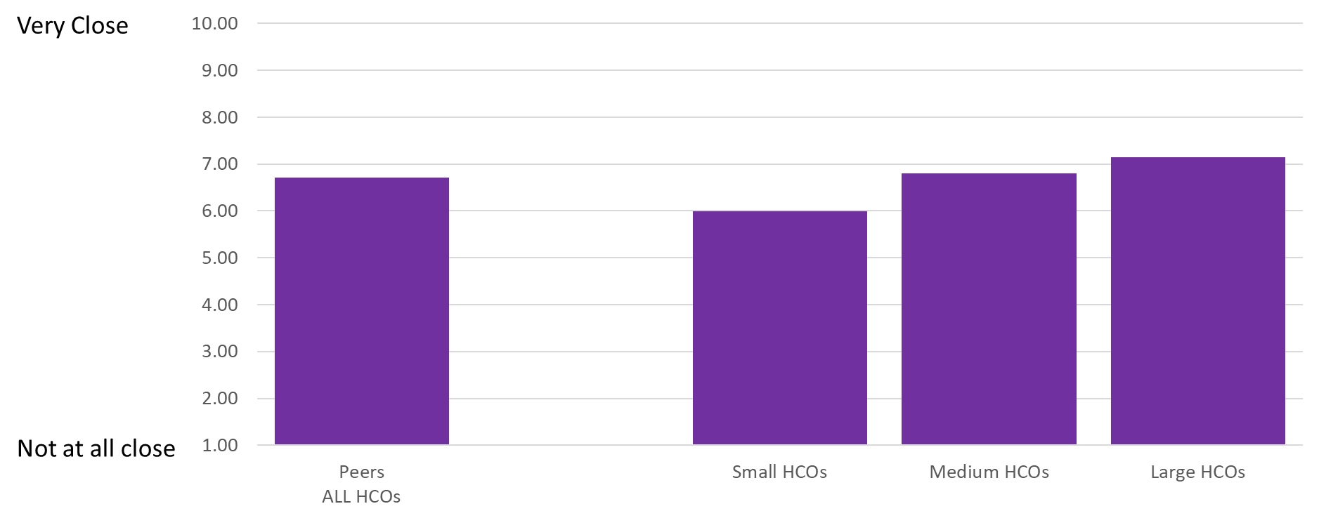
(PRI-02) Imagine an ideal healthcare provider organization transformed by digital technologies and capabilities that improve processes, engage talent across the organization, enable better patient care and drive new and value- generating business models. How close is your organization to that ideal? How close is your organization to that ideal?

Slide 4
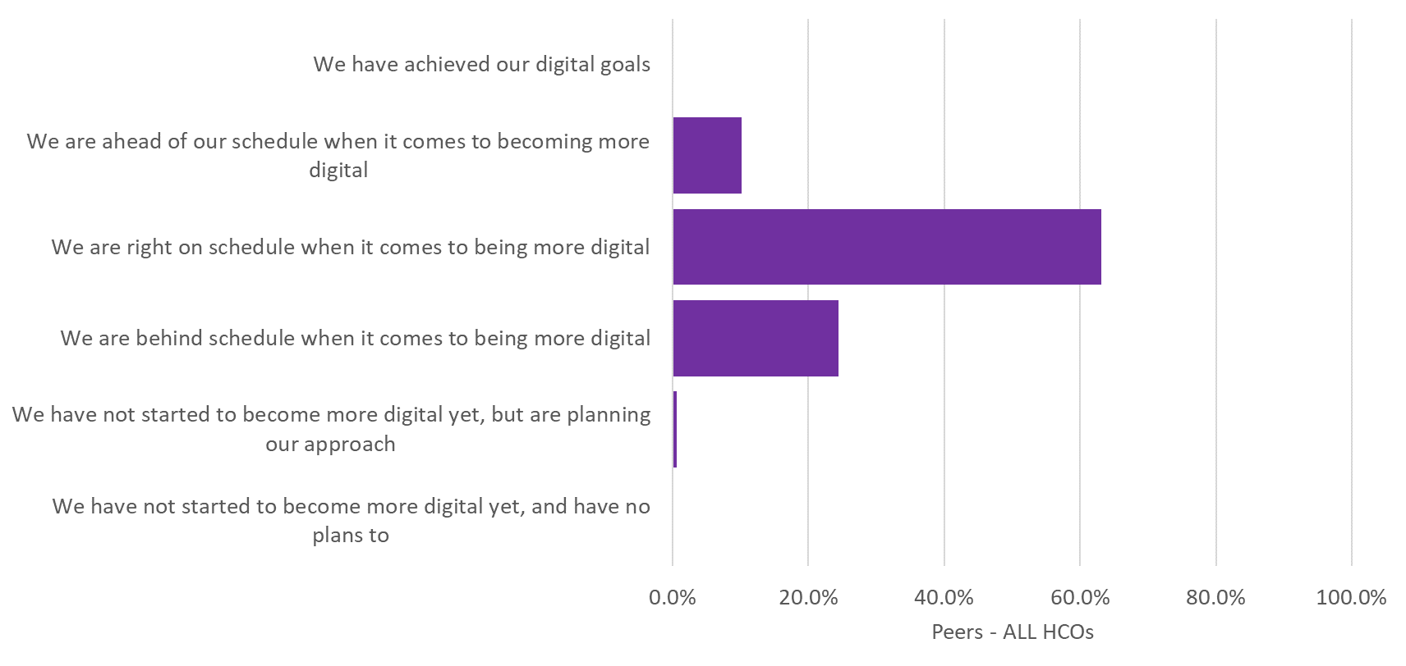
(PRI-03) Where do you see your own organization currently when it comes to becoming more digital?

Slide 5
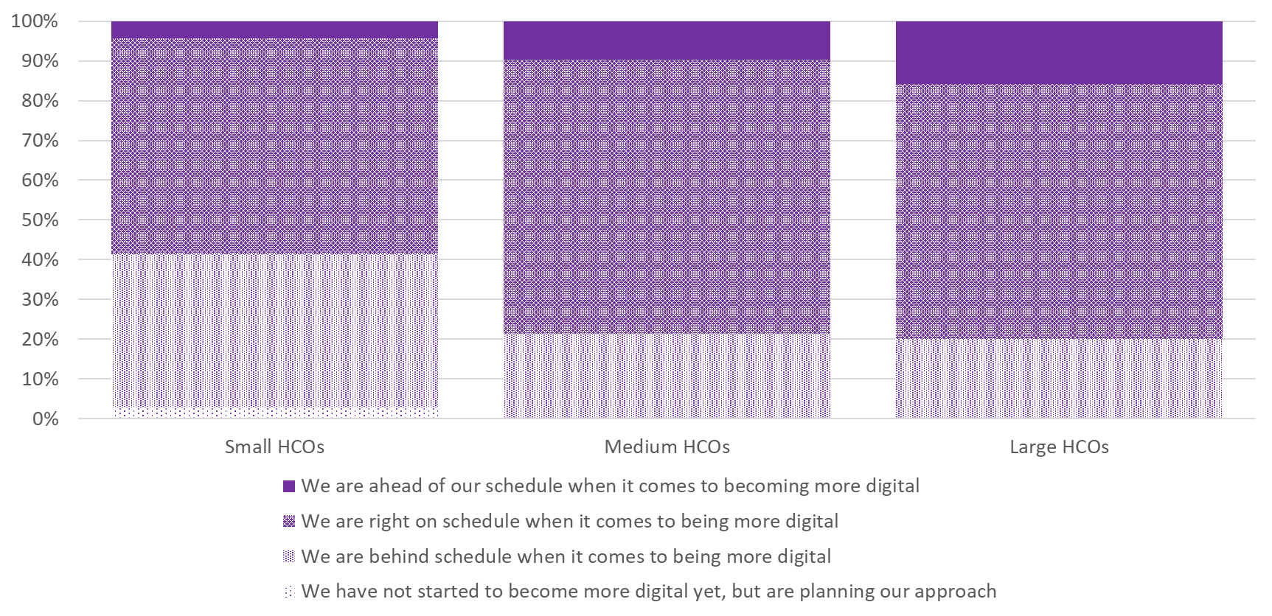
(PRI-03) Where do you see your own organization currently when it comes to becoming more digital?

Slide 6
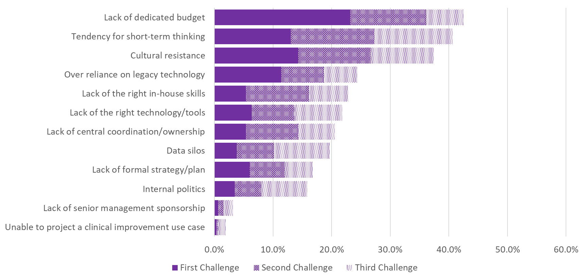
(PRI-04) What are the biggest challenges that your organization has experienced in trying to undertake a successful digital transformation? Rank your top 3 challenges from this list.

Slide 7
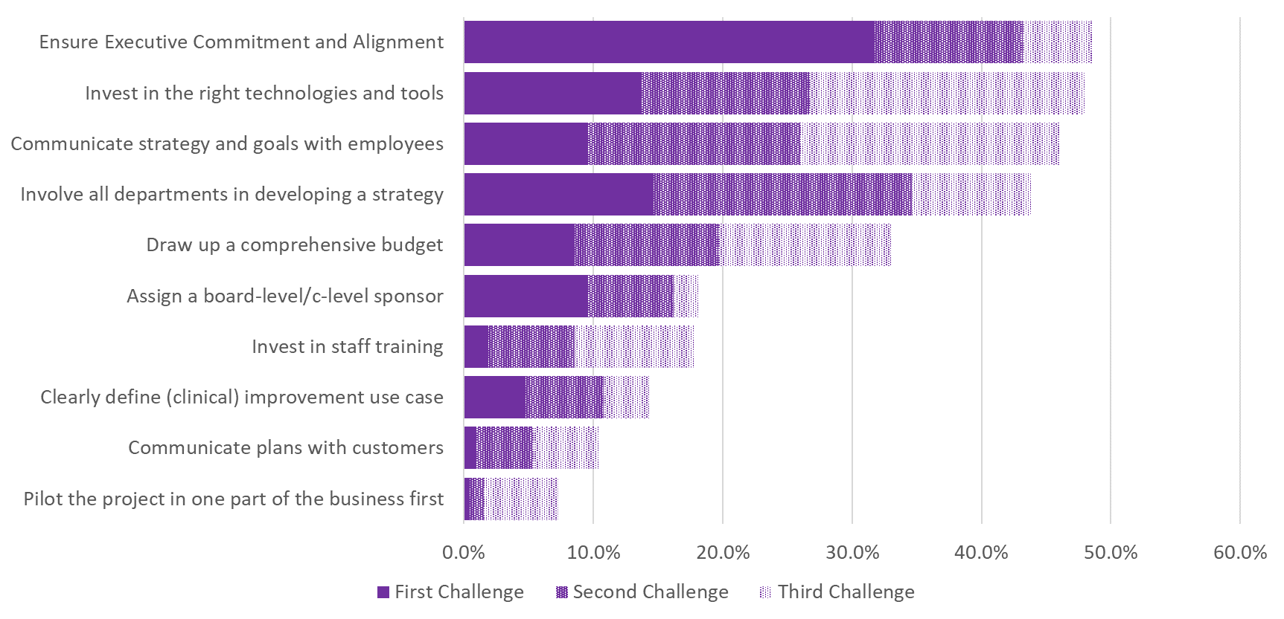
(PRI-05) What are the most critical steps to enable a successful digital transformation? Rank your top 3 steps from this list.

Slide 8
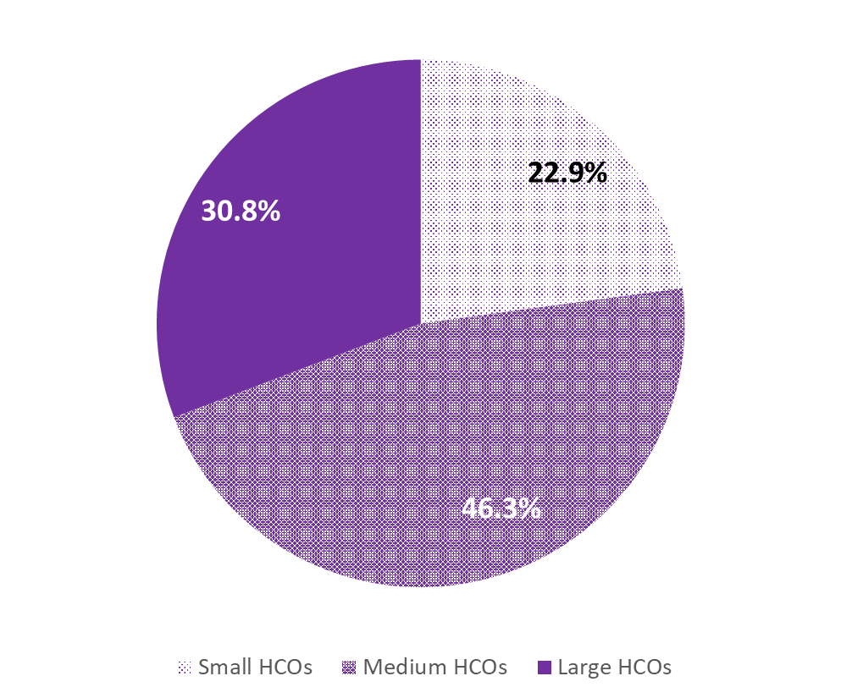
2023 DHMW Survey – HCO Size
Small HCOs
Medium HCOs
Large HCOs
<=250 beds
>250 and <=1000 beds
>1000 beds

