Slide 1
Topics – Innovation
Leadership / Structure
Practices
Focus Areas

Slide 2
Leadership / Structure

Slide 3
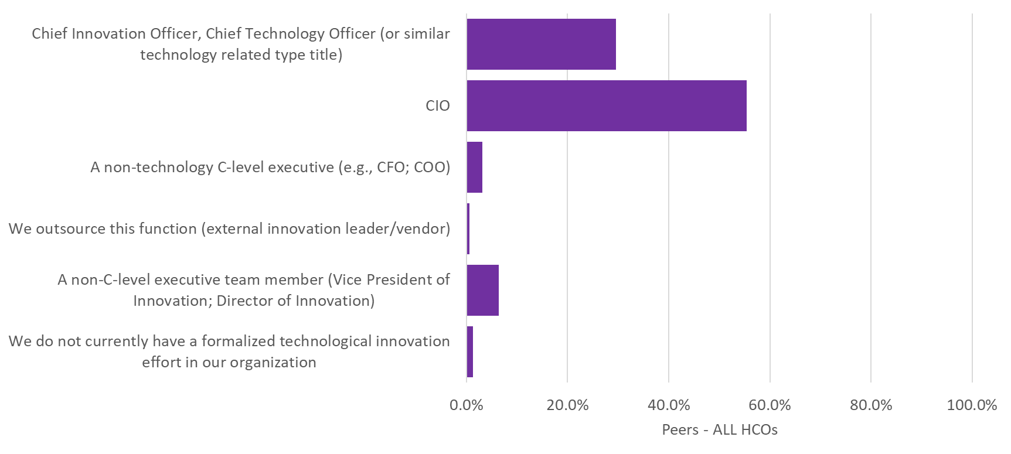
Q82. Whom on your executive team is primarily responsible for leading tactical technological innovation efforts in your organization?

Slide 4
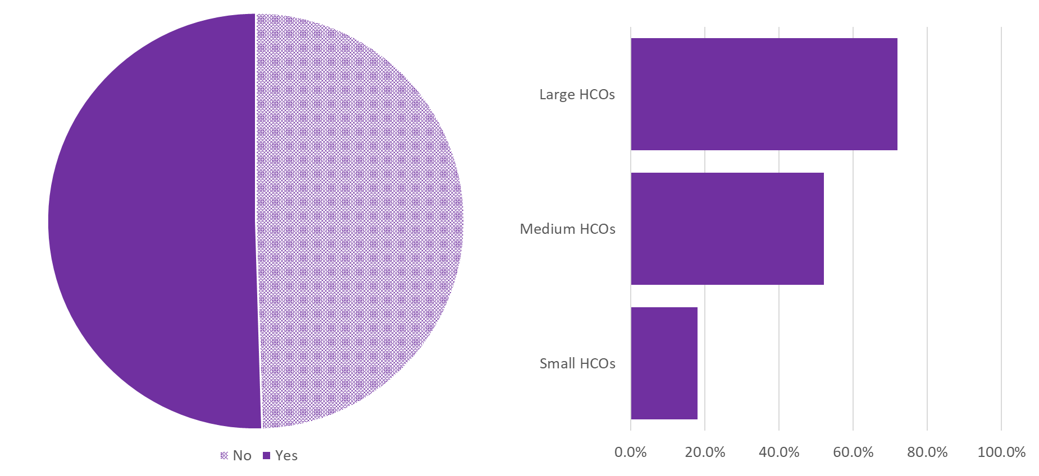
Q92. Is your organization formally associated with an Innovation Center involved in healthcare technological innovations?

Slide 5
Practices

Slide 6
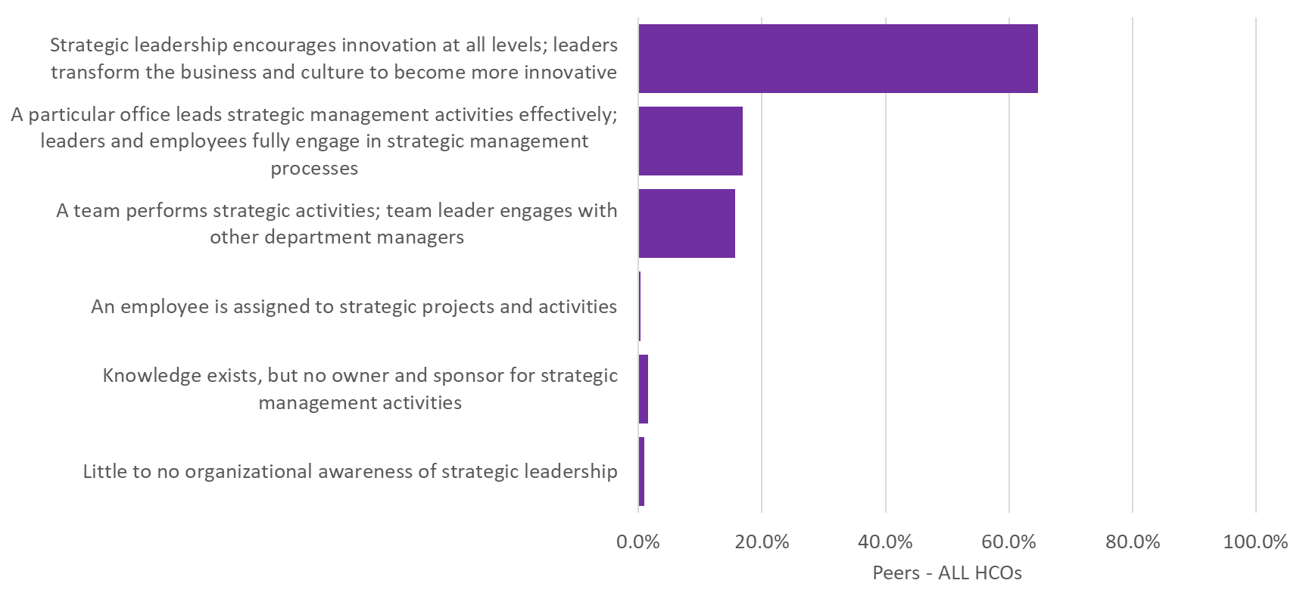
Q83. When thinking about technological innovation in your organization, which of the following statements best characterize your organization’s strategic management LEADERSHIP approach?

Slide 7
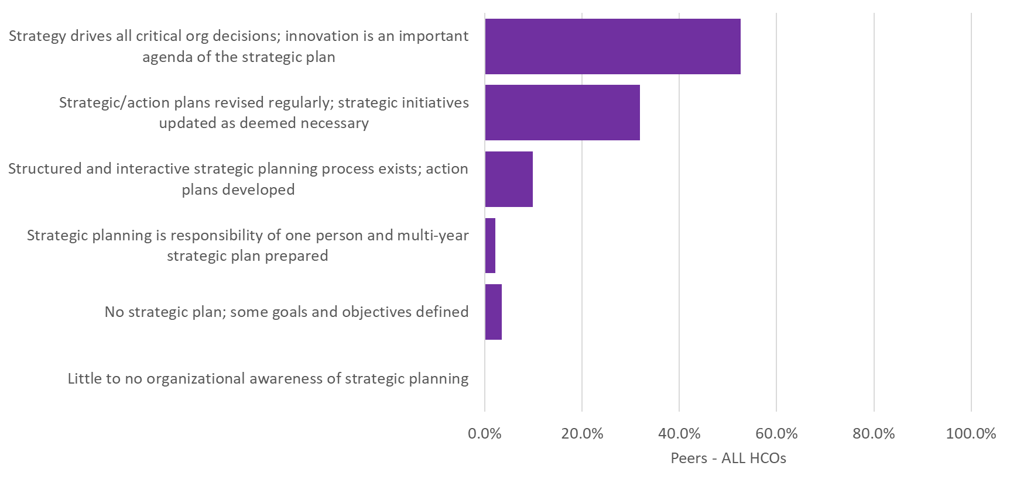
Q84. When thinking about technological innovation in your organization, which of the following statements best characterize your organization’s approach to the strategic management of PLANNING and EXECUTING?

Slide 8
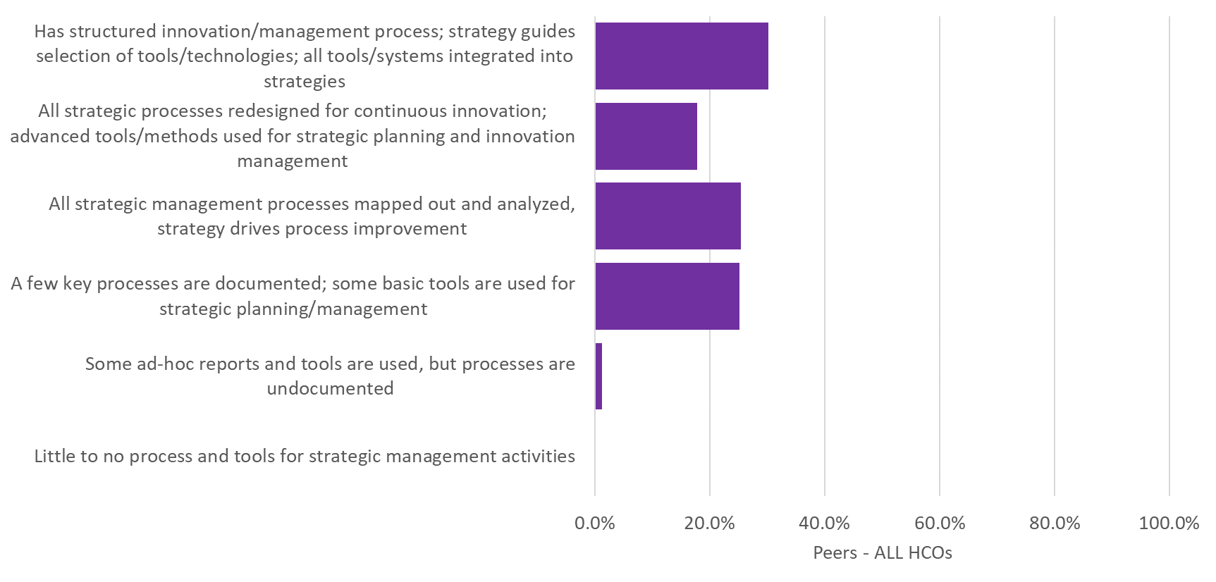
Q85. When thinking about technological innovation in your organization, which of the following statements best characterize your organization’s approach to the strategic management of PROCESSES and TOOLS?

Slide 9
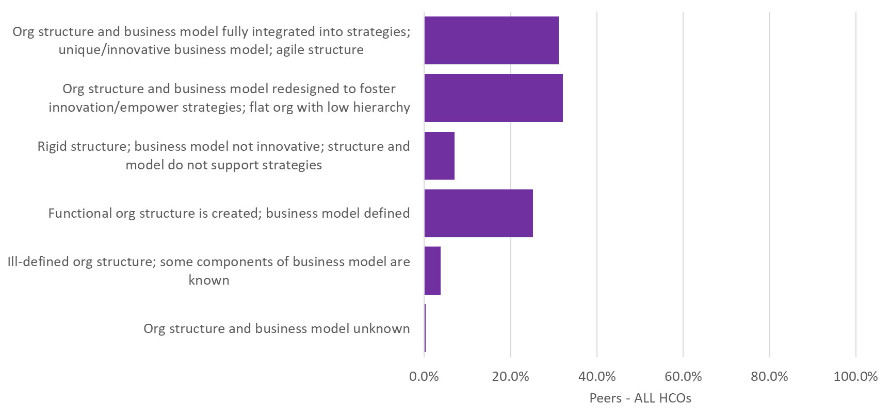
Q86. When thinking about technological innovation in your organization, which of the following statements best characterize your organization’s approach to the strategic management of ORGANIZATIONAL STRUCTURE and BUSINESS MODEL?

Slide 10
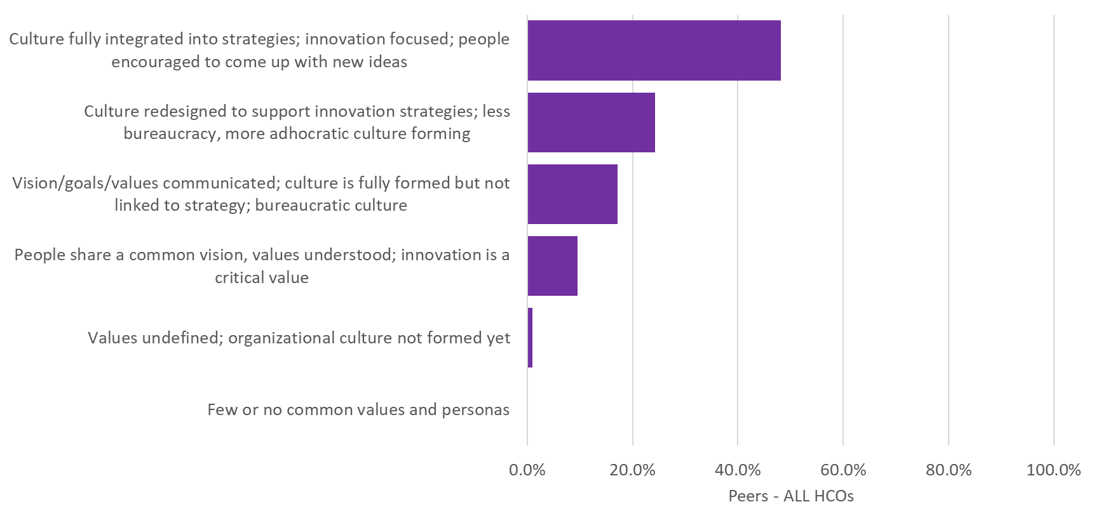
Q87. When thinking about technological innovation in your organization, which of the following statements best characterize your organization’s approach to the strategic management of PEOPLE and CULTURE?

Slide 11
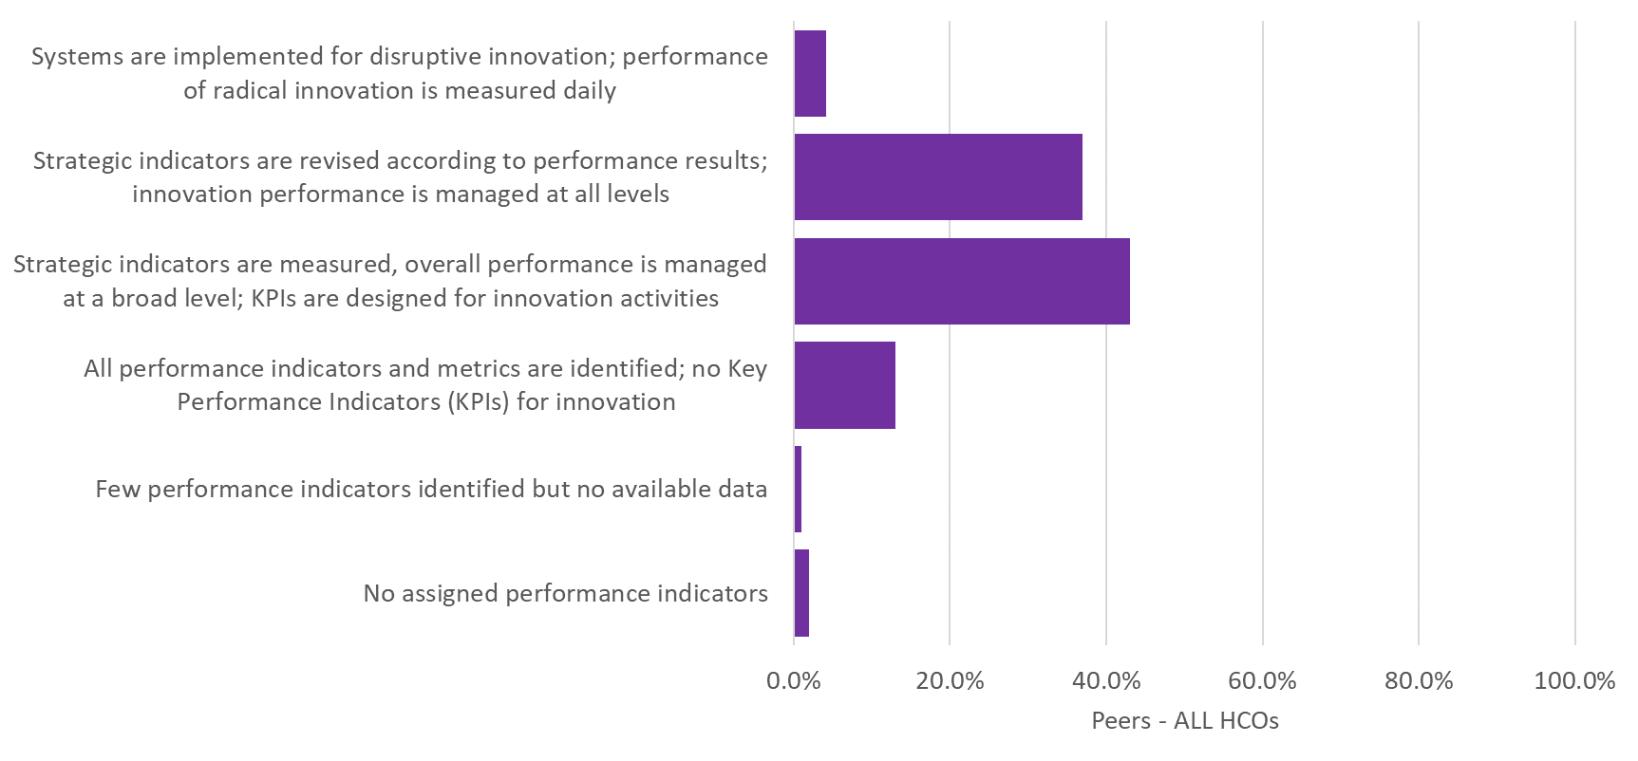
Q88. When thinking about technological innovation in your organization, which of the following statements best characterize your organization’s approach to the strategic management of PERFORMANCE MANAGEMENT?

Slide 12
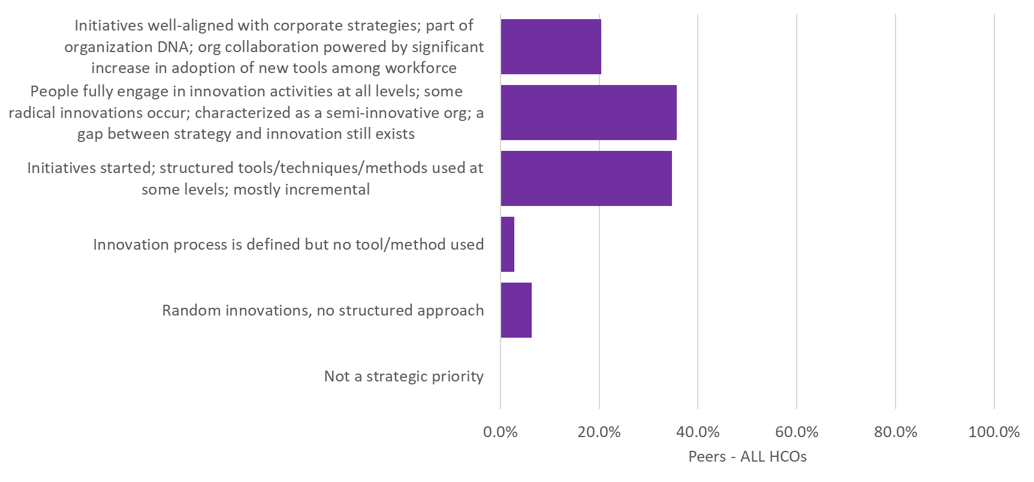
Q89. When thinking about technological innovation in your organization, which of the following statements best characterize your organization’s APPROACH to the strategic management of innovation?

Slide 13
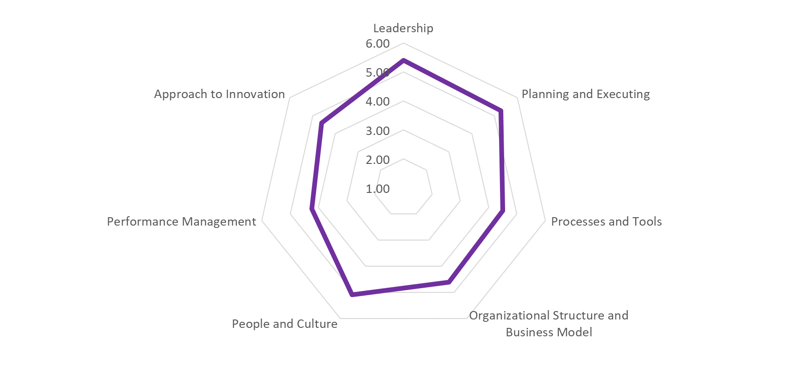
Innovation Profile Averages of Q83 – Q89

Slide 14
Focus Areas

Slide 15
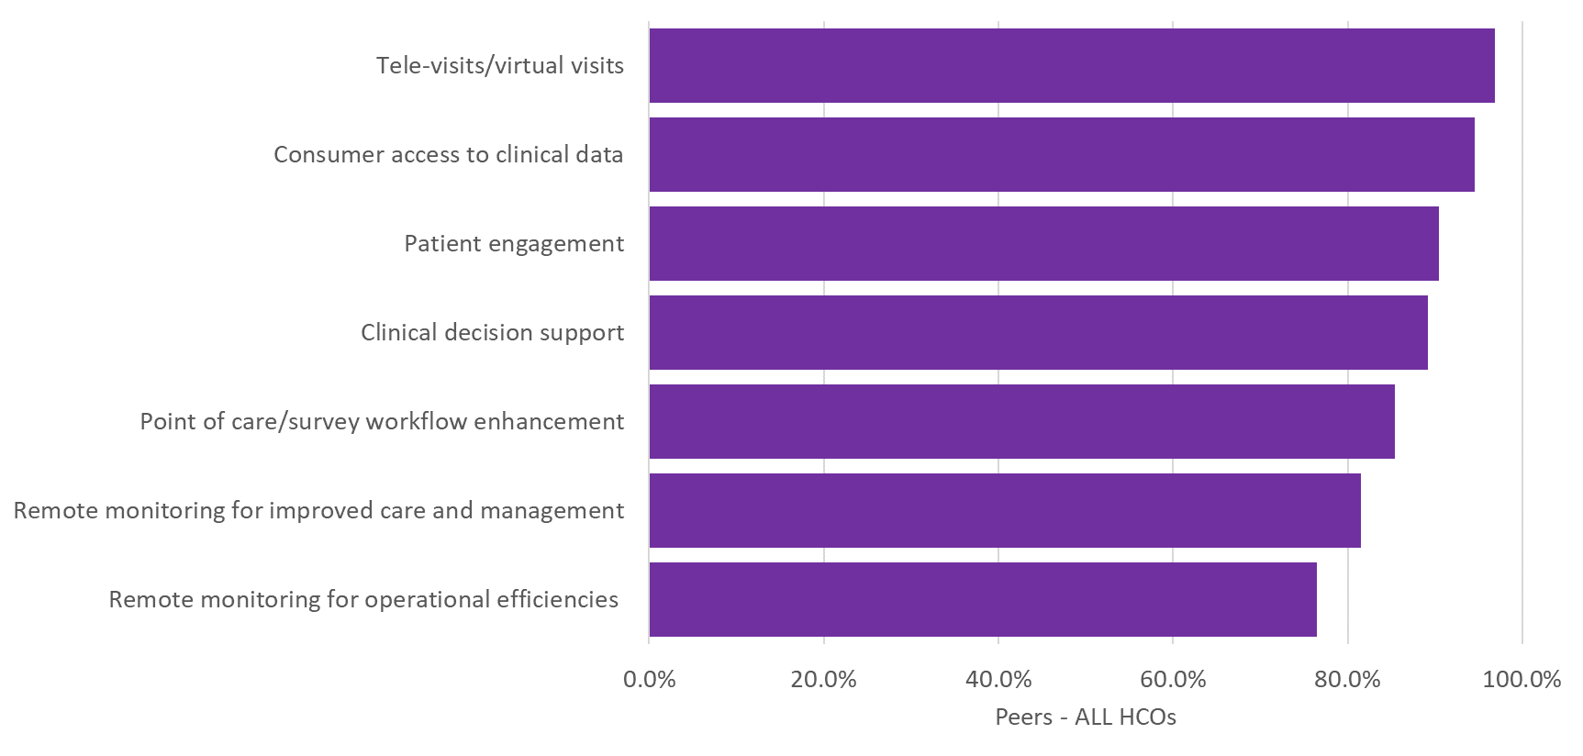
Q90. Which of the following types of digital health tools have your technological innovation assessment efforts addressed within the past three-years?

Slide 16
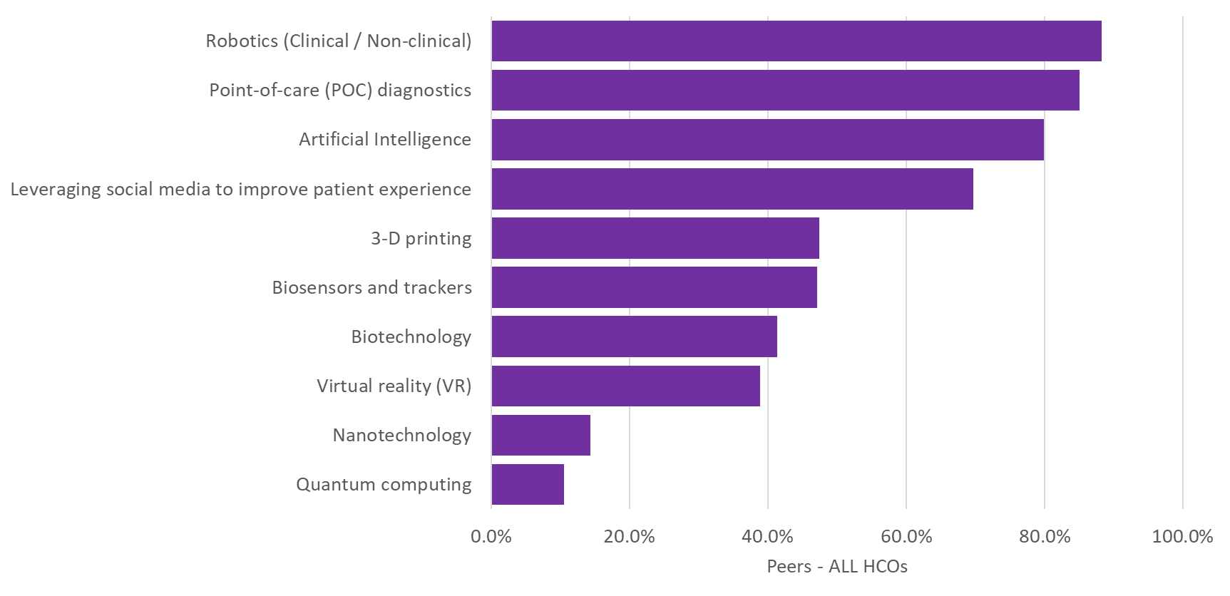
Q91. Of the following types of innovations, which do you currently use in your organization?

