Slide 1
Topics – Clinical Quality & Safety
Availability of Clinical Tools
Utilization of Clinical Tools

Slide 2
Availability of Clinical Tools

Slide 3
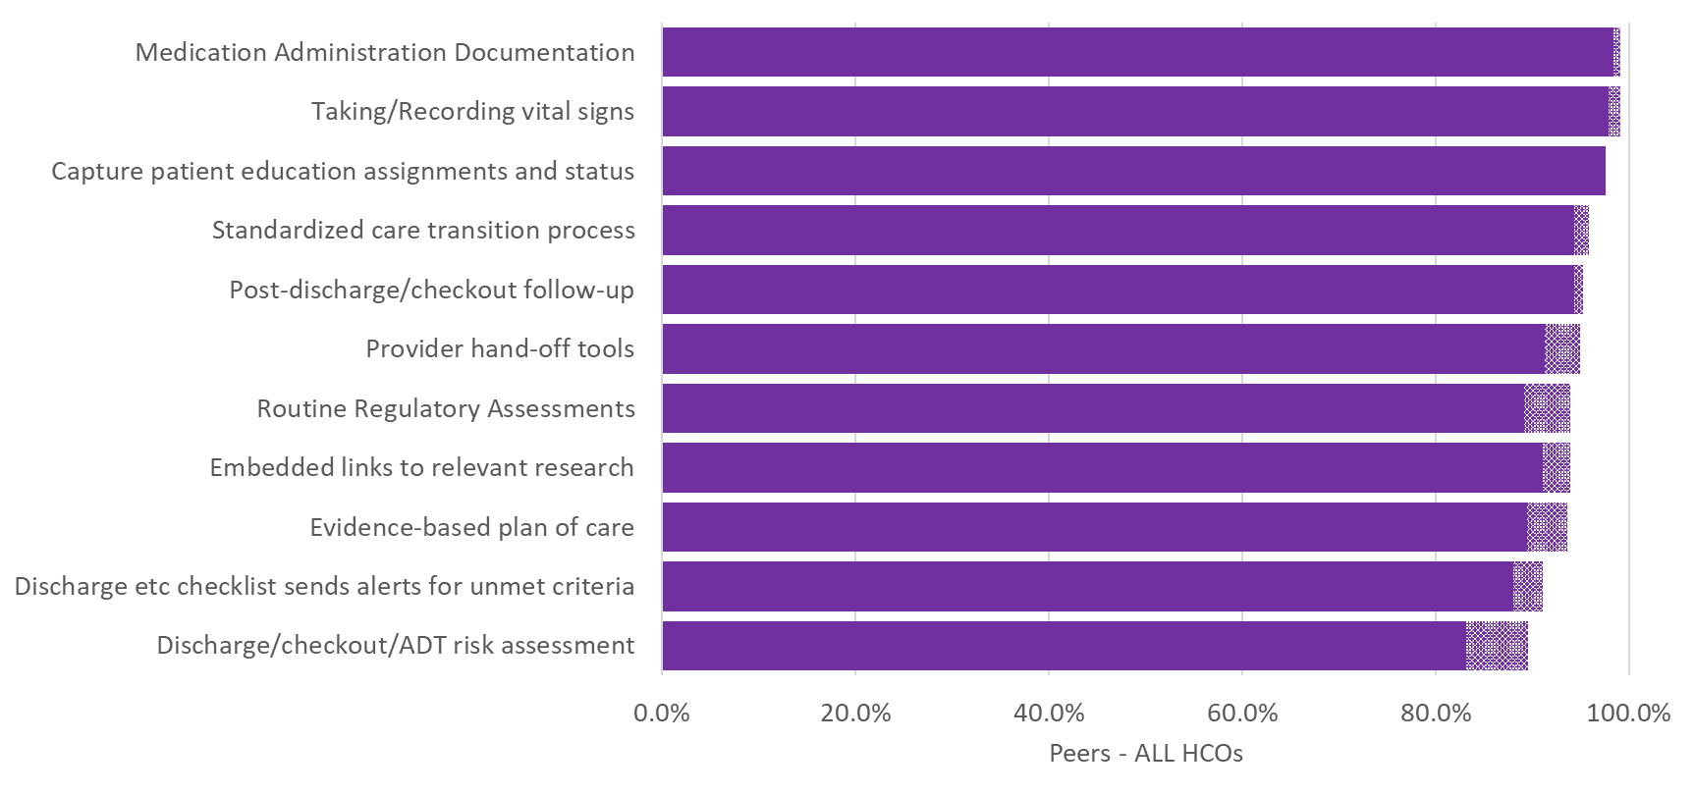
Q68. Which of the following nurse activities are electronically enabled in your organization?

Slide 4
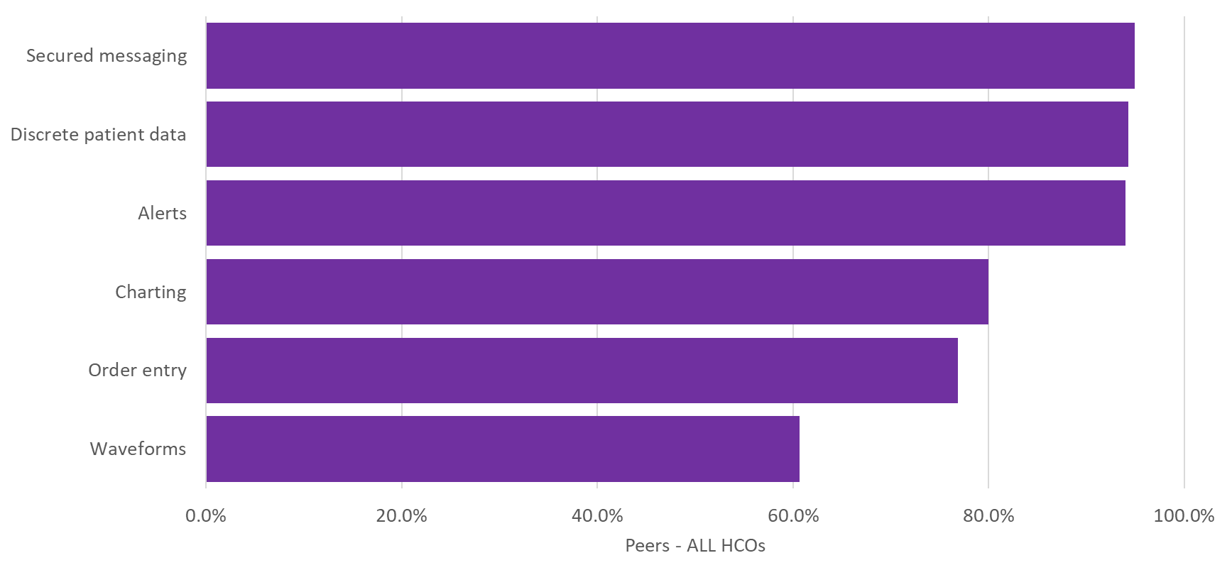
Q69. Which of the following capabilities are delivered via a wireless network to care team members using handheld devices at the point of care?

Slide 5
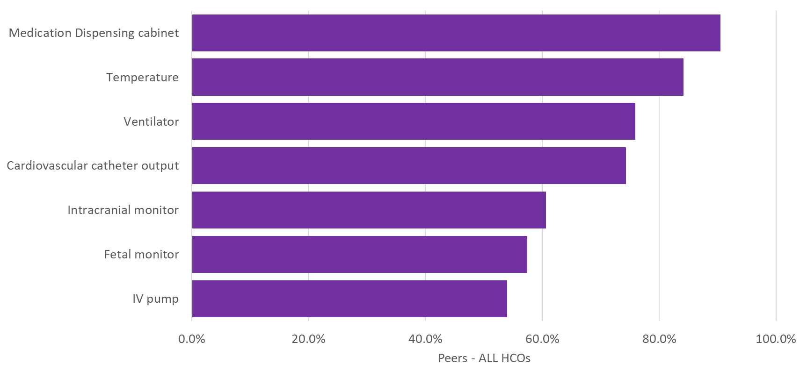
Q71. Which care sites in your organization automatically load patient data directly into the EHR, from the monitoring technologies listed below?

Slide 6
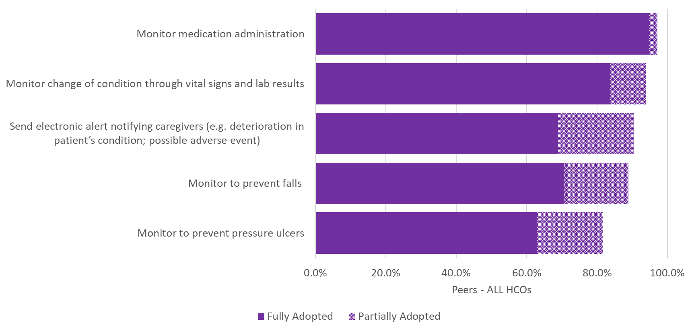
Q72. How would you characterize the adoption of your EHR-integrated surveillance system in conducting the following?

Slide 7
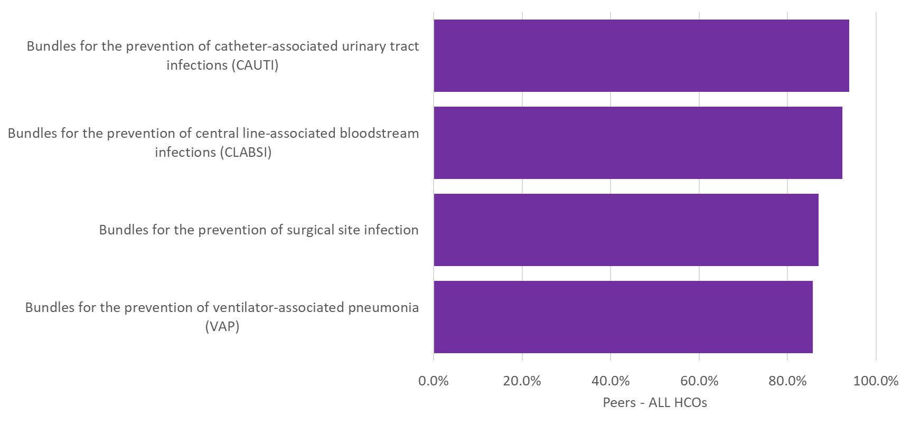
Q73. Which of the following healthcare-associated infection (HAIs) bundles do you leverage technology to electronically track within your EHR?

Slide 8
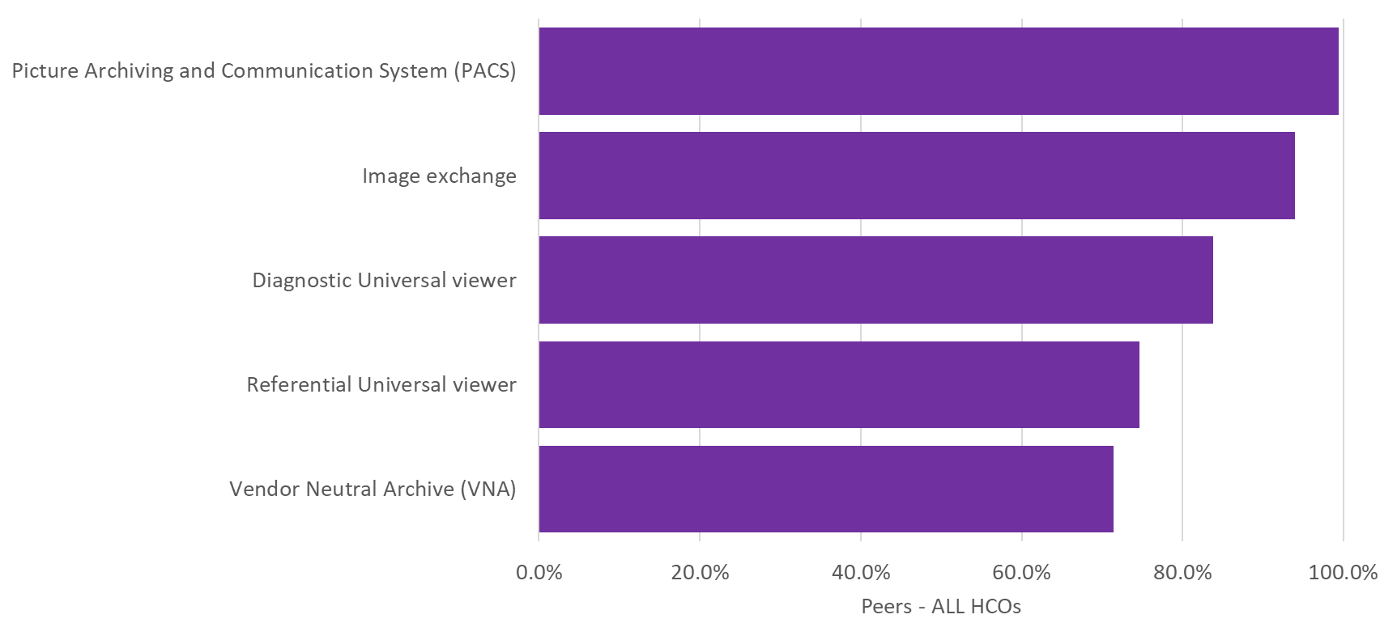
Q75. Which of the following solutions are part of your enterprise imaging system?

Slide 9
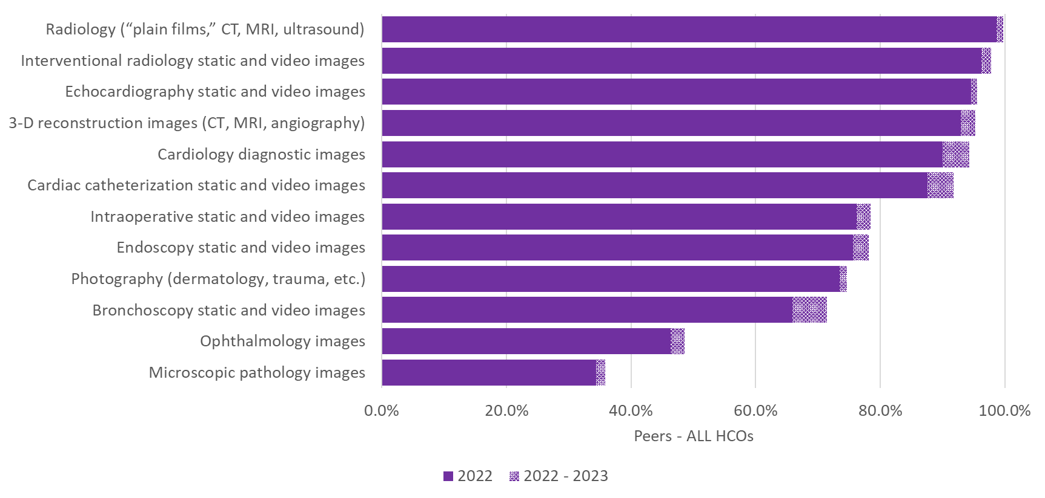
Q76. Which of the following diagnostic images can be accessed via your enterprise imaging system?

Slide 10
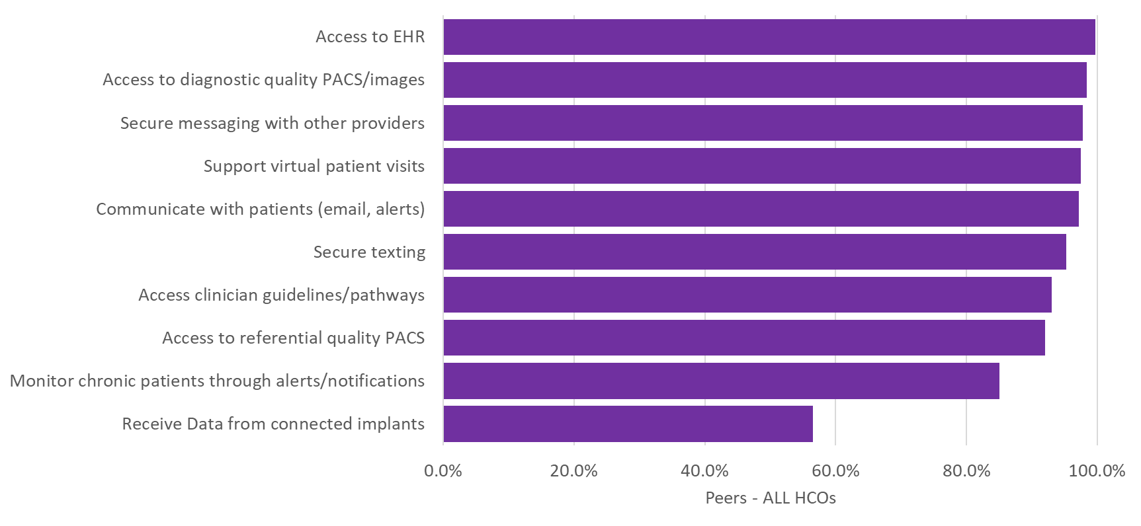
Q78. Which of the following resource functions can providers associated with your organization access remotely?

Slide 11
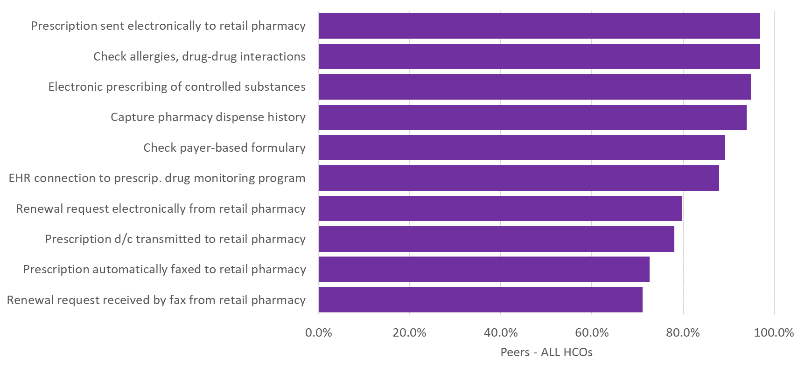
Q79. Which of the following e-prescribing functions do you provide for independent providers associated with your organization?

Slide 12
Utilization of Clinical Tools

Slide 13
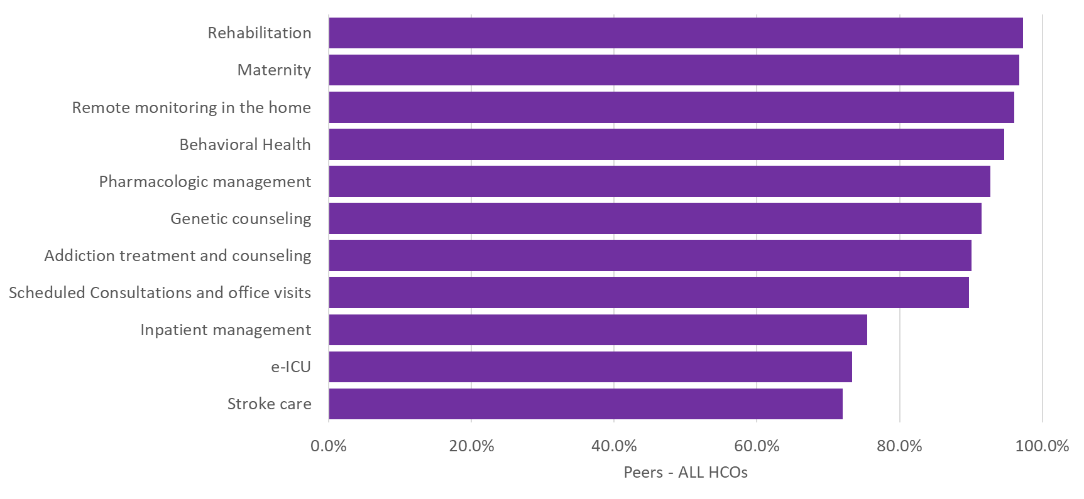
Q70. What percent of your clinicians are using the following real-time quality reporting resources? If none, put 0%.

Slide 14
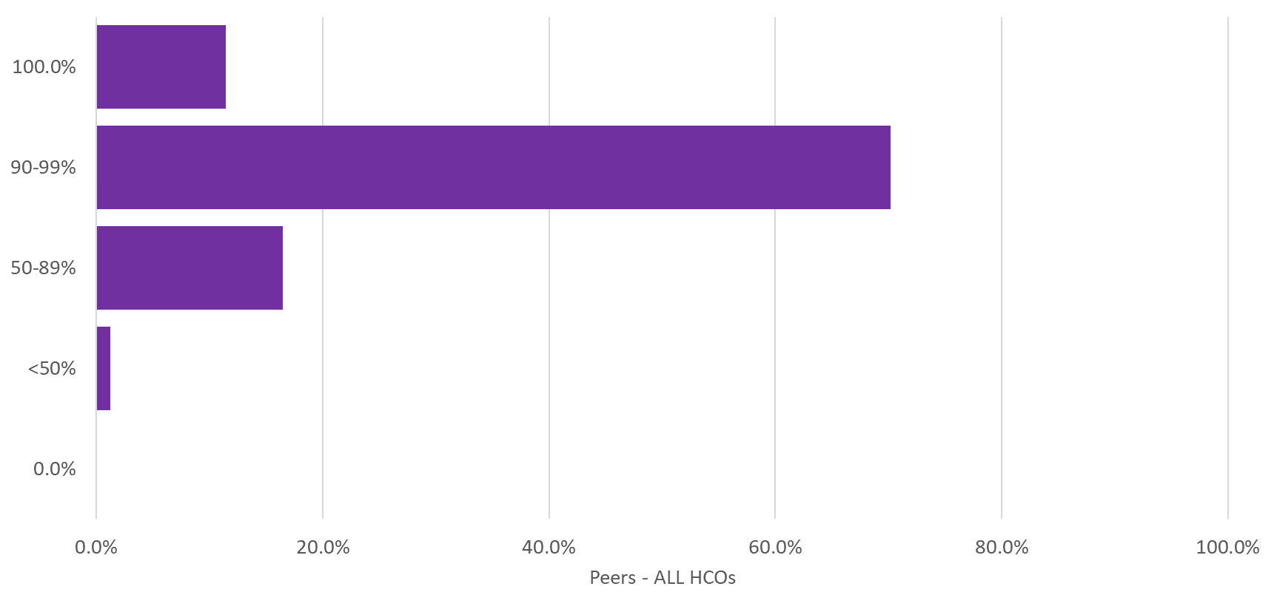
Q74. Please estimate the percentage of discharge/check-out medication orders (for new or changed prescriptions) transmitted as an electronic prescription.

Slide 15
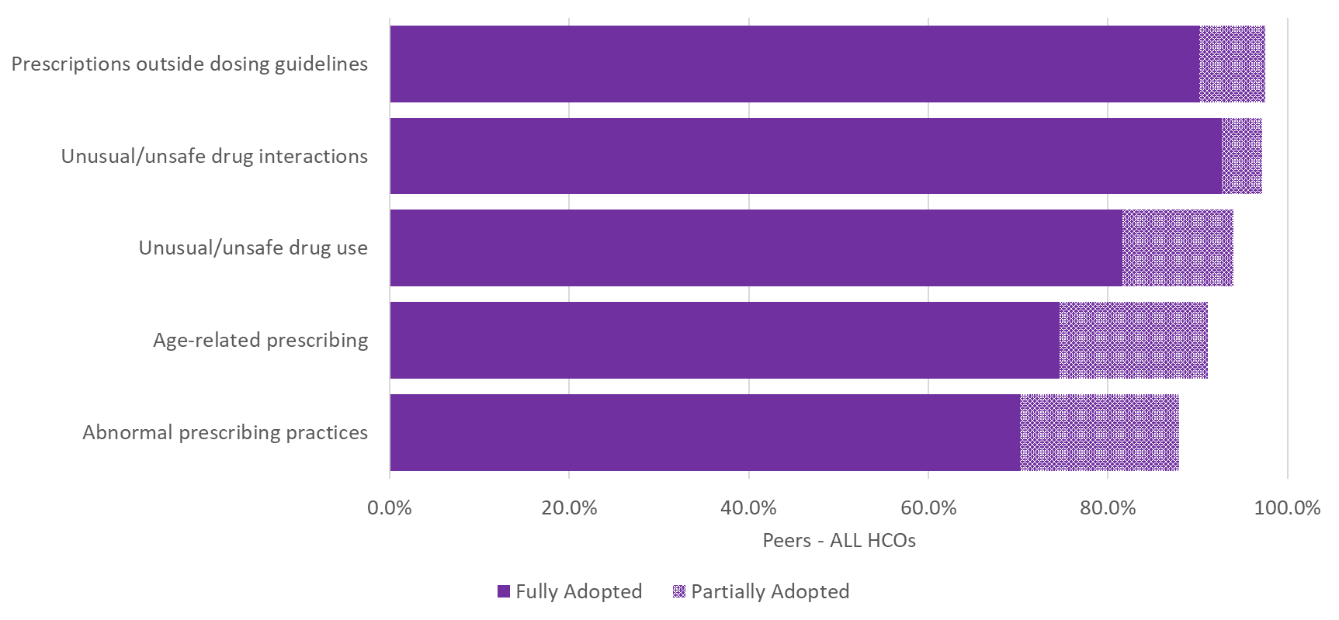
Q77. How would you characterize the adoption of your decision support system to identify the following possible prescribing anomalies?

Slide 16
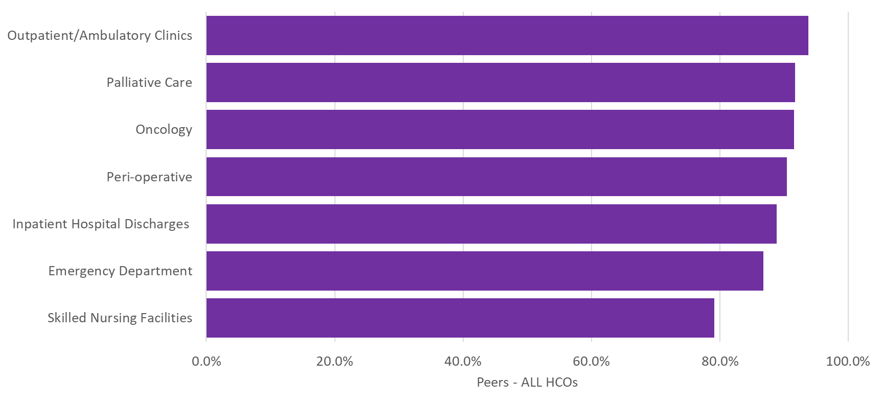
Q80. What percentage of controlled substances (schedule 2-4) are electronically prescribed to patients in the following areas of your organization?

Slide 17
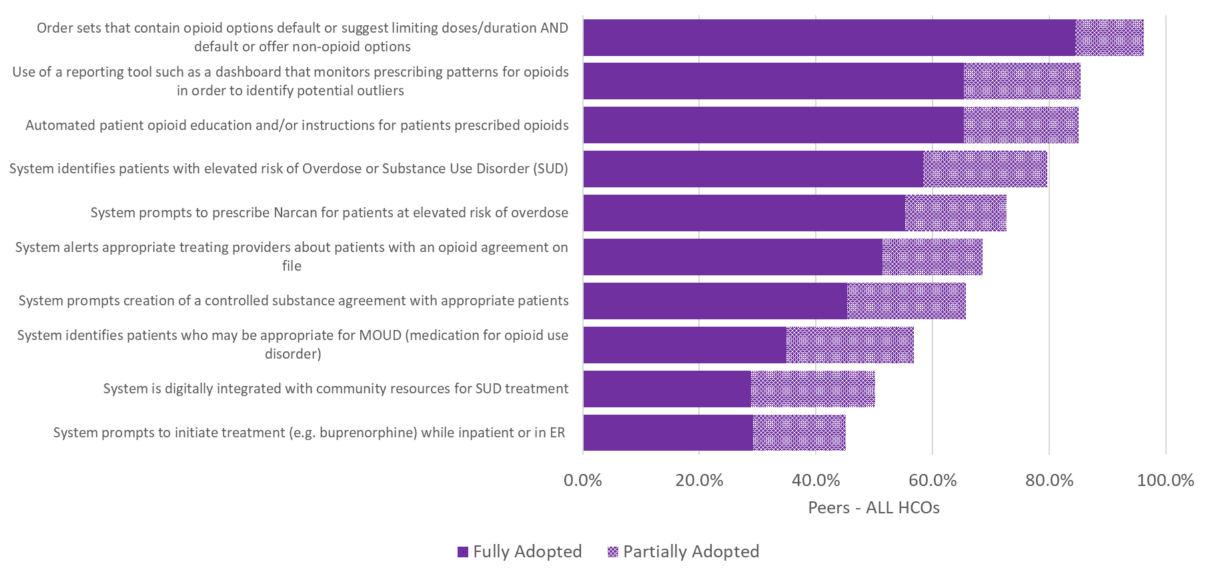
Q81. How would you characterize the adoption of technology designed to support the following opioid use reduction mechanisms in your organization?

