Slide 1
Topics – Patient Engagement
Leadership / Structure
Patient Engagement
Tools
Utilization
Promotion

Slide 2
Leadership / Structure

Slide 3
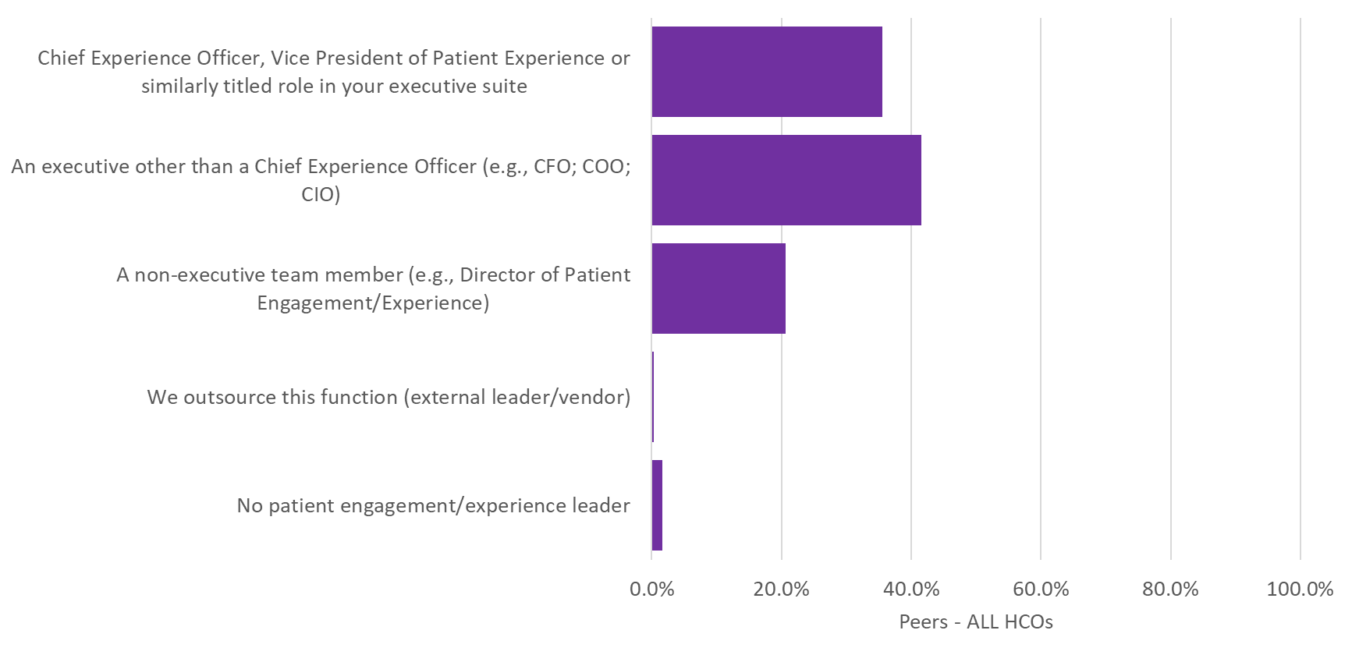
Q55. Whom on your executive team is primarily responsible for leading your organization’s patient engagement/experience efforts?

Slide 4
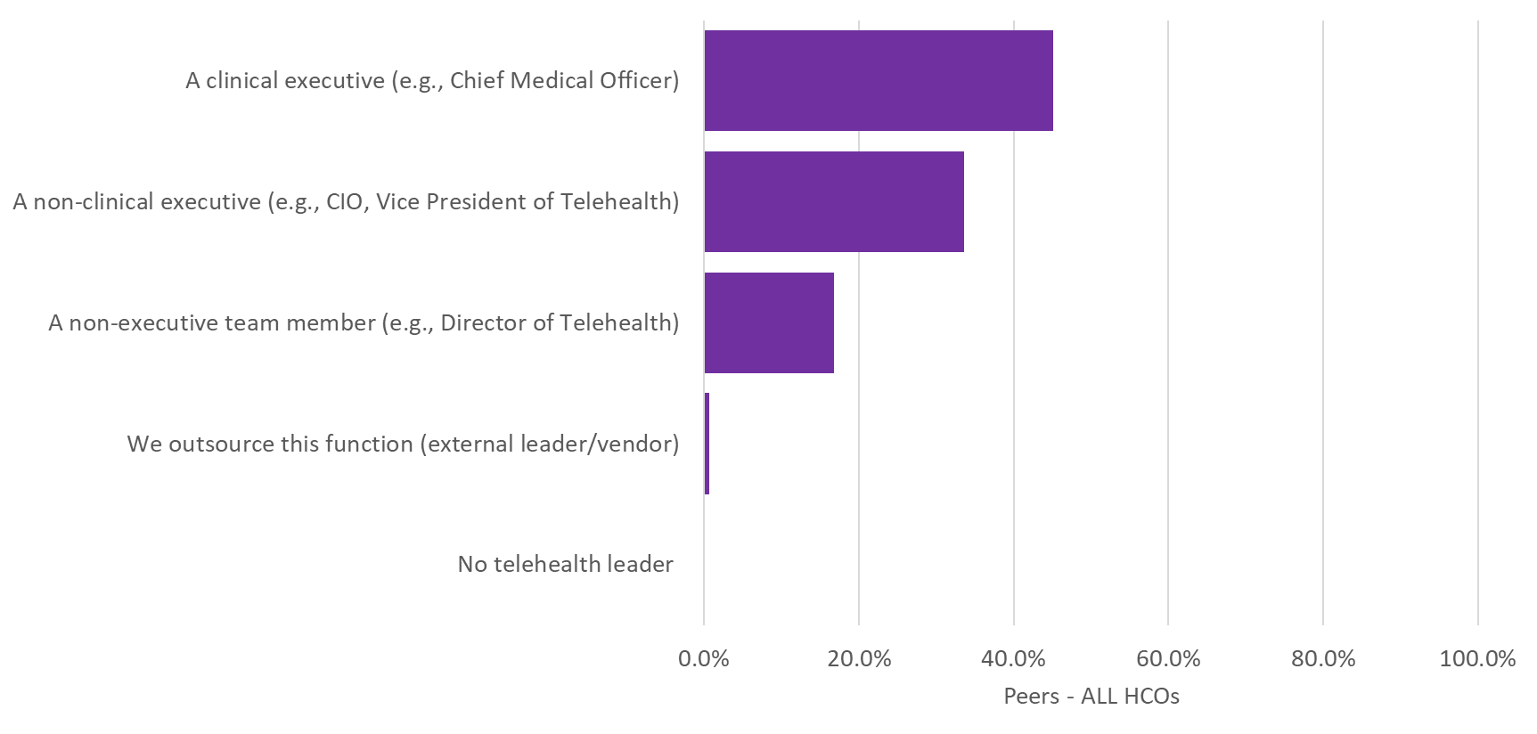
Q61. Whom on your executive team is primarily responsible for leading your organization’s telehealth efforts?

Slide 5
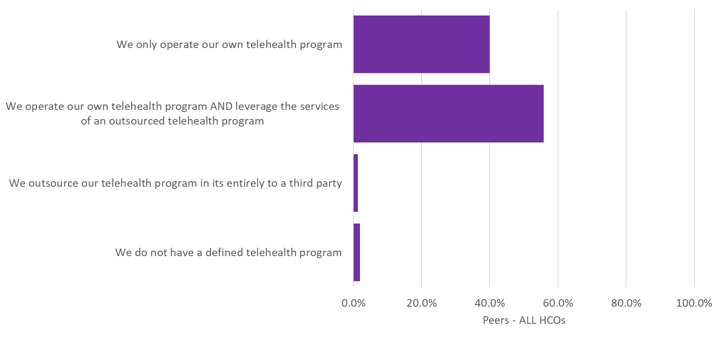
Q62. Which of the following reflect how telehealth services are provided at your organization?

Slide 6
Patient Engagement Tools

Slide 7
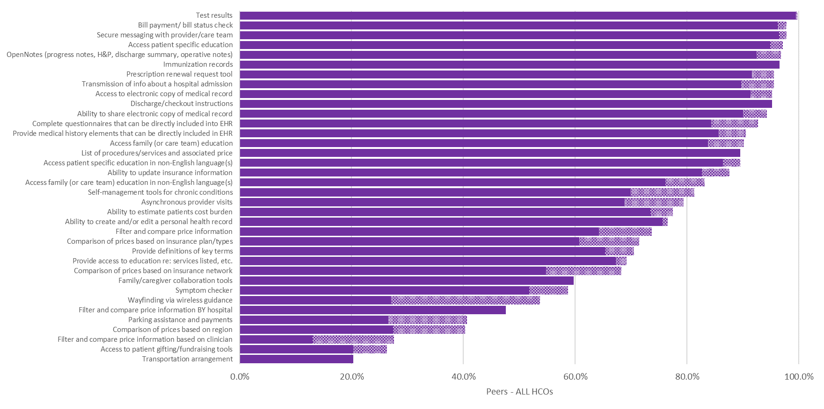
Q56. Which of the following capabilities are available to patients through your organization’s web site or patient portal?

Slide 8
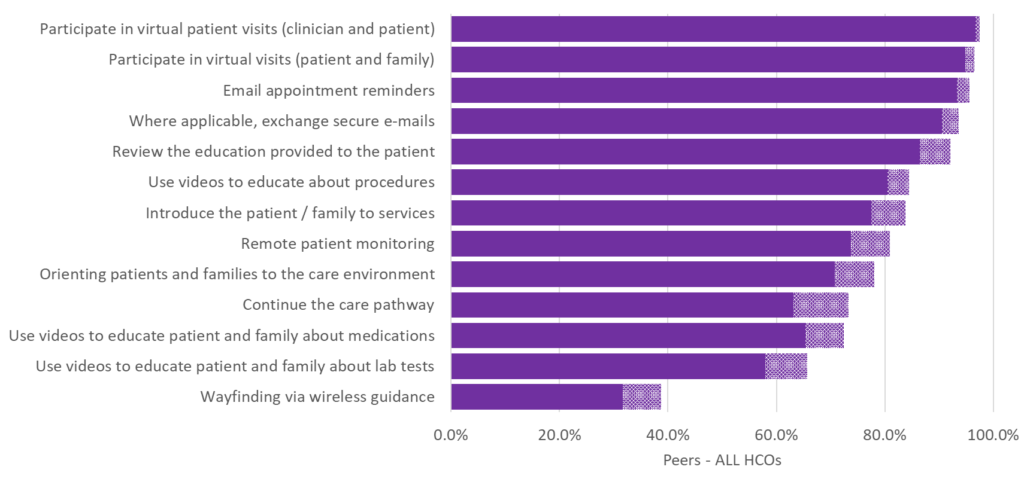
Q57. Which of the following services designed to empower patients and their families outside of your facility setting does your organization support via electronic tools? Please do not include pilots. All services/capabilities should be fully deployed HIT based products and services

Slide 9
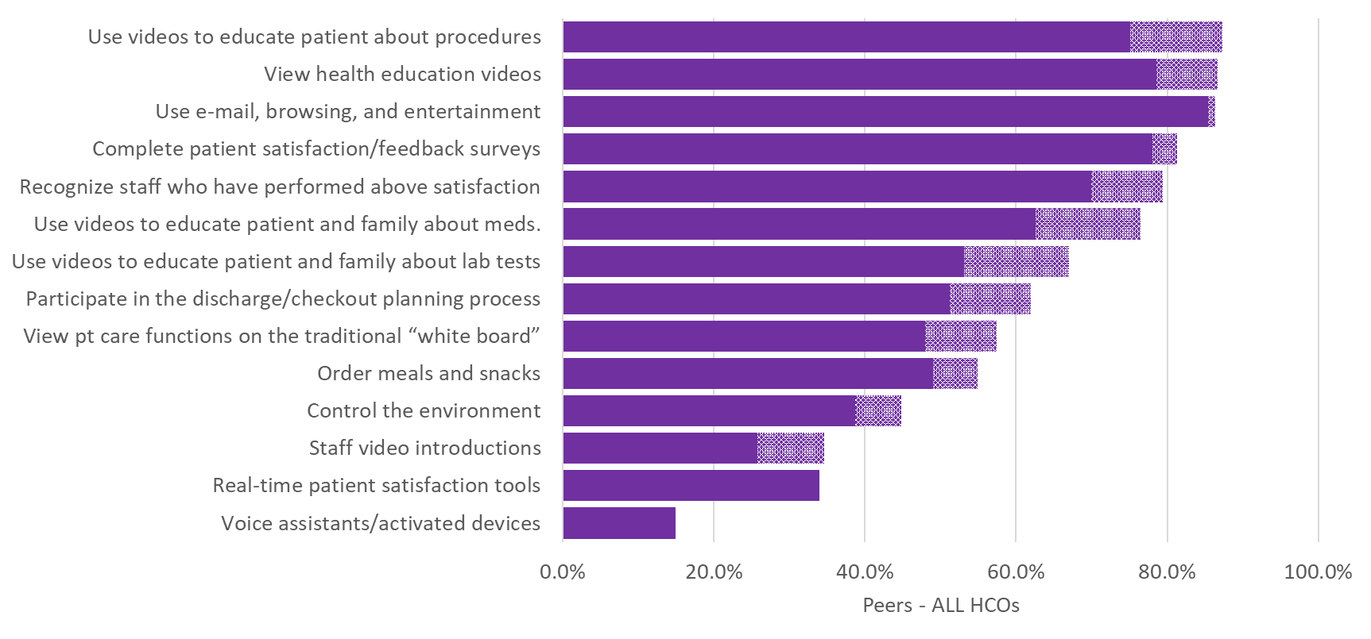
Q58. Which of the following services designed to empower patients and their families inside of your facility setting does your organization support via electronic tools? Please do not include pilots. All services/capabilities should be fully deployed HIT based products and services.

Slide 10
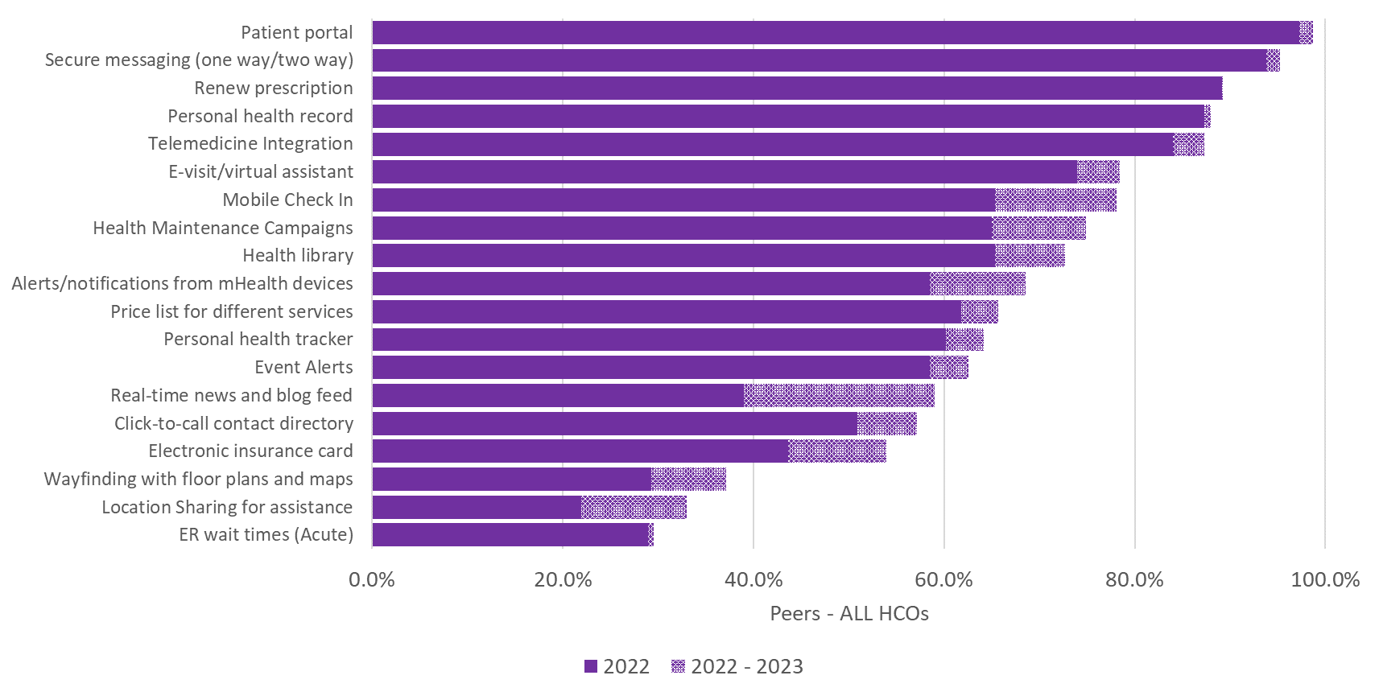
Q59. Which of the following functionalities are included in mobile apps your organization provides to your patients? These should be apps created for a mobile handheld device and should NOT include responsive designed websites

Slide 11
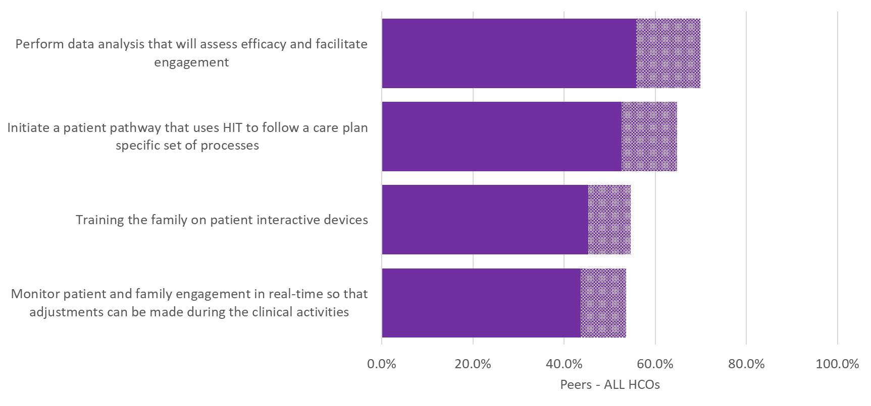
Q60. Which of the following patient interactive capabilities does your organization provide your staff members to help to promote patient and family engagement in your facility? Please do not include pilots. All services/capabilities should be fully deployed HIT based products and services.

Slide 12
Patient Engagement Utilization

Slide 13
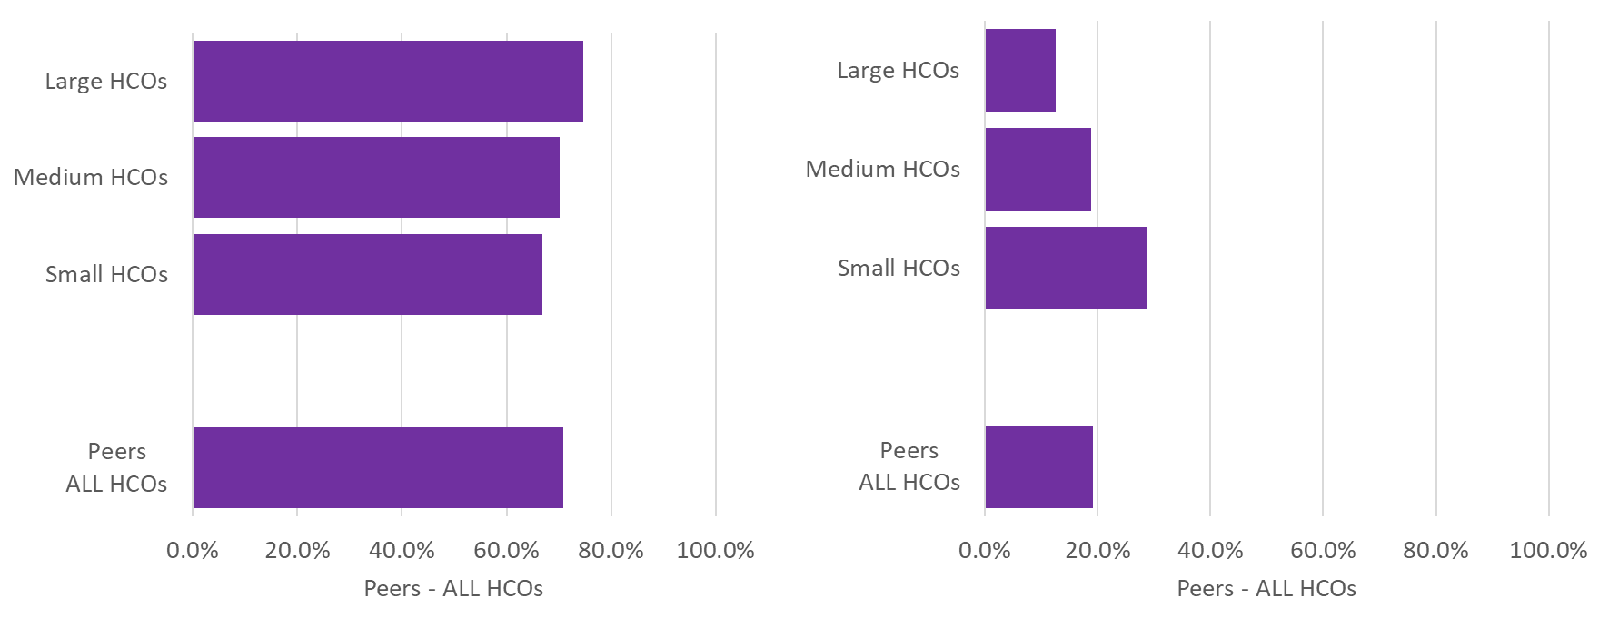
Q63. Please indicate the percentage of your organization’s…
Associated physicians/clinicians who have integrated telehealth services as part of their face-to-face practice
Total patient visits conducted via telehealth during the last 12 months

Slide 14
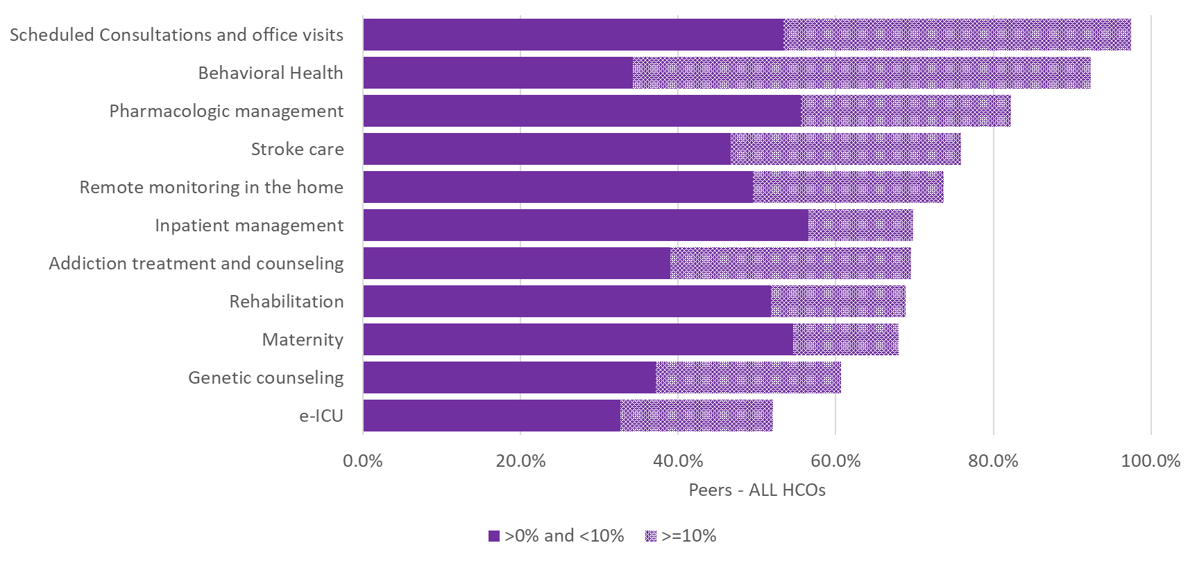
Q64. Of the following diagnostic and therapeutic medical exchanges between patients and providers in your organization, what percentage are conducted via telehealth?

Slide 15
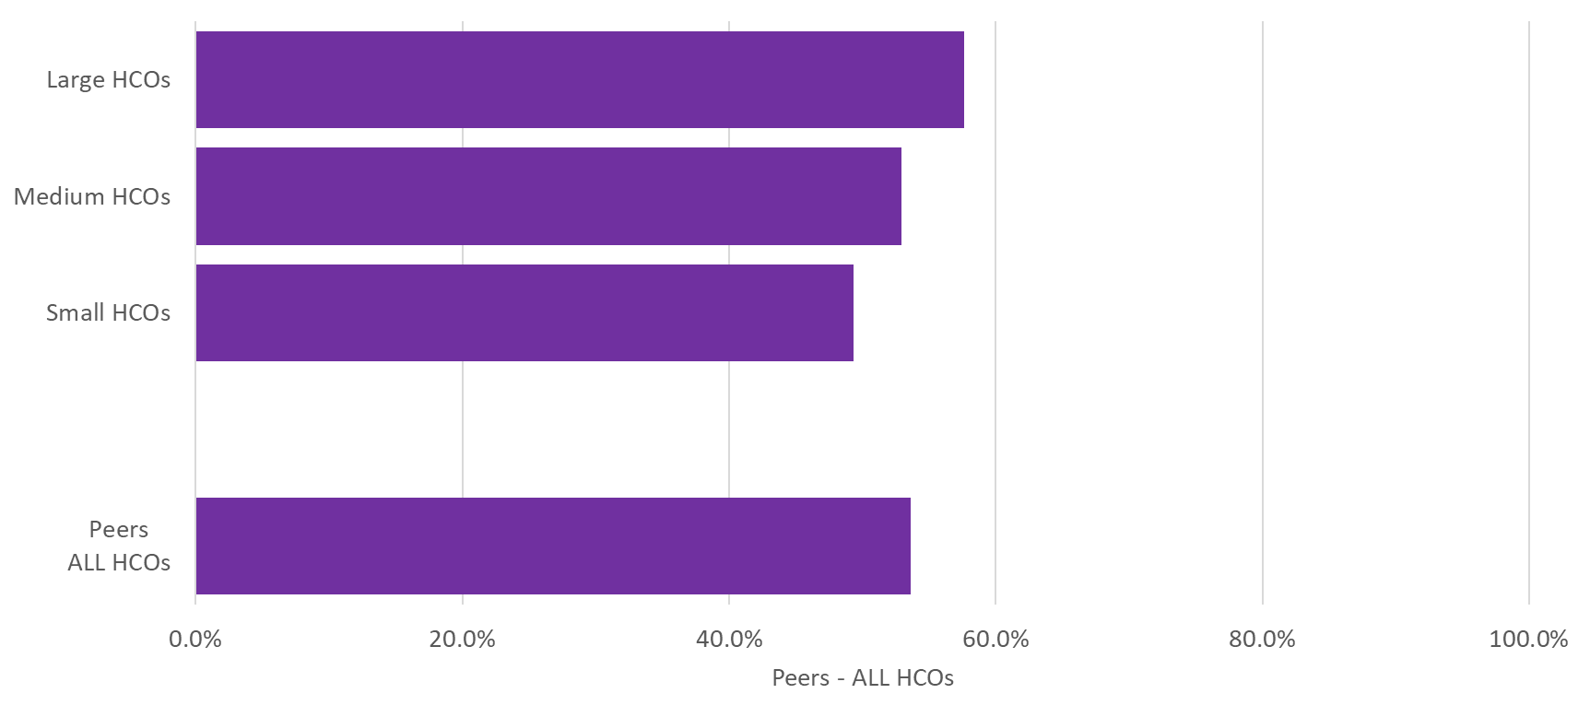
Q65. Please indicate the percentage of unique patients your organization serviced during the last 12 months who have accessed your organization’s patient portal at least once this last year?

Slide 16
Patient Engagement Promotion

Slide 17
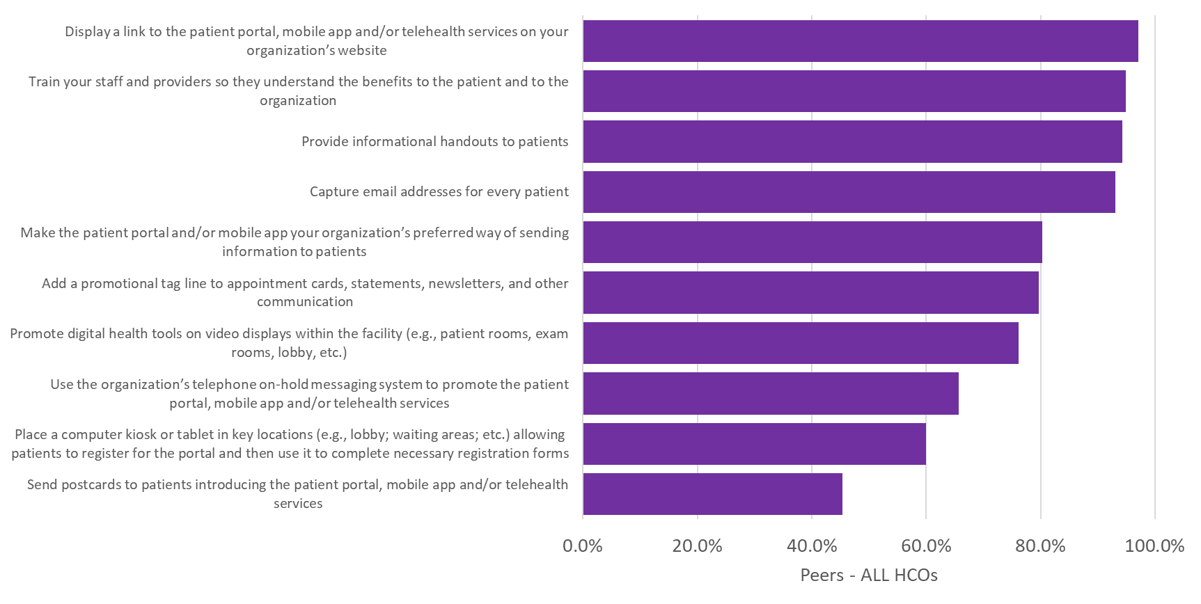
Q66 Which of the following tactics does your organization use to promote your organization’s digital health tools to patients (patient portal, mobile app and telehealth services)?

