Slide 1
Topics – Interoperability & Population Health
Interoperability
Population Health
Disease Registries
Chronic Care
Interventions

Slide 2
Interoperability

Slide 3
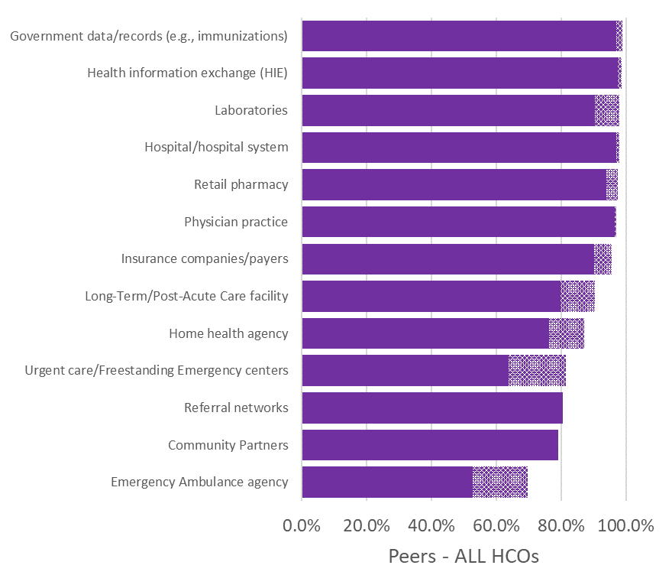
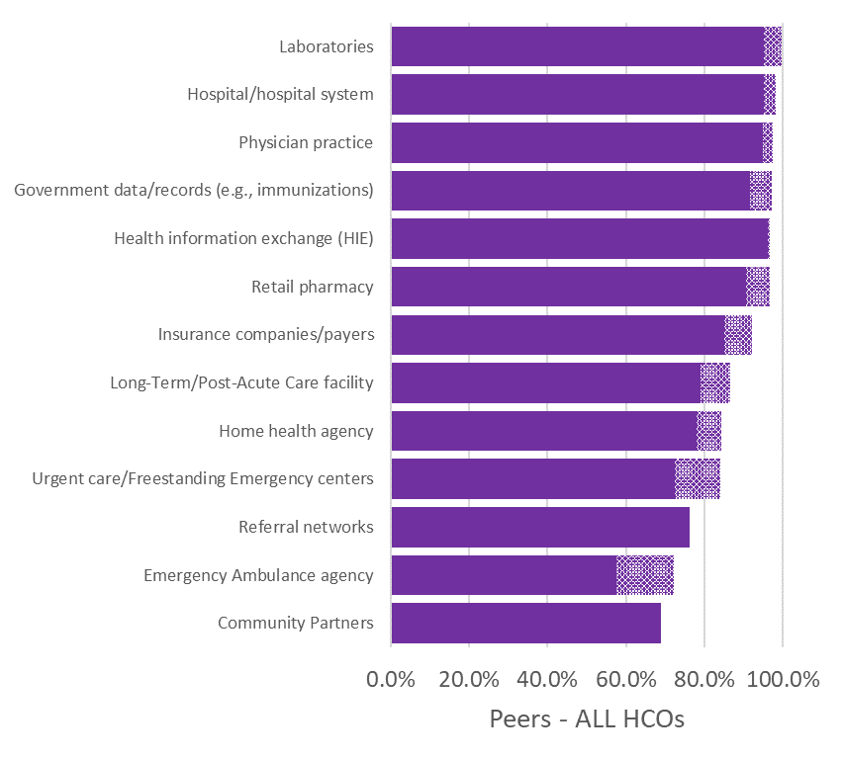
Which of the following types of healthcare entities external to your organization can your organization’s EHR successfully…
Q46. send discrete patient data electronically to
Q47. receive discrete electronic patient data from

Slide 4
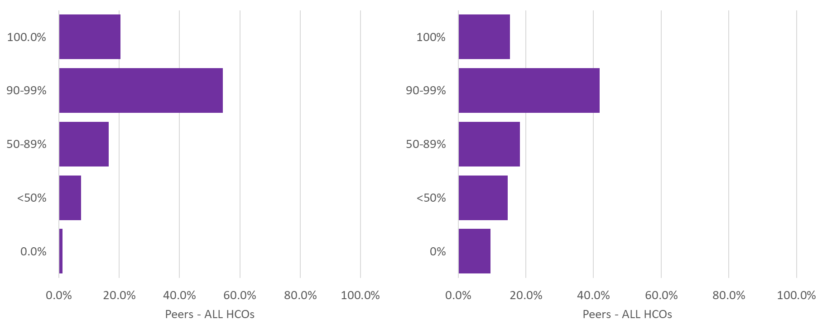
Q48. For transitions of care and referrals involving automated electronic processes, please indicate the percentage of cases in which your organization provides a summary care record…:
Directly from your EHR
From an HIE

Slide 5
Population Health Disease Registries

Slide 6
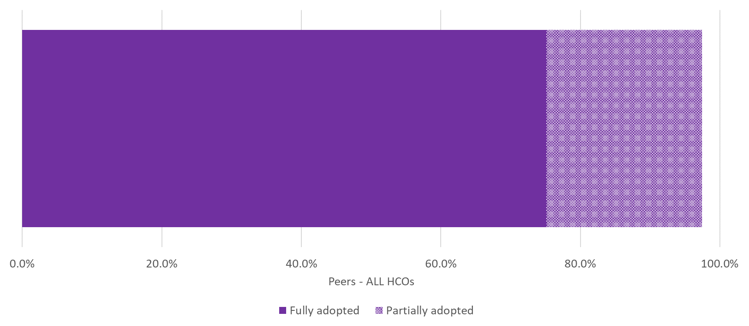
Q49. How would you characterize your organization’s adoption of an electronic disease registry(s) to identify and manage gaps in care across a population?

Slide 7
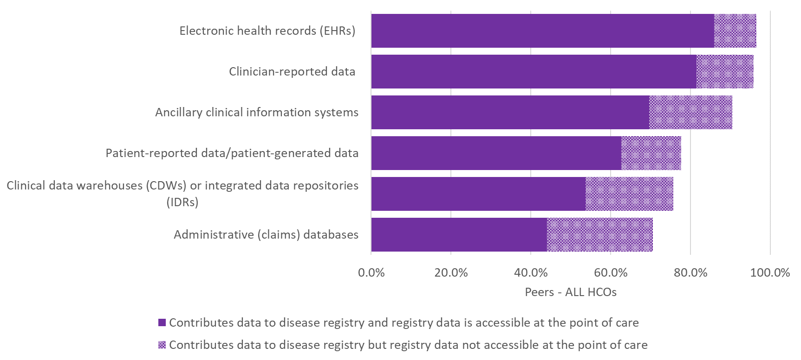
Q50. How would you describe your organization’s use of the following data sources in contributing data electronically to disease registries?

Slide 8
Population Health Chronic Care

Slide 9
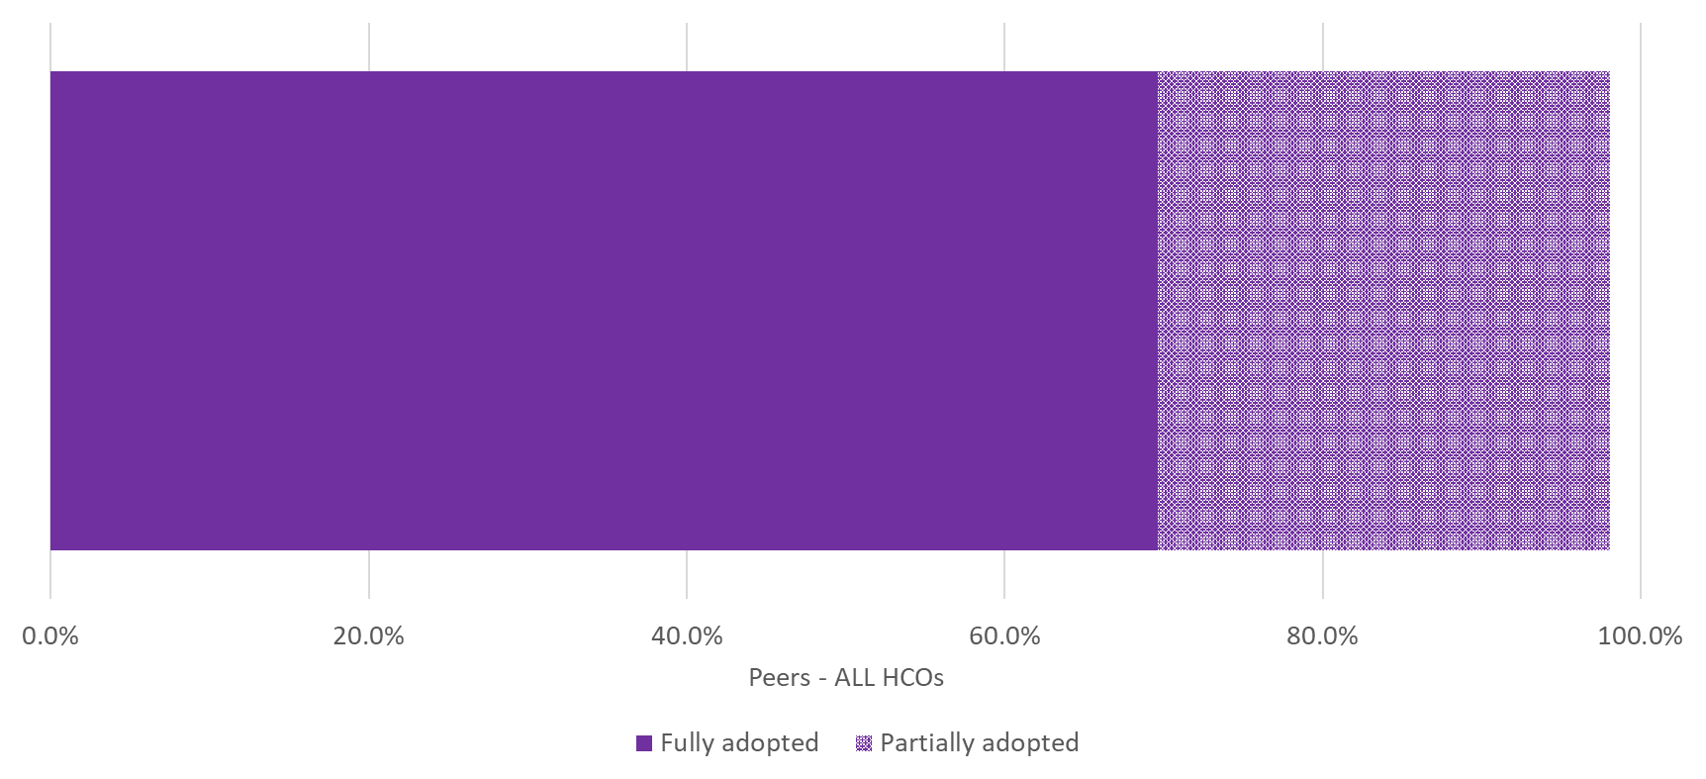
Q51. How would you characterize the adoption of technology in your organization to track the management of your chronic-care patients?

Slide 10
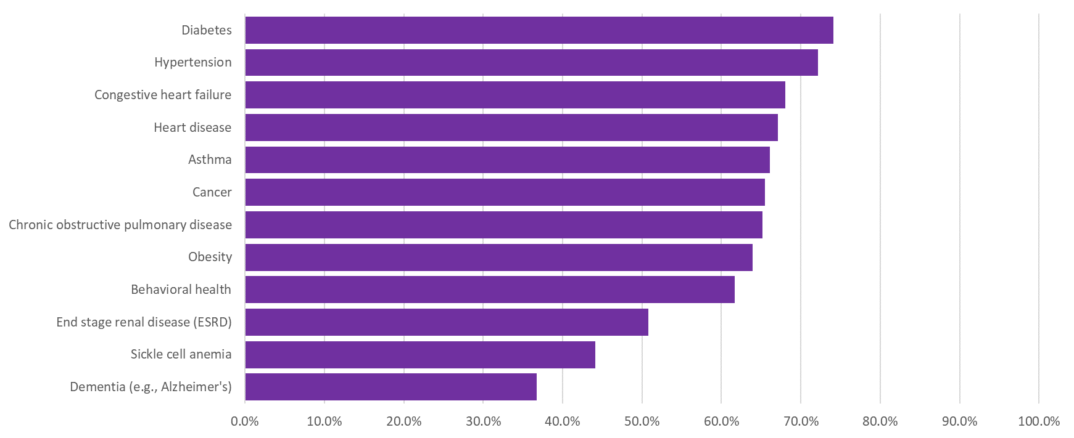
Q52. For each of the following conditions, which electronic-based chronic and/or care disease management services do you provide to patients “outside the walls” of your facility? Include only fully implemented programs (not pilots) for relevant patient population.
Care management data integrated with EHR

Slide 11
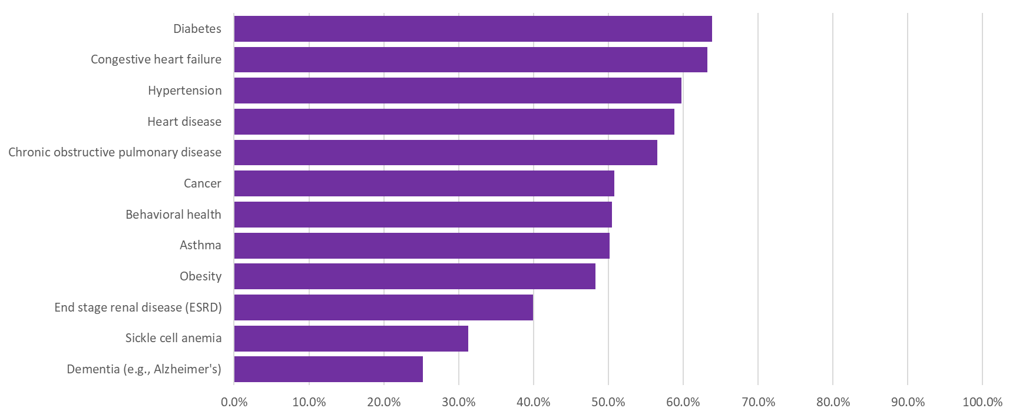
Q52. For each of the following conditions, which electronic-based chronic and/or care disease management services do you provide to patients “outside the walls” of your facility? Include only fully implemented programs (not pilots) for relevant patient population.
Real-time care management

Slide 12
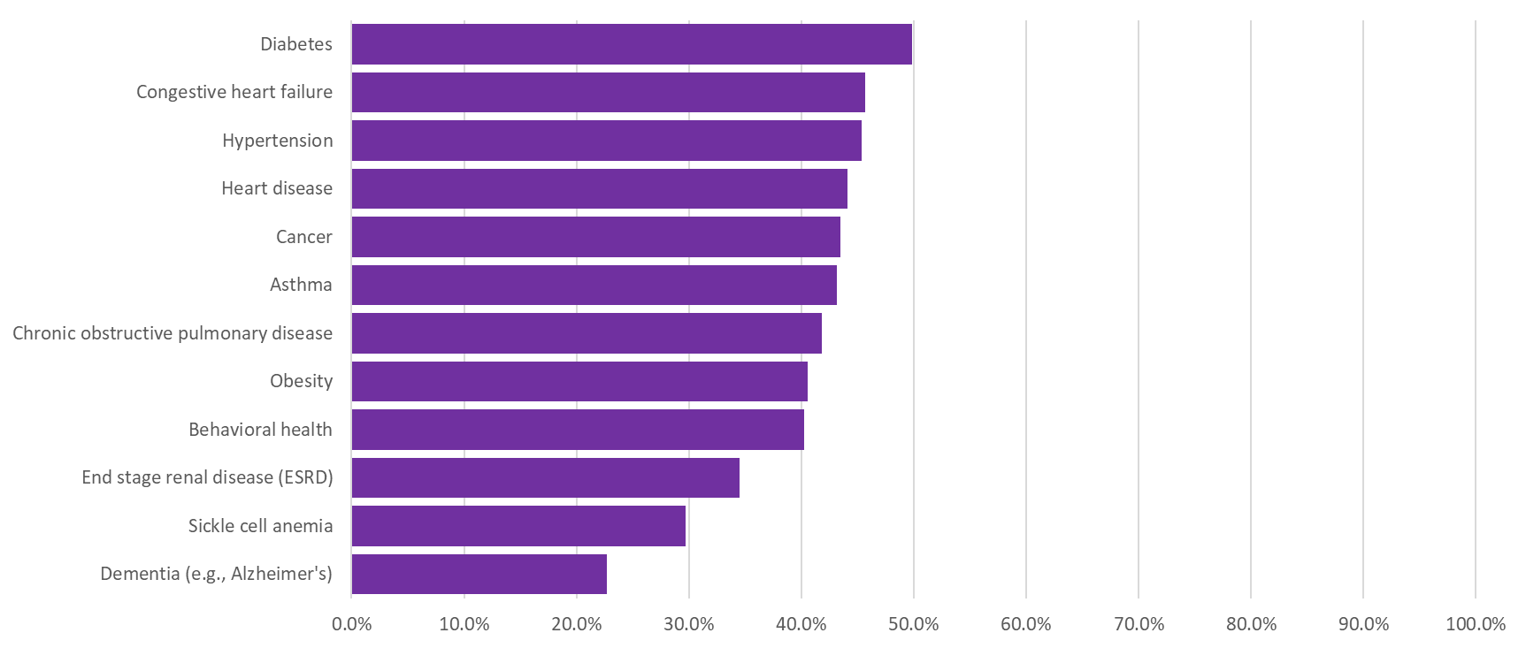
Q52. For each of the following conditions, which electronic-based chronic and/or care disease management services do you provide to patients “outside the walls” of your facility? Include only fully implemented programs (not pilots) for relevant patient population.
Medication management/ compliance using secure e-mail

Slide 13
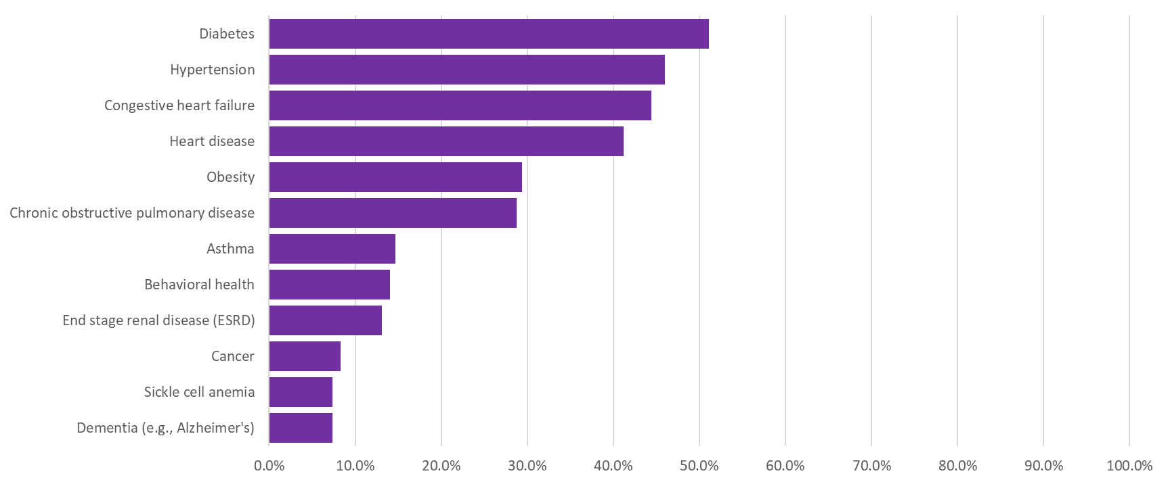
Q52. For each of the following conditions, which electronic-based chronic and/or care disease management services do you provide to patients “outside the walls” of your facility? Include only fully implemented programs (not pilots) for relevant patient population.
Self-test results submitted using internet-enabled monitoring device

Slide 14
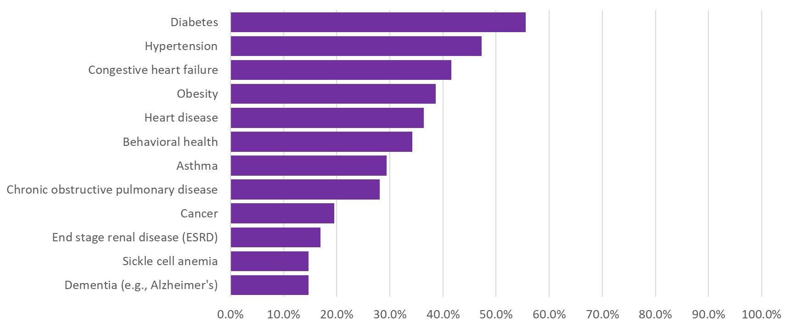
Q52. For each of the following conditions, which electronic-based chronic and/or care disease management services do you provide to patients “outside the walls” of your facility? Include only fully implemented programs (not pilots) for relevant patient population.
Self-test results entered manually online

Slide 15
Population Health Interventions

Slide 16
Q53. Which technologies does your organization use in addressing the following population health activities?
EMR
3rd Party Solution
Home Grown Solution
DATA AGGREGATION
DATA ANALYSIS
CARE MANAGEMENT
ADMIN & FIN REPORTING
PATIENT ENGAGEMENT
CLINICIAN ENGAGEMENT

Slide 17
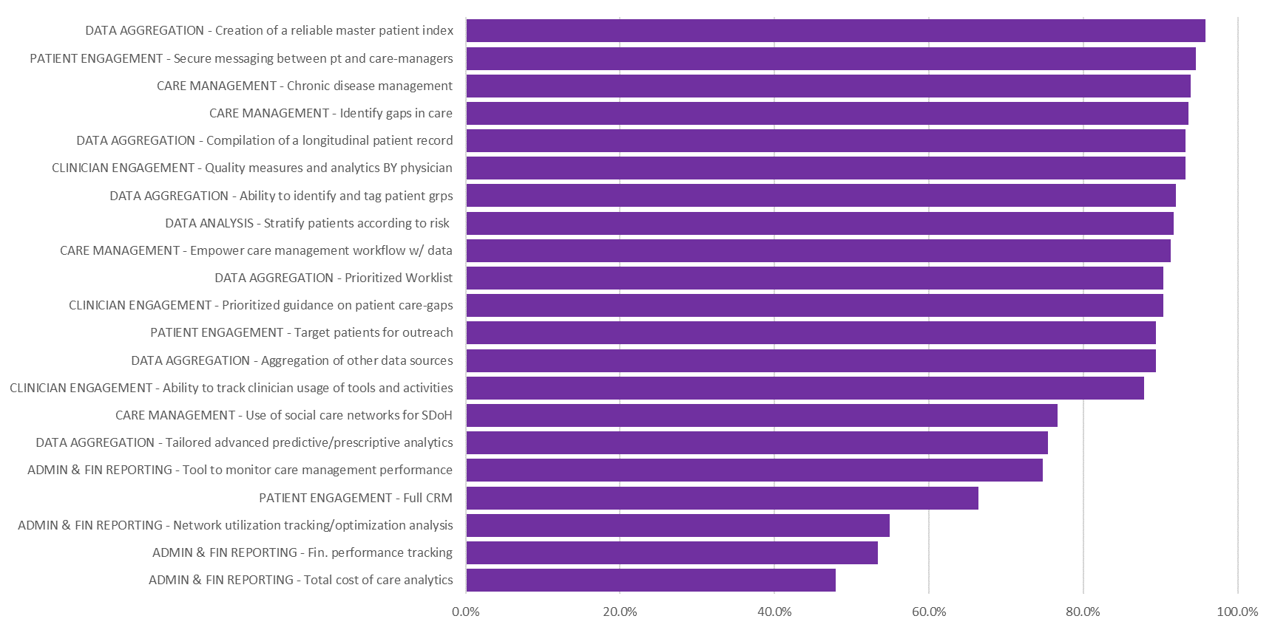
Q53. Which technologies does your organization use in addressing the following population health activities?
EMR

Slide 18
Q53. Which technologies does your organization use in addressing the following population health activities?
3rd Party Solution

Slide 19
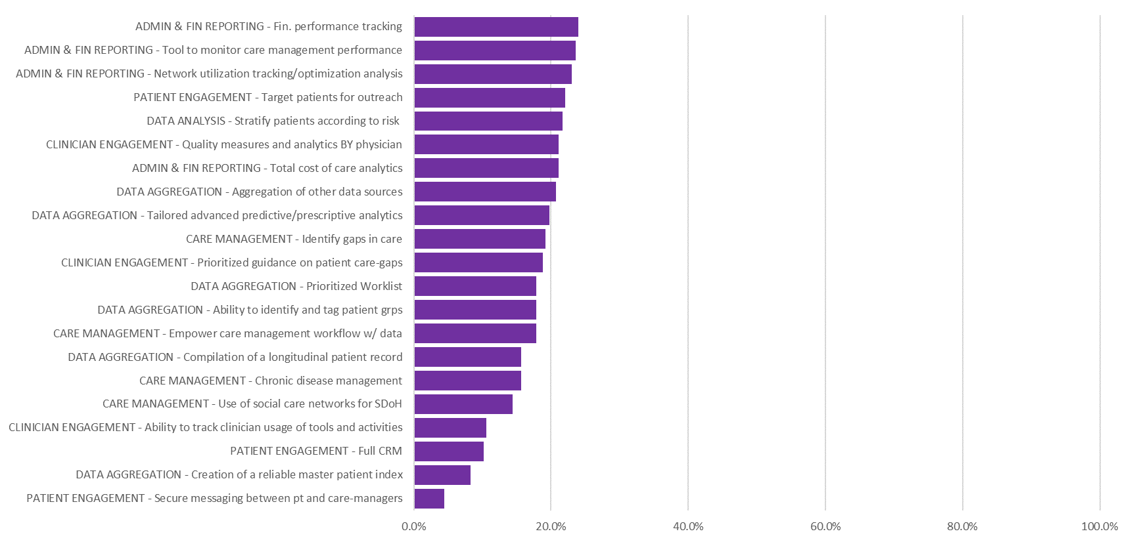
Q53. Which technologies does your organization use in addressing the following population health activities?
Home Grown Solution

Slide 20
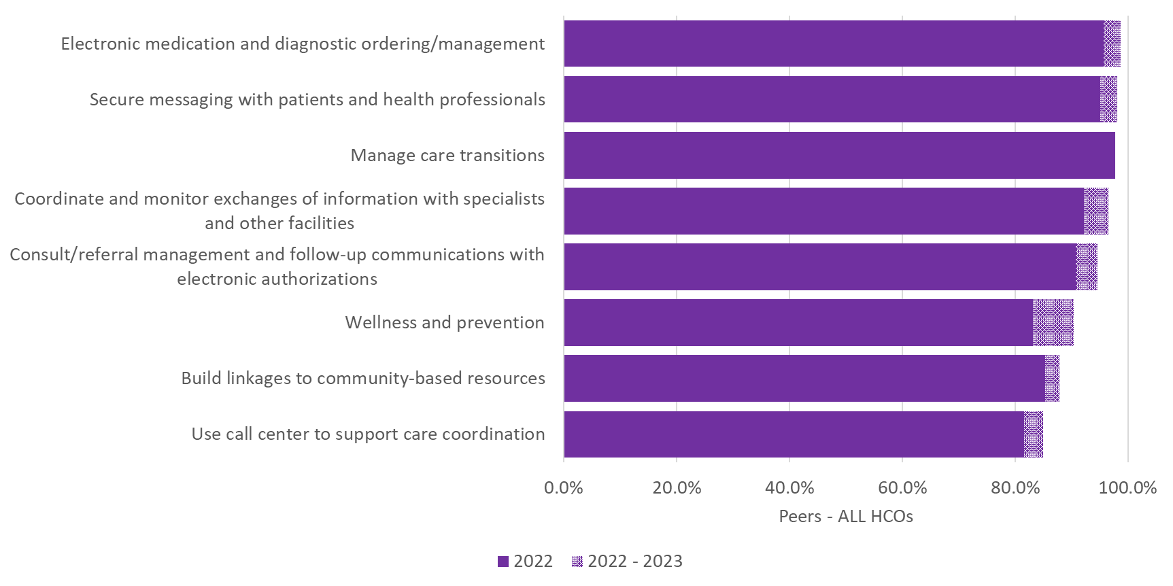
Q54. Which of the following care coordination activities involving your clinical partners are performed leveraging information technologies?

