Slide 1
Topics – Analytics & Data Management
Analytics Leadership / Structure
Data Management
Analytical Capabilities
Data Governance

Slide 2
Analytics Leadership & Structure

Slide 3
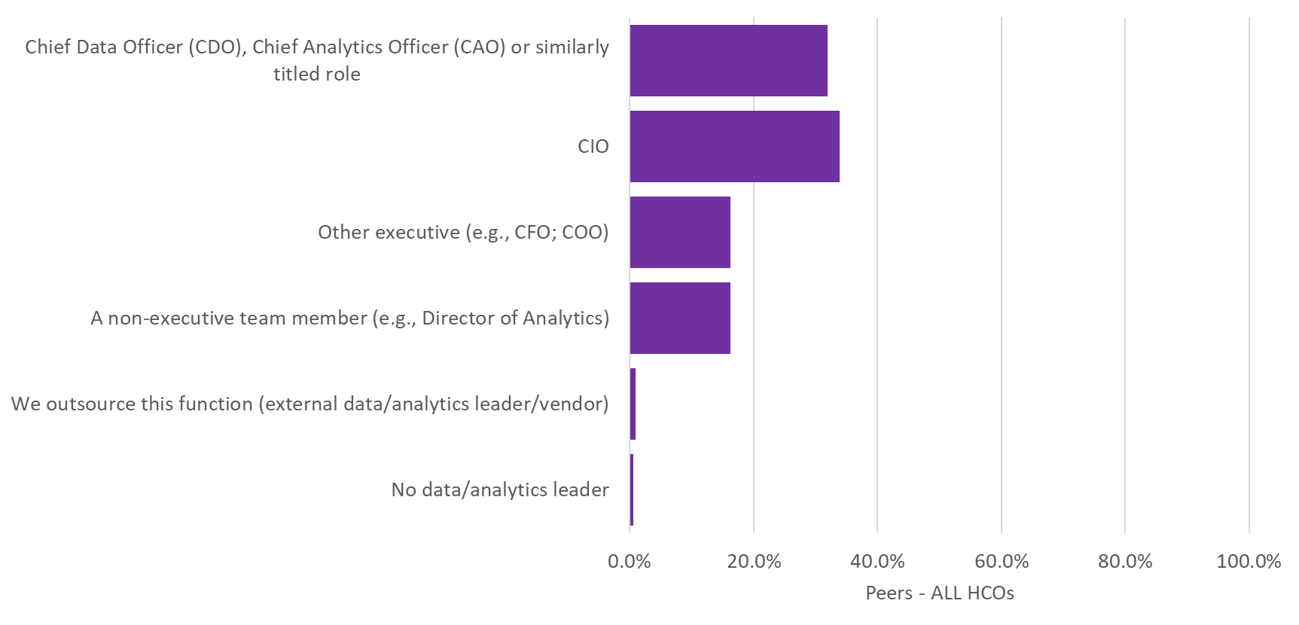
Q32. Whom on your executive team is primarily responsible for leading your organization’s analytics and data management efforts?

Slide 4
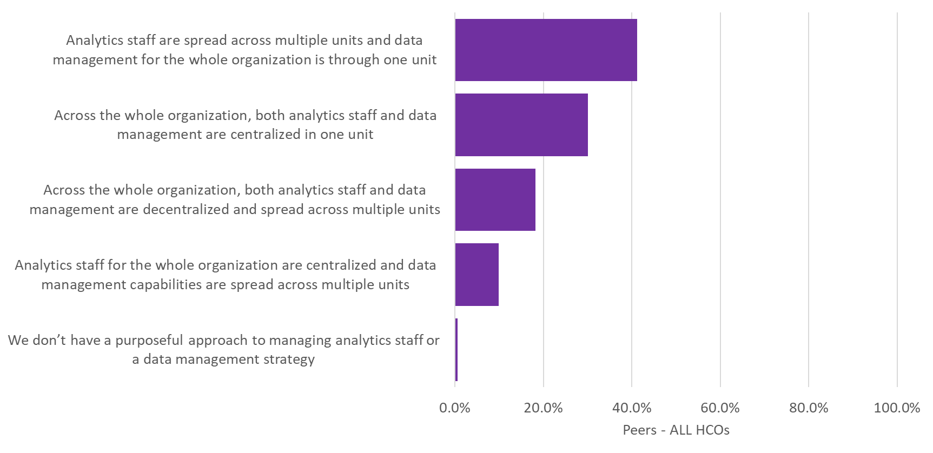
Q33. Which of the following best describe the management of data analytics and staffing in your organization?

Slide 5
Data Management

Slide 6
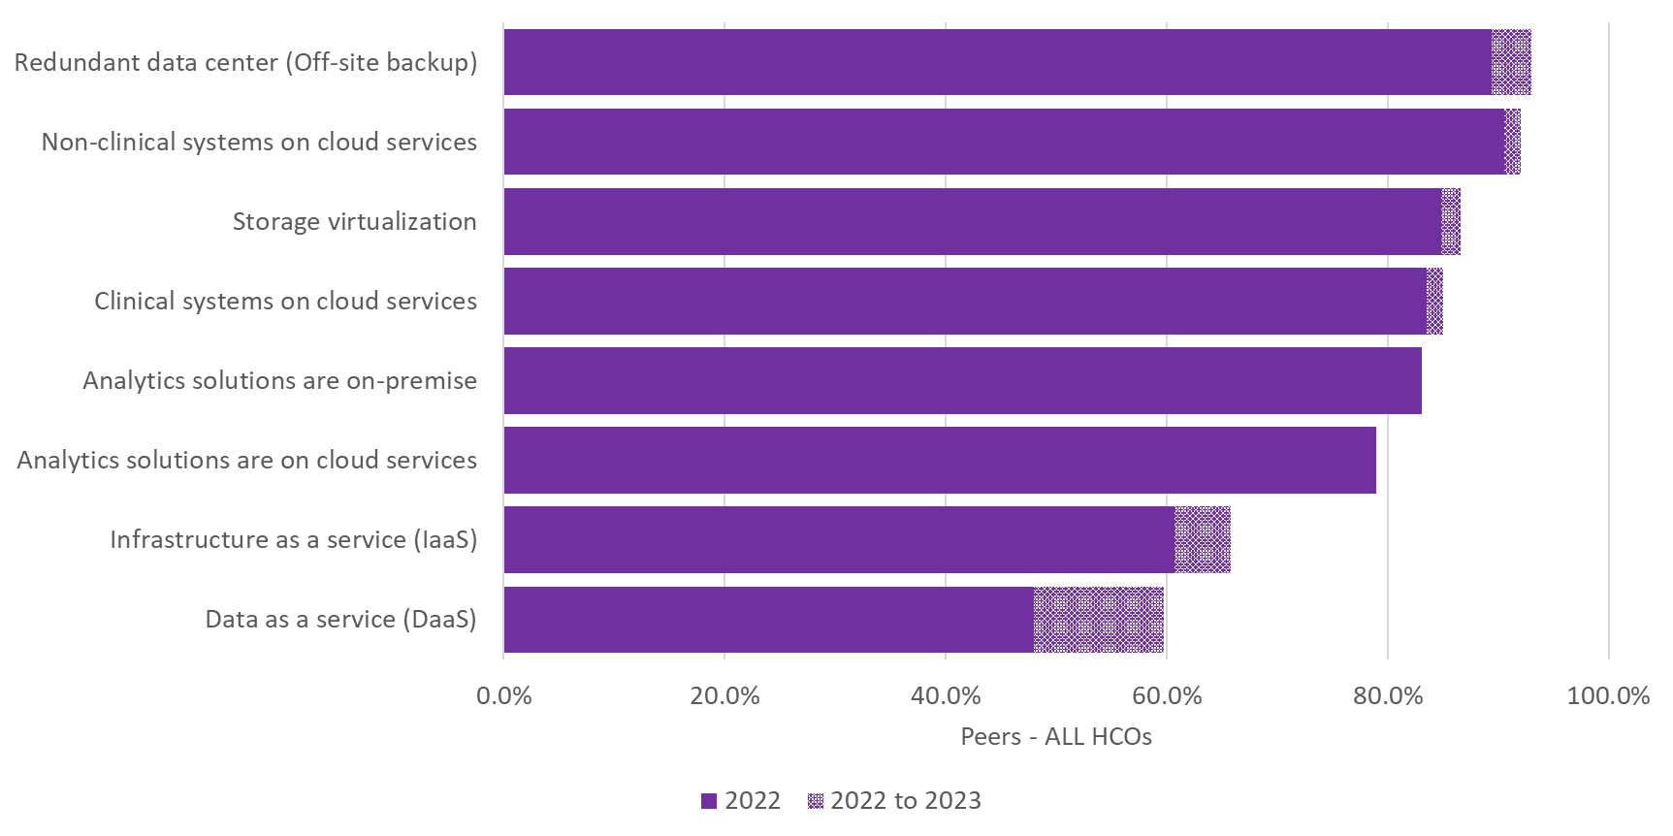
Q34. Which of the following data storage/analytics applications models does your organization use?

Slide 7
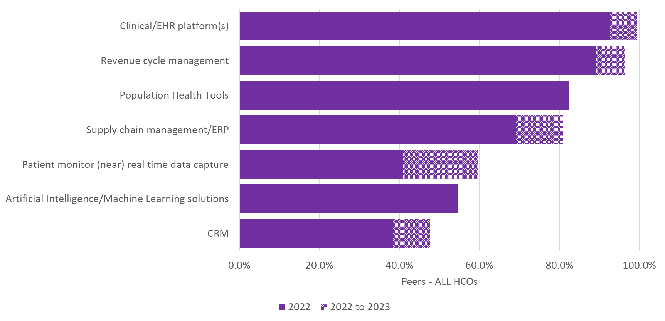
Q35. Which of the following data sources send data to your organization’s Enterprise Data Warehouse and/or Operational Data Store?

Slide 8
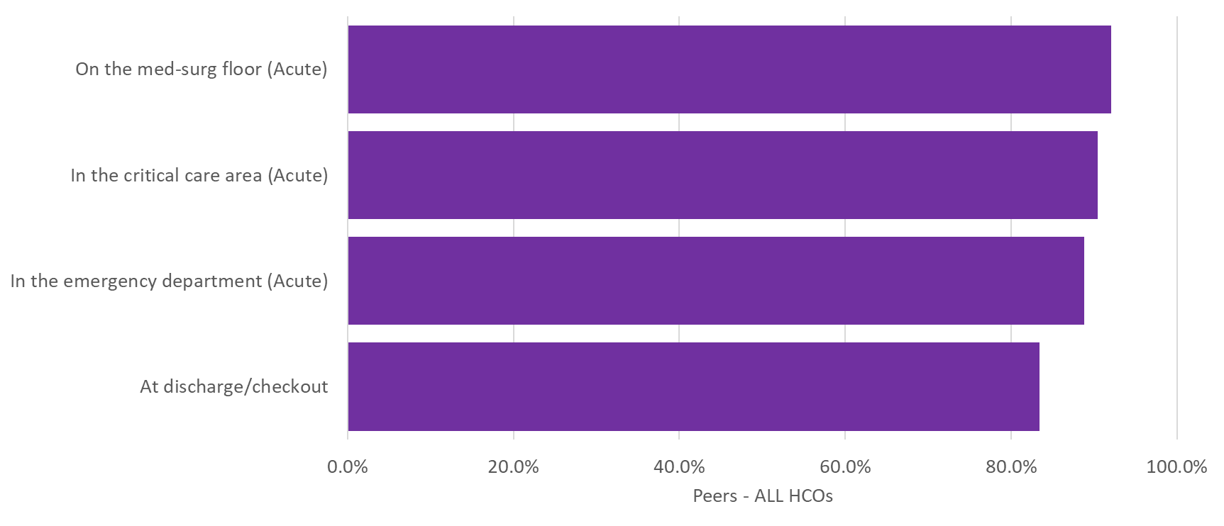
Q36. Which of the following areas in your organization leverage technology to automatically review patient data in your EHR and alert caregivers when their patients are out of compliance with key quality indicators?

Slide 9
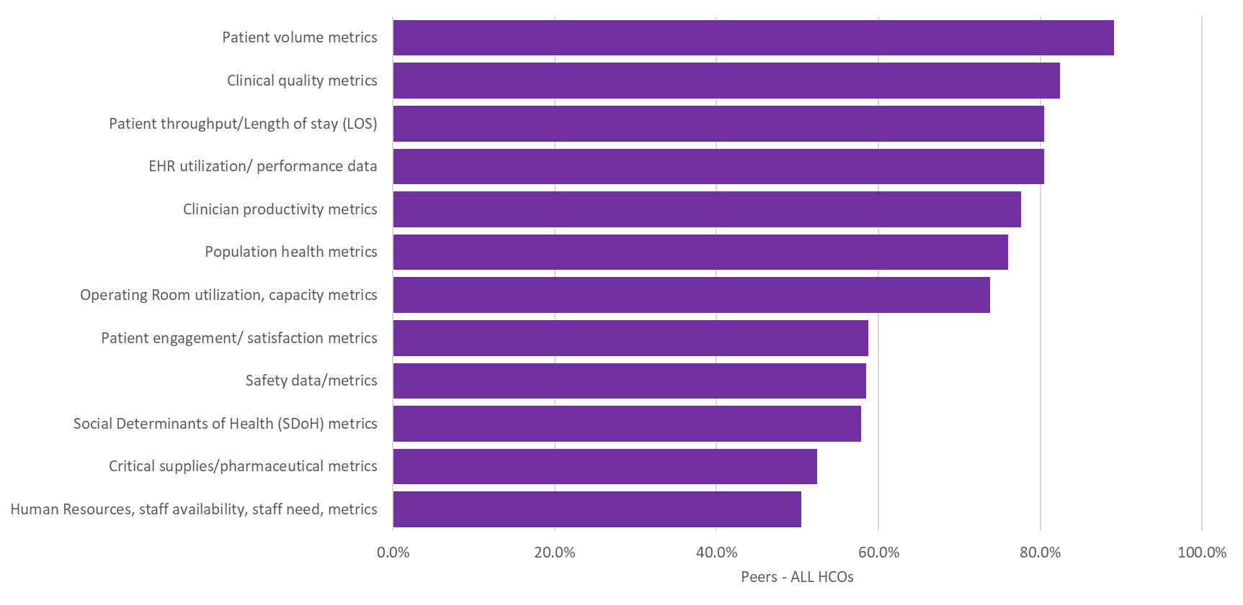
Q37 How does your organization deliver the following data to your organization’s clinical and operational personnel (leaders and individual clinicians)?
Automated real-time Dashboards

Slide 10
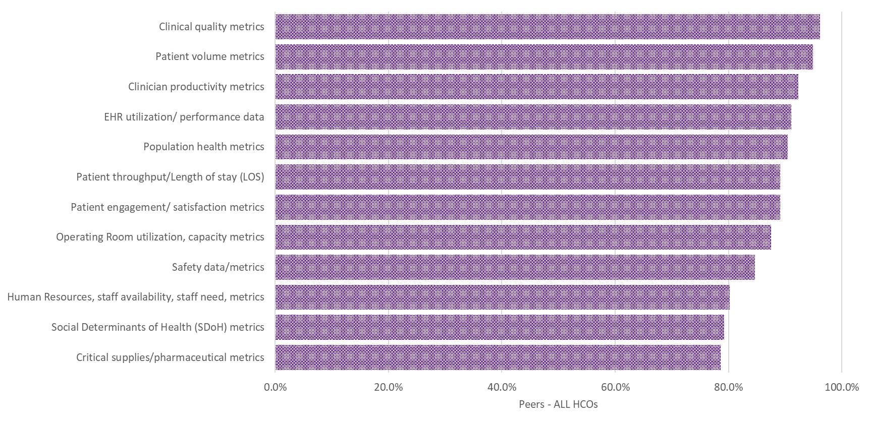
Q37 How does your organization deliver the following data to your organization’s clinical and operational personnel (leaders and individual clinicians)?
On-demand self-service dashboards and reporting

Slide 11
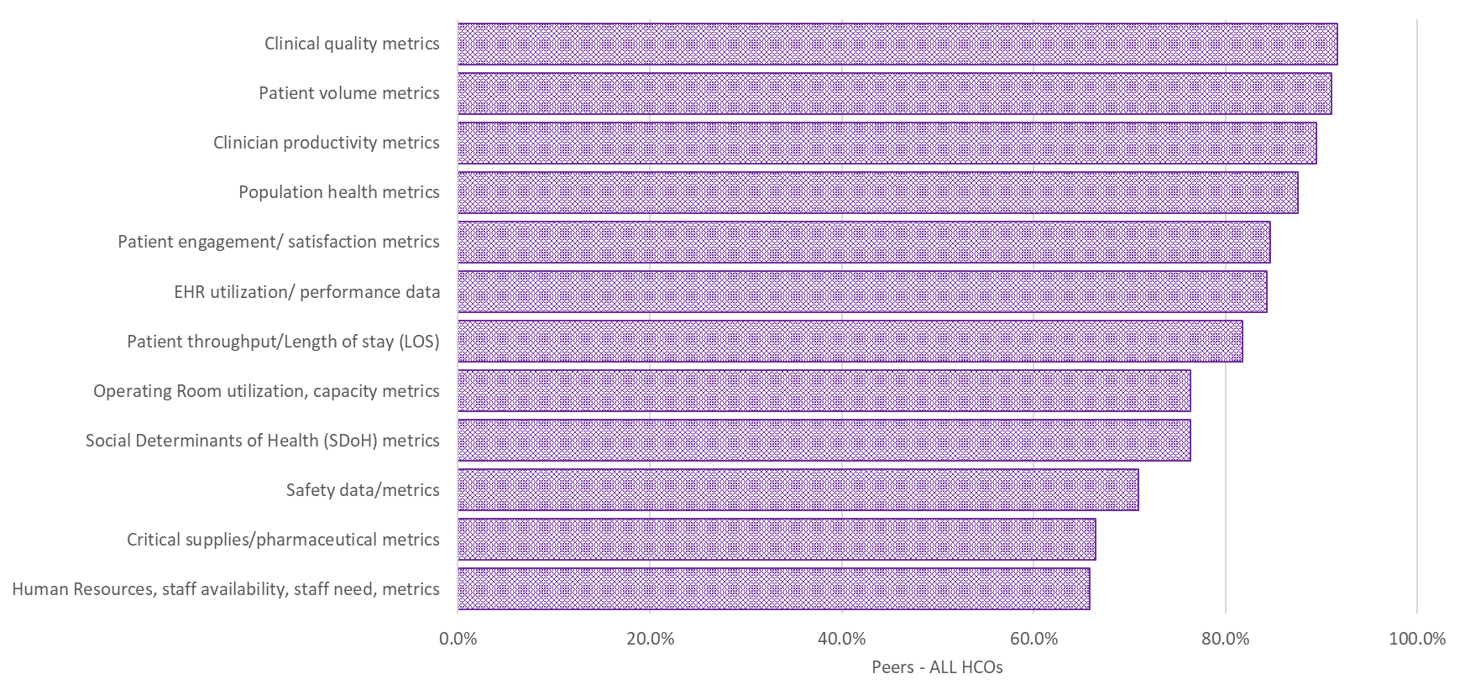
Q37 How does your organization deliver the following data to your organization’s clinical and operational personnel (leaders and individual clinicians)?
Personal Data Visualization Tools

Slide 12
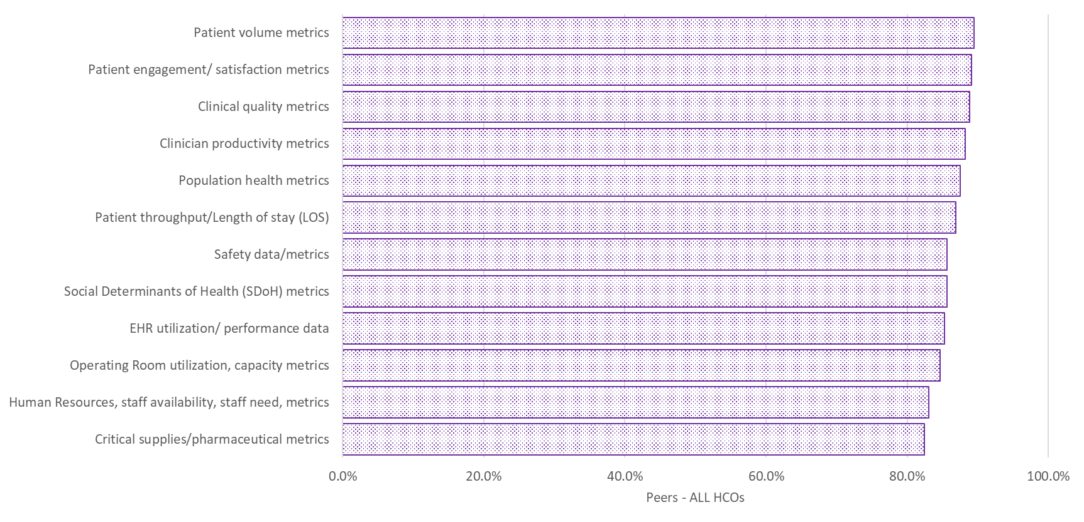
Q37 How does your organization deliver the following data to your organization’s clinical and operational personnel (leaders and individual clinicians)?
After the Fact Reporting

Slide 13
Analytical Capabilities

Slide 14
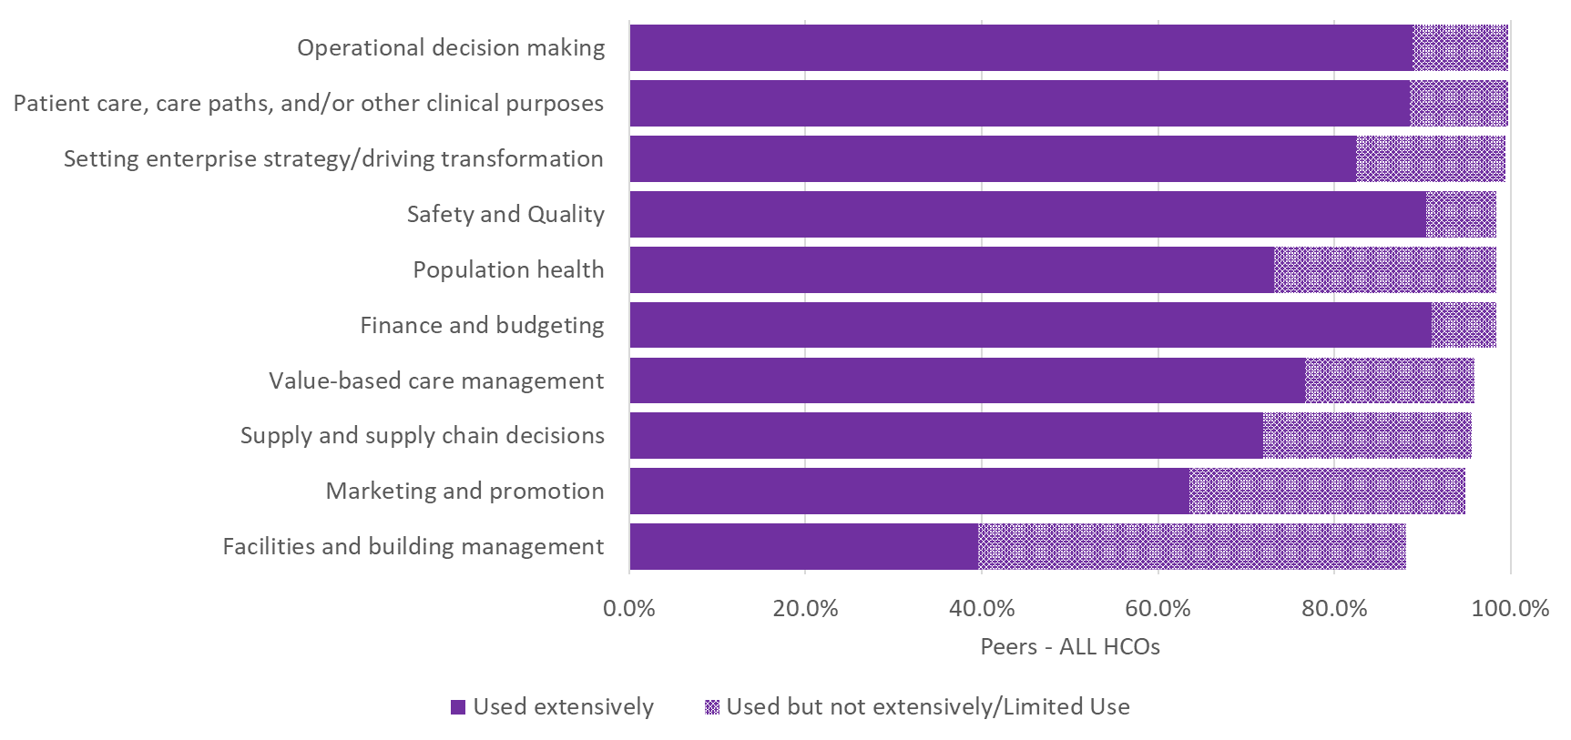
Q38 How would you characterize the utilization of data analytics to support the following business functions in your organization?

Slide 15
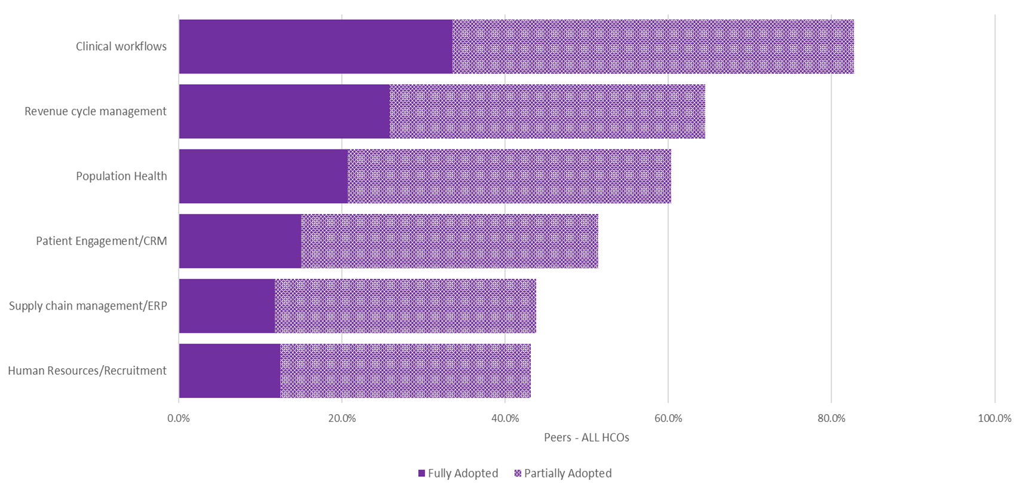
Q39. How would you characterize the adoption of Machine Learning in each of the following business functions in your organization?

Slide 16
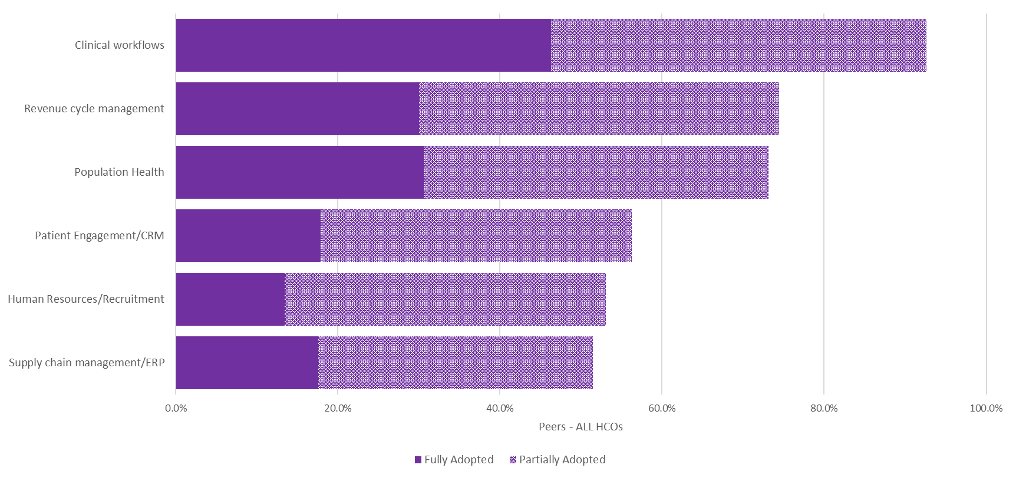
Q40. How would you characterize the adoption of Predictive Analytics in each of the following business functions in your organization?

Slide 17
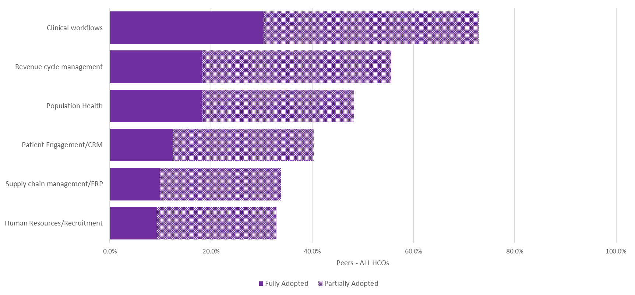
Q41. How would you characterize the adoption of Artificial Intelligence in each of the following business functions in your organization?

Slide 18
Data Governance

Slide 19
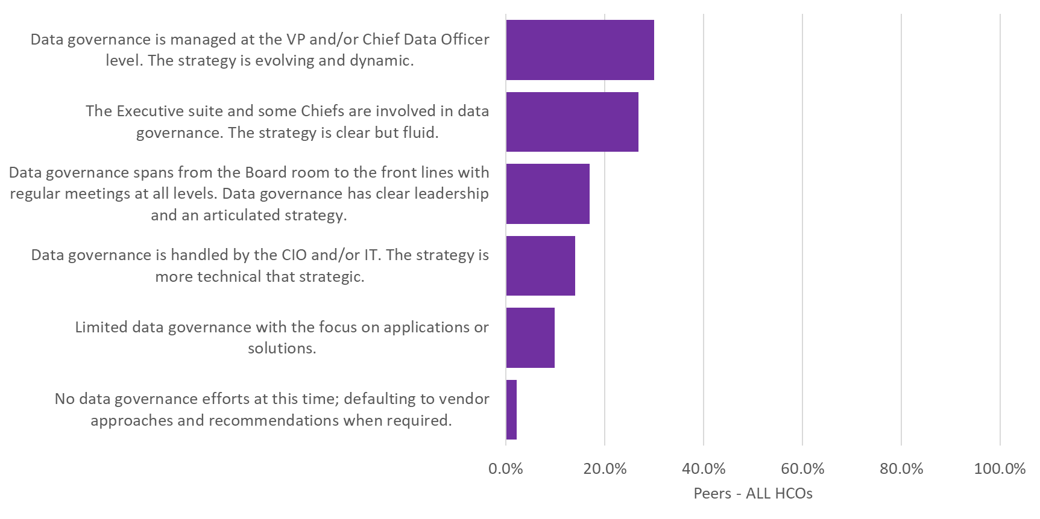
Q42. Which of the following best describe the scope of your organization’s data governance program?

Slide 20
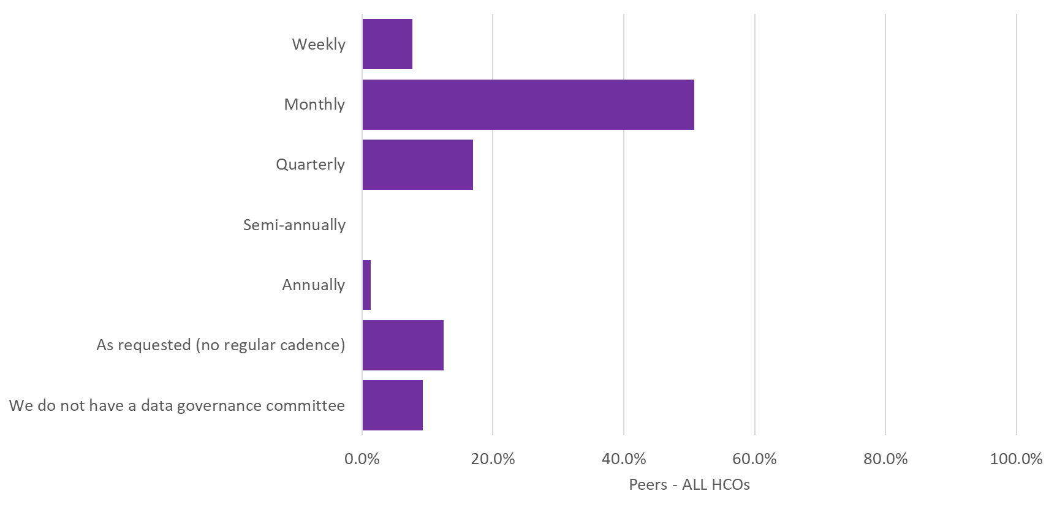
Q43. How often does your organization's Data Governance committee meet?

Slide 21
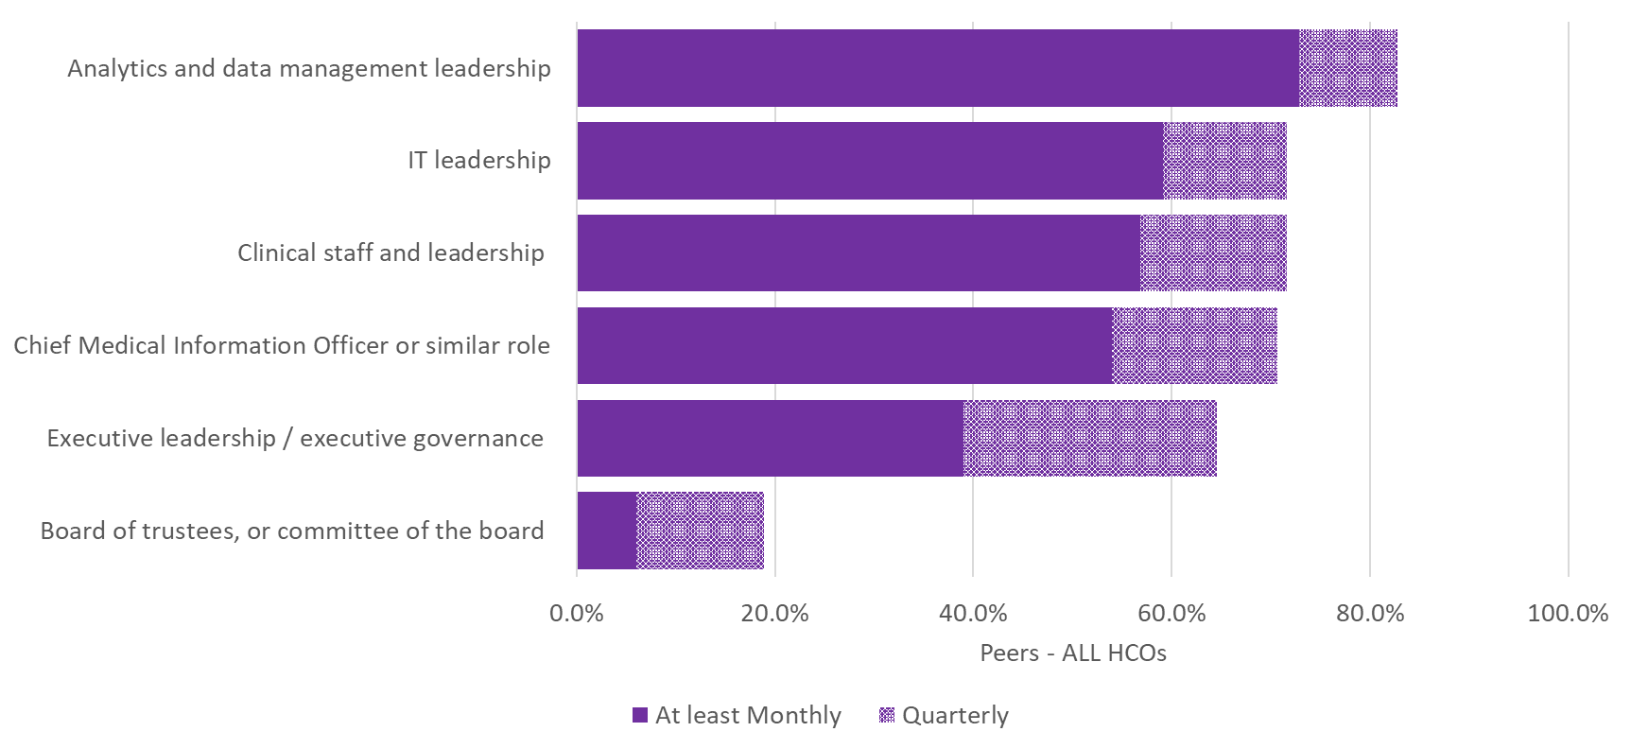
Q44. How often do the following groups engage in your organization’s data governance efforts?

Slide 22
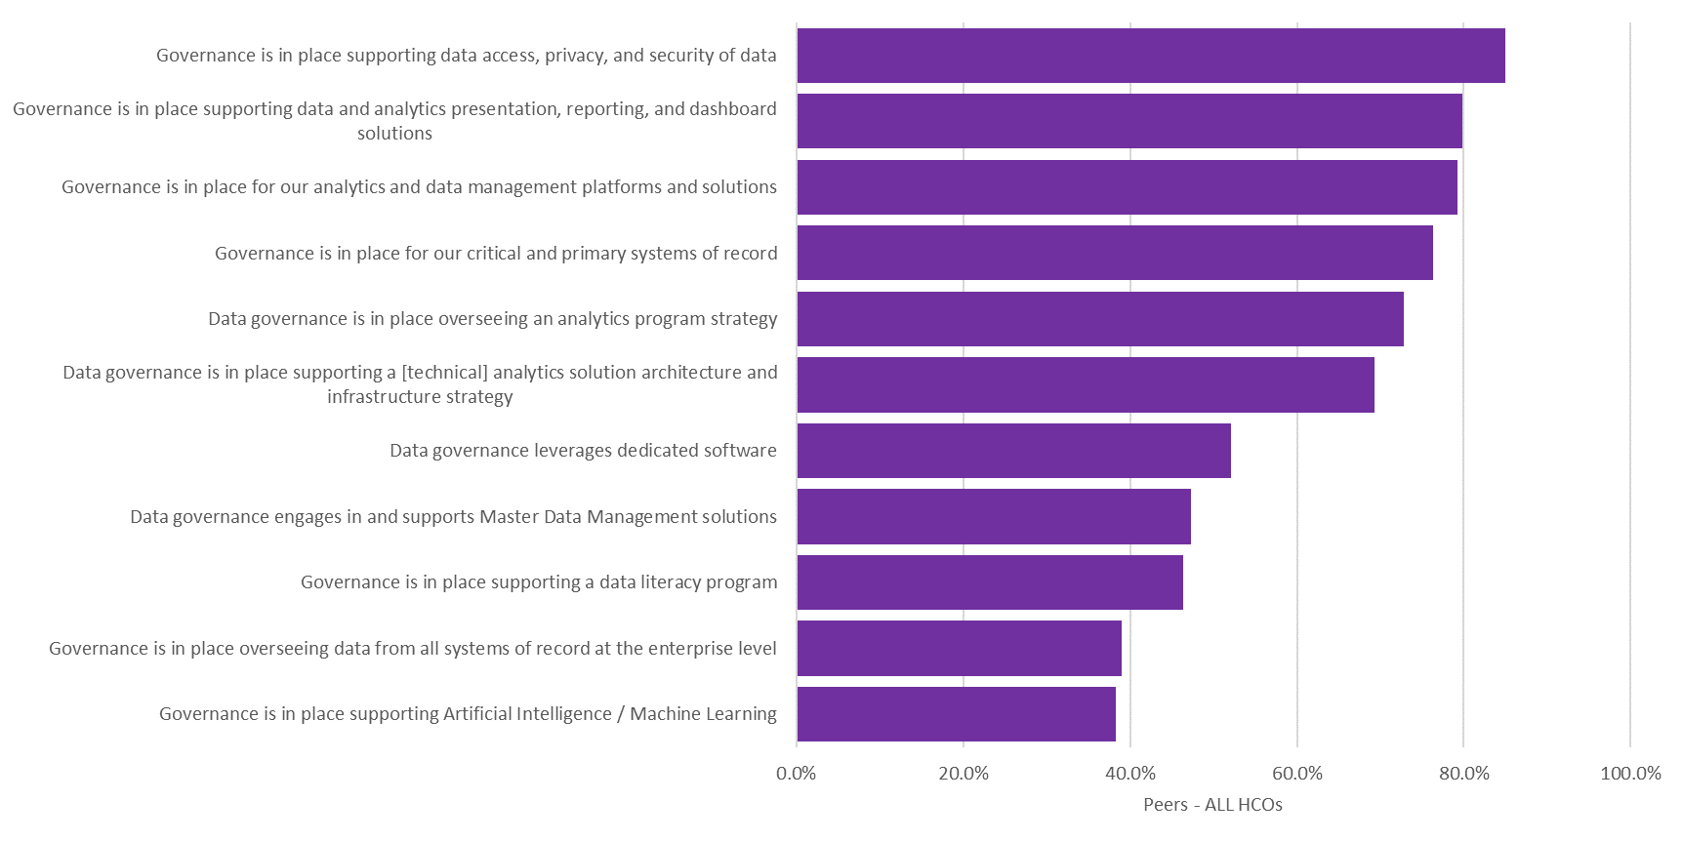
Q45. Which of the following are reflective of your organization’s data governance effort?

