Slide 1
Topics – Administrative & Supply Chain
Inventory Management
Financial Management
Personnel Management

Slide 2
Inventory Management

Slide 3
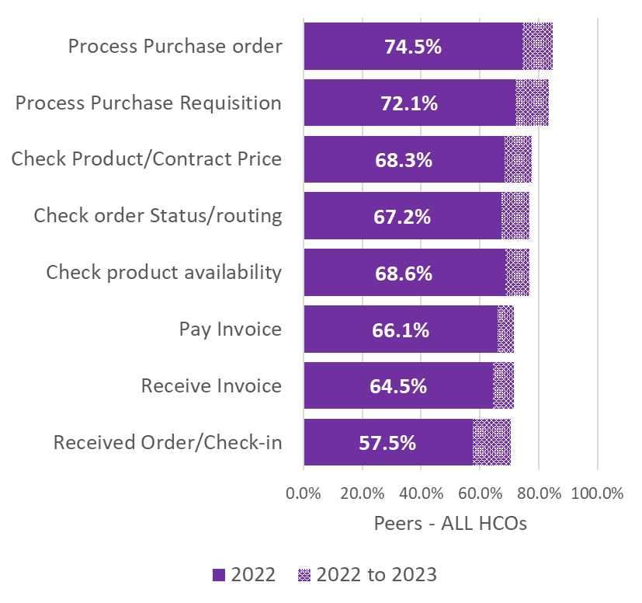
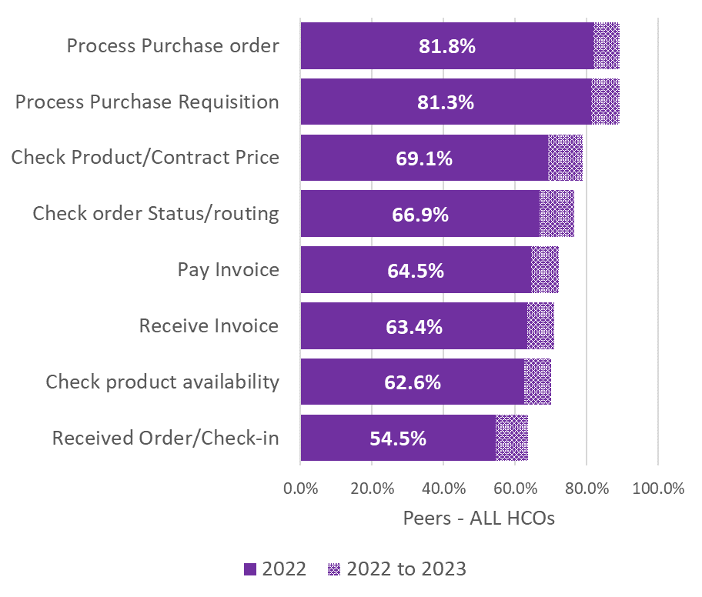
Select the method best describing how your organization completes the majority of the following…
Q23. pharmacy supply activities
Q25. medical/surgical supply activities

Slide 4
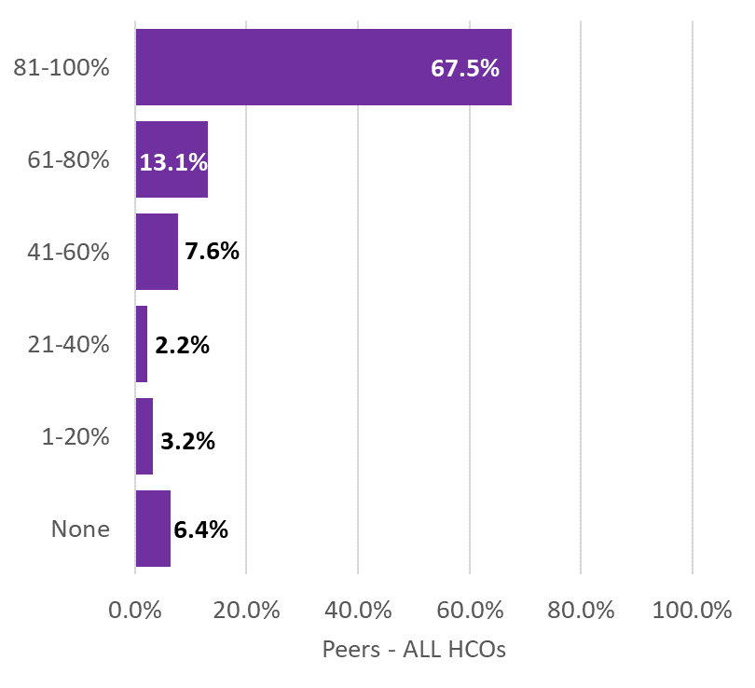
What percentage of your supply orders are electronically generated once they reach a predetermined par level?
Q24. pharmaceutical supplies
Q26. medical/surgical supplies

Slide 5
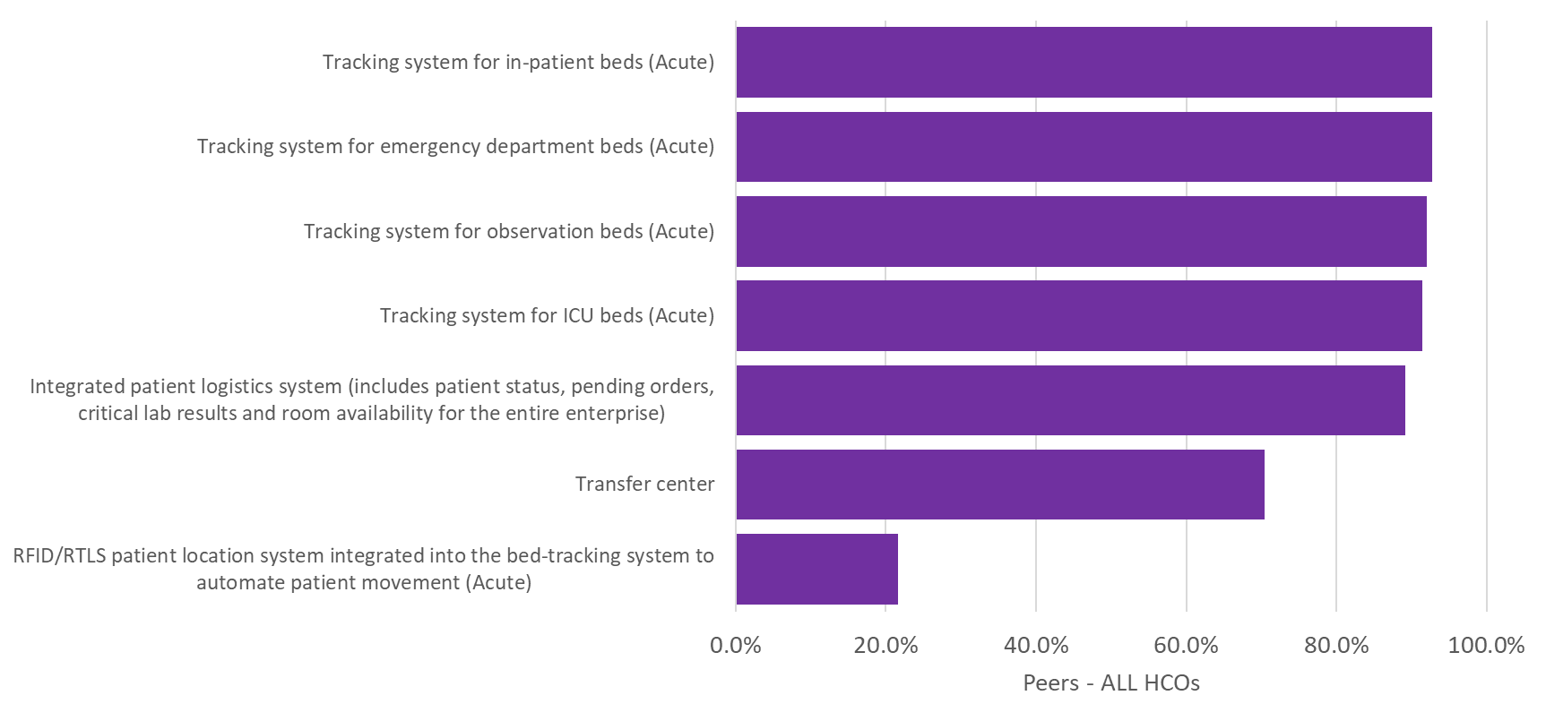
Q29. Which of the following settings in your organization use a bed/exam room tracking or patient-flow software system (Note: bed tracking/patient-logistics management may be functionality included within your electronic health record)?

Slide 6
Financial Management

Slide 7
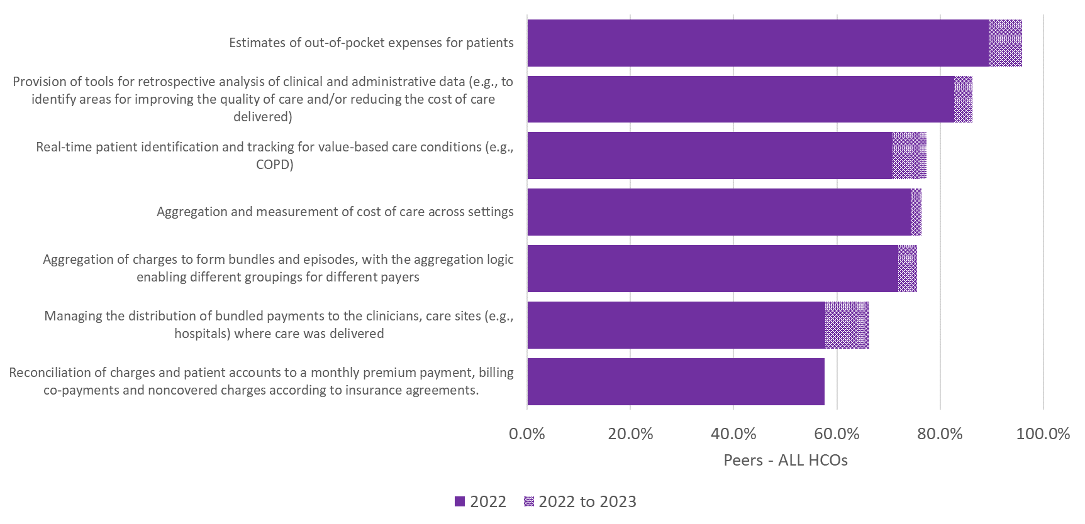
Q27. Which of the following deliverables does your organization’s revenue-cycle and contracts-management application offer:

Slide 8
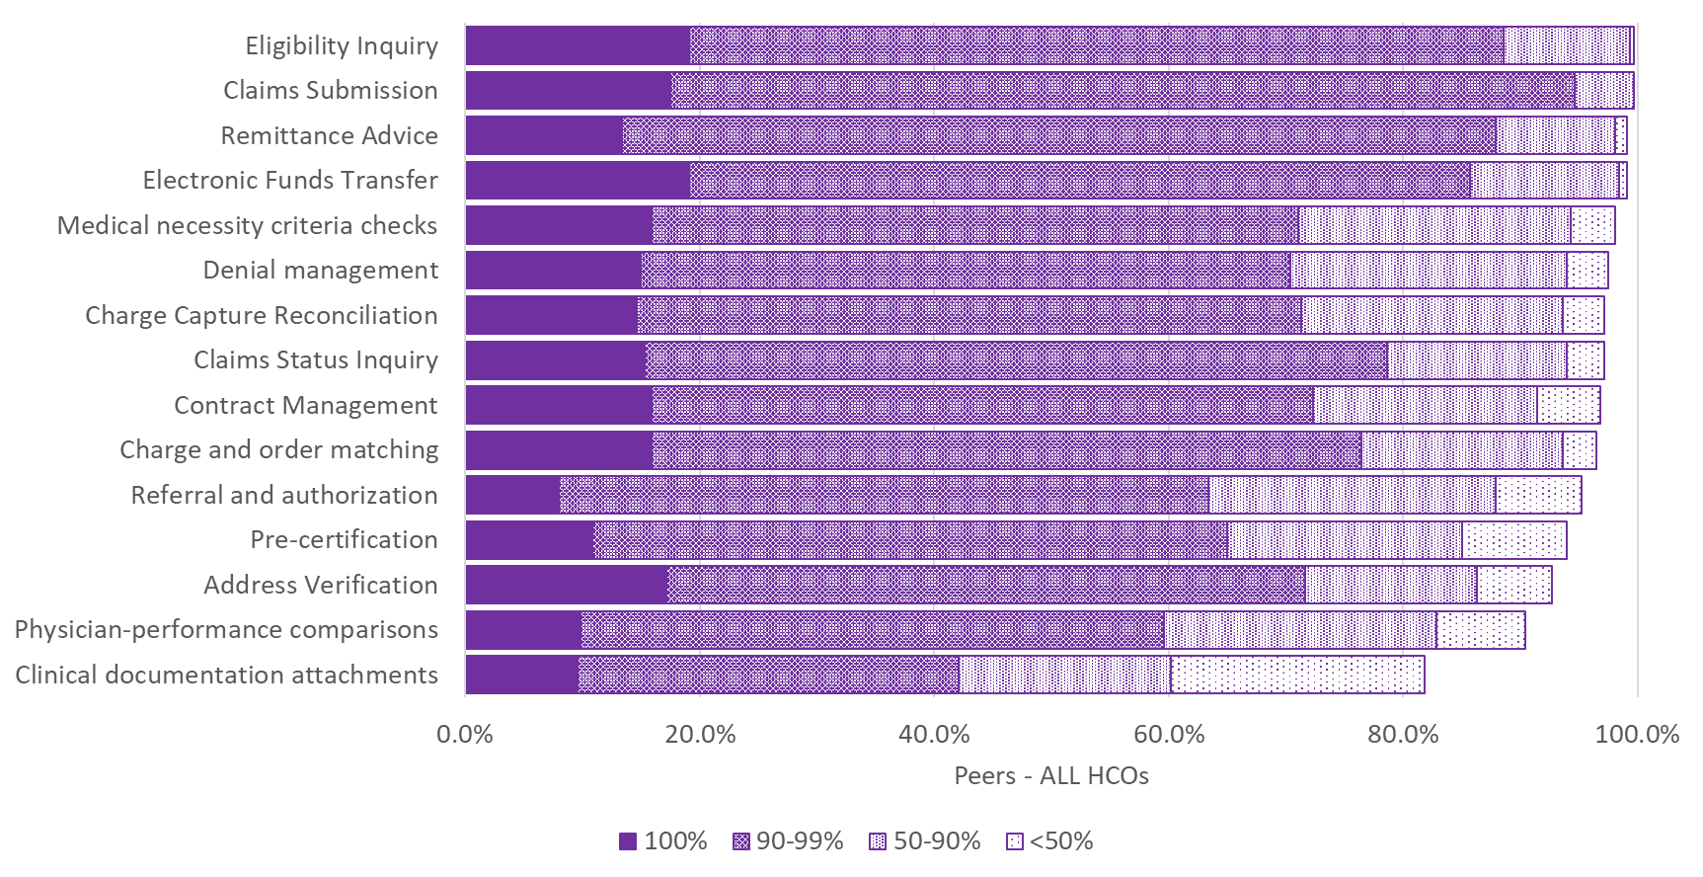
Q28. What percentage of the following payer-related activities are accomplished using automated electronic routines and/or software?

Slide 9
Personnel Management

Slide 10
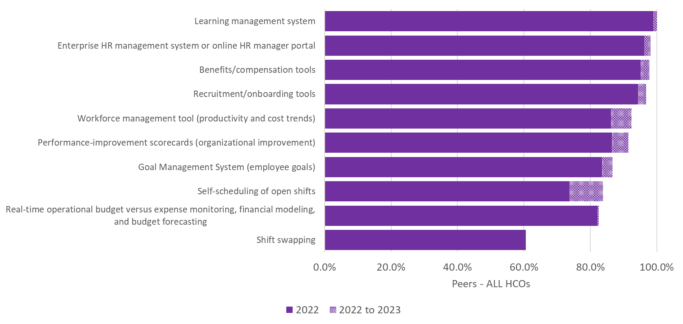
Q30. Which of the following management tools are available electronically/online to employees throughout your organization?

Slide 11
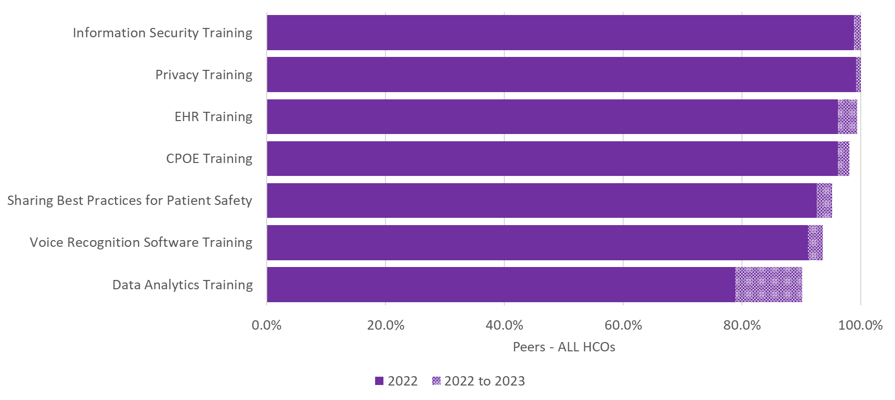
Q31. Which of the following types of computer-based clinical education offerings do you provide to clinicians in your organization

