Slide 1
Topics - Security
Security Leadership
Security Governance
Security Practices
Leveraging External Resources
Internal Processes
Security Insurance

Slide 2
Security Leadership

Slide 3
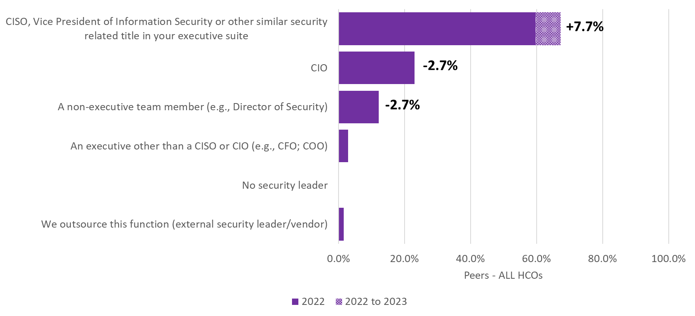
Q9. Whom on your executive team is primarily responsible for leading information security in your organization?

Slide 4
Security Governance

Slide 5
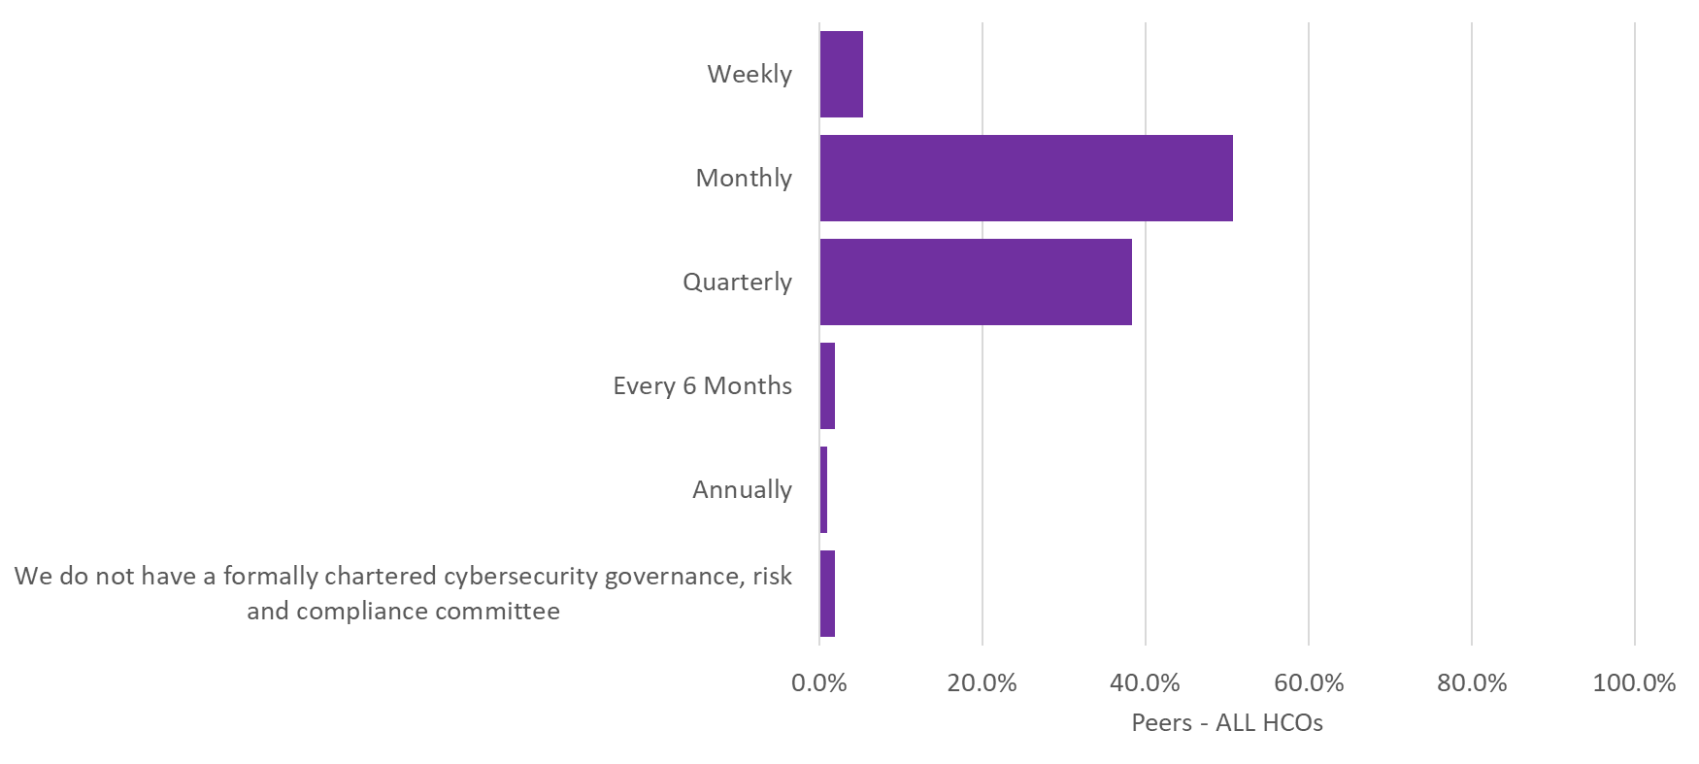
Q10. How often does your organization's formally chartered cybersecurity governance, risk and/or compliance committee meet?

Slide 6
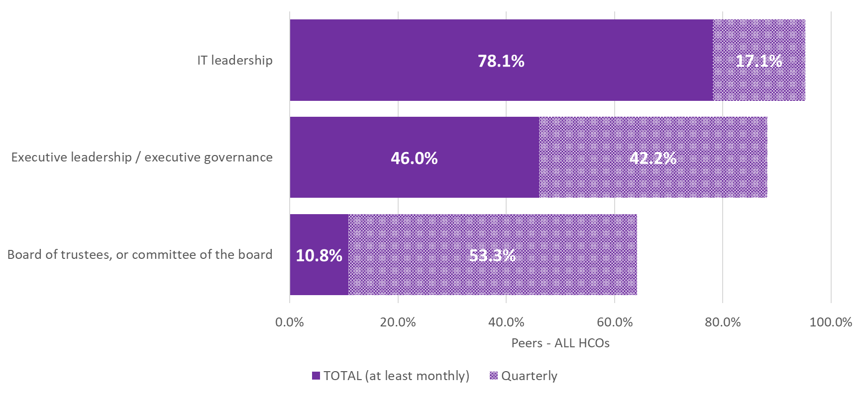
Q11. How often do the following groups receive a formal report regarding your organization’s information security efforts?

Slide 7
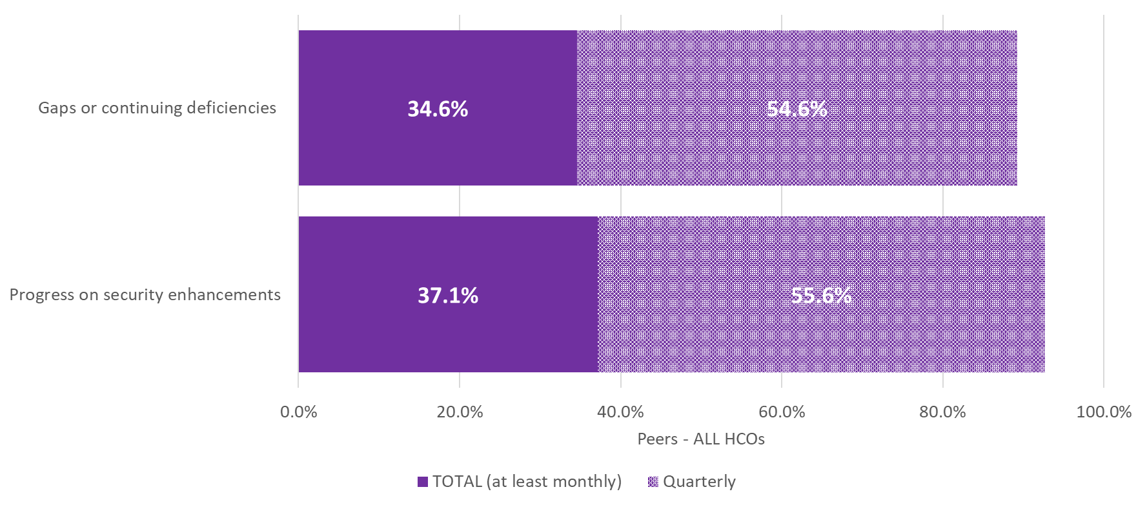
Q12. How often are the results of the following reported to your organization’s executive team?

Slide 8
Security Practices Leveraging External Resources

Slide 9
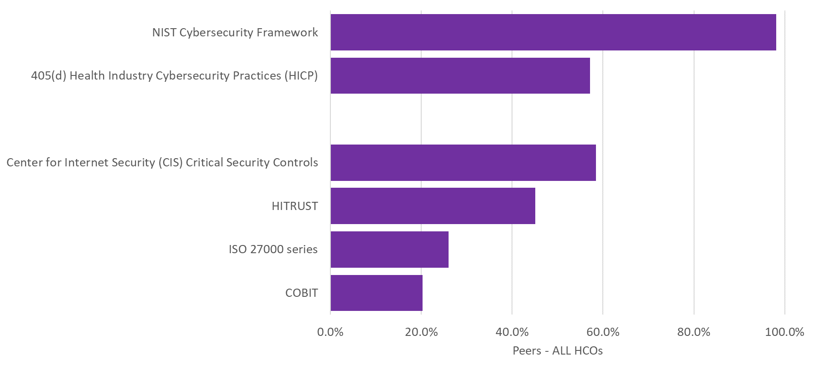
Q14. Which of the following information security frameworks does your organization use to guide your information security program?

Slide 10
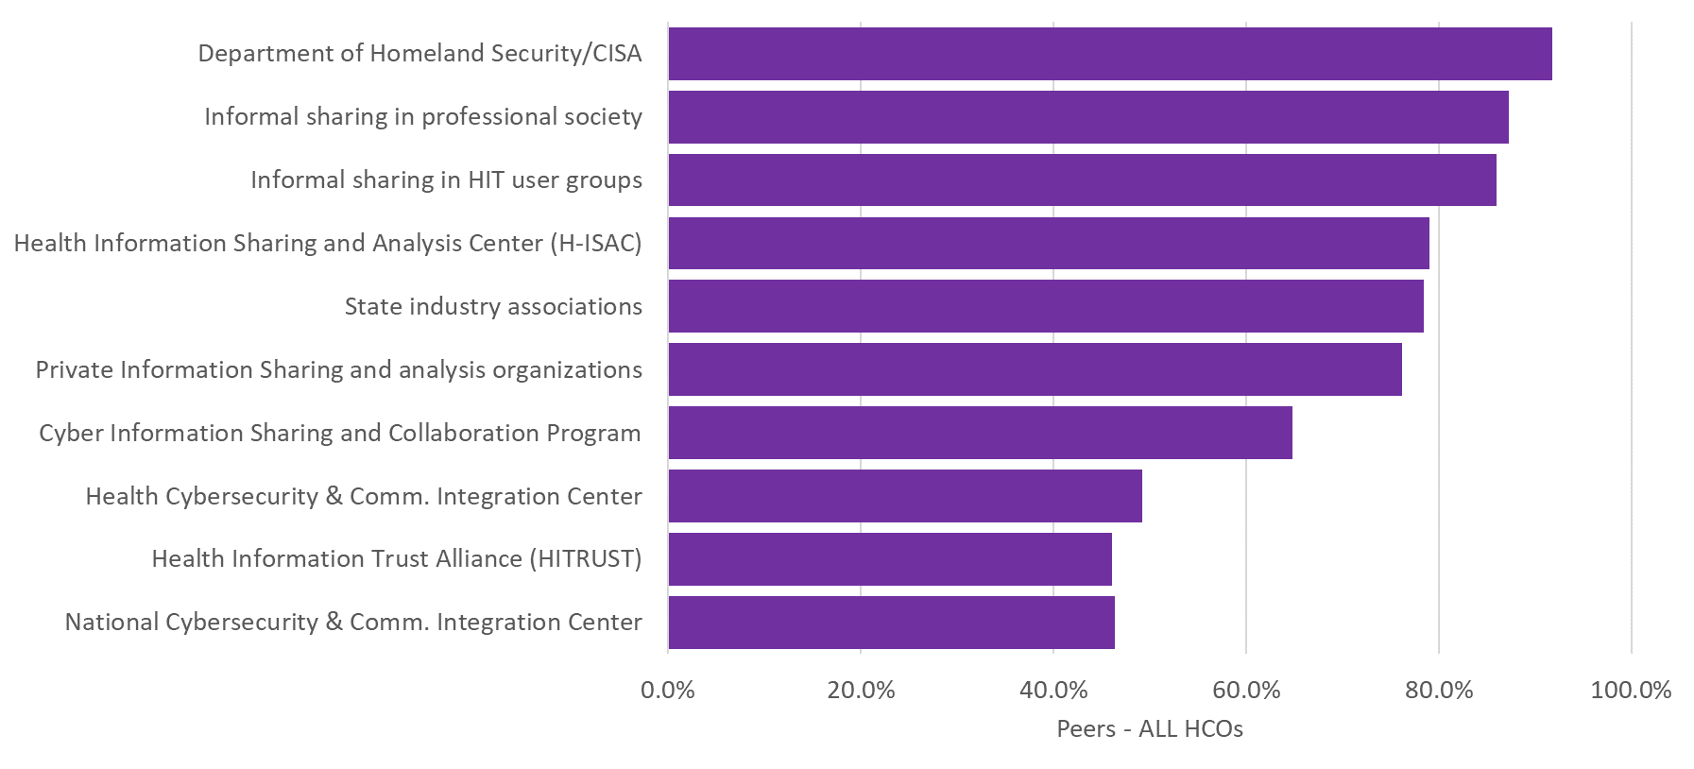
Q15. Which of the following information sharing and analysis organizations does your organization participate with to identify cybersecurity threats and vulnerabilities?

Slide 11
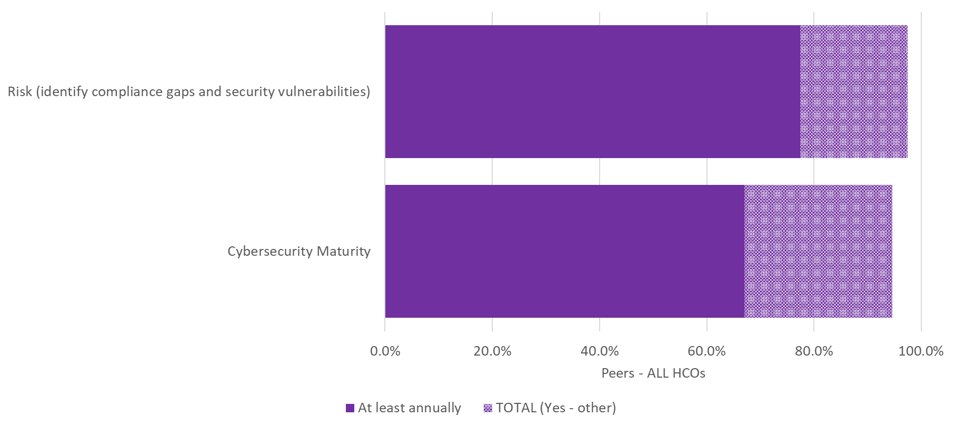
Q17. Does your organization use the services of a 3rd party to conduct the following assessments?

Slide 12
Security Practices Internal Processes

Slide 13
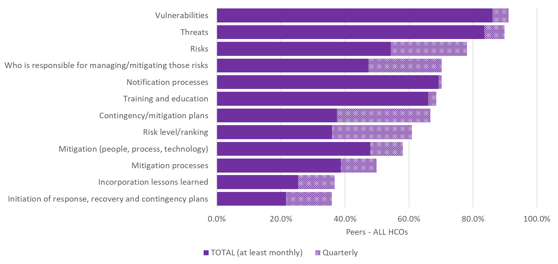
Q13. How often are the following components of your risk management program reviewed and/or updated?

Slide 14
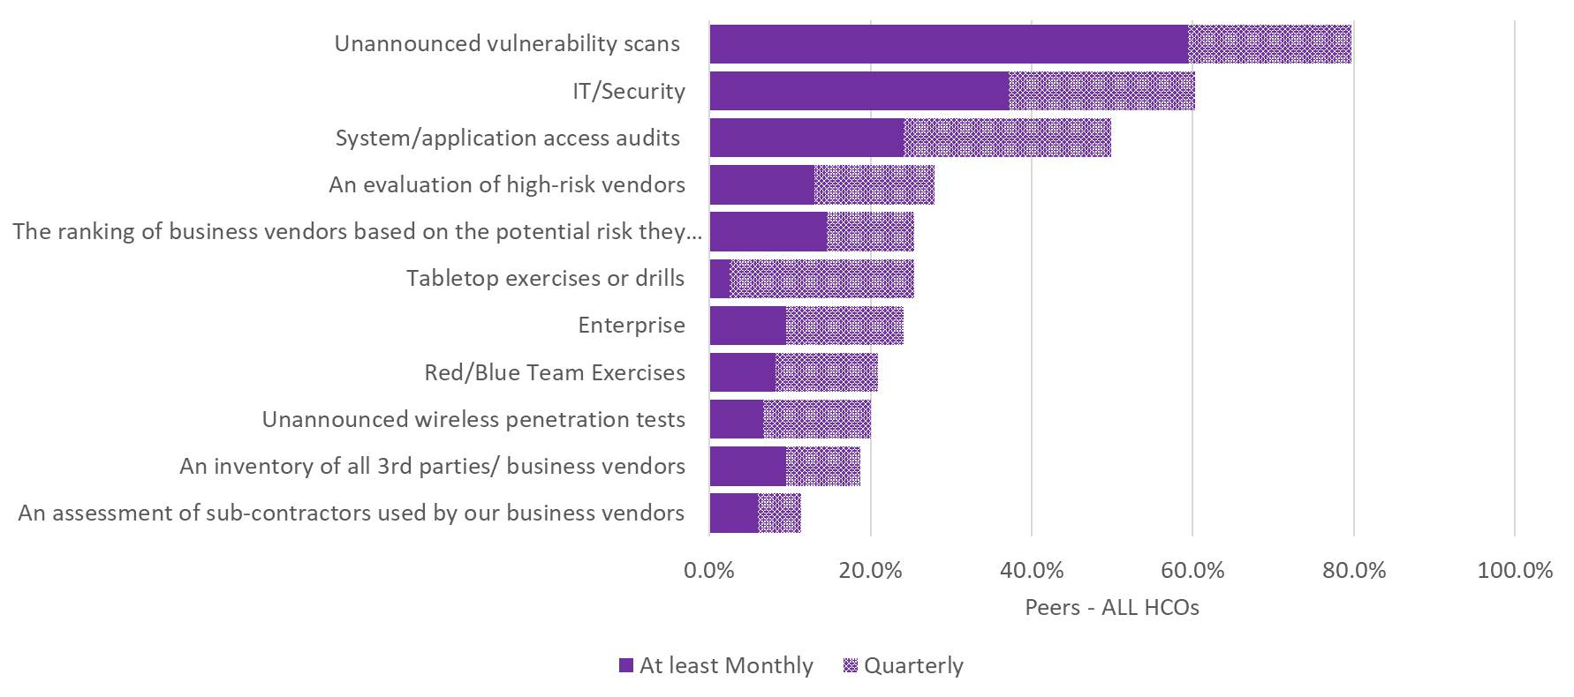
Q16. How often does your organization conduct each of the following?

Slide 15
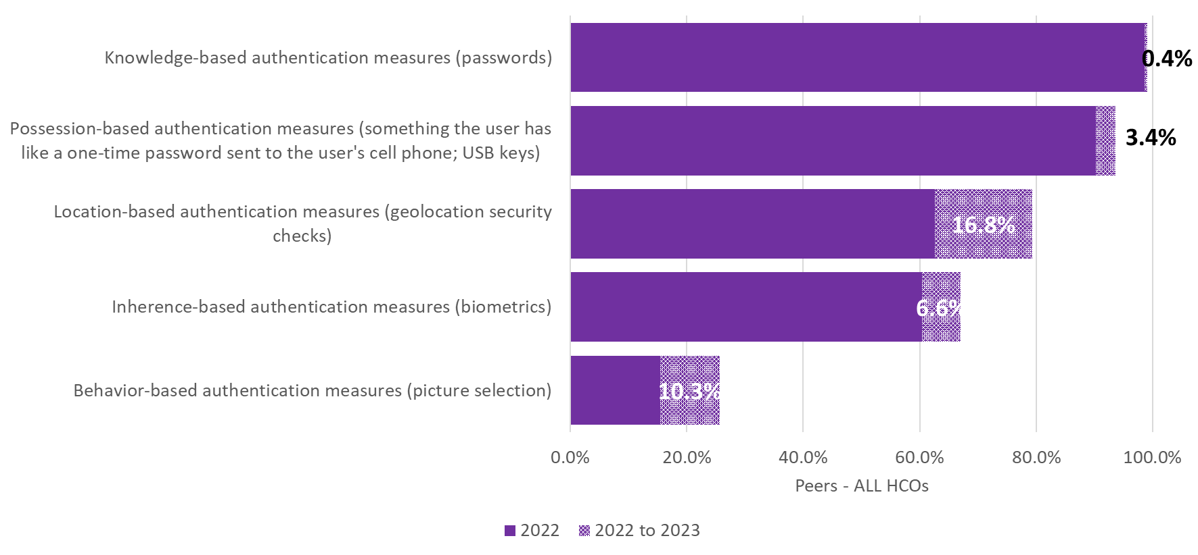
Q18. Which of the following types of security authentication measures does your organization currently use to authenticate/manage authorized users?

Slide 16
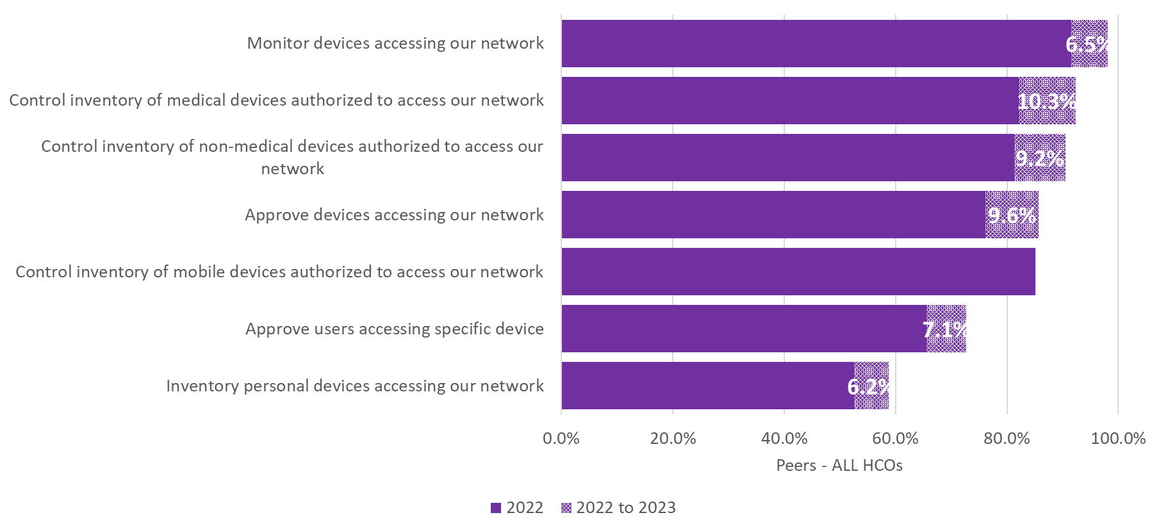
Q19. Which of the following security controls does your organization currently use to authenticate/manage devices accessing your network?

Slide 17
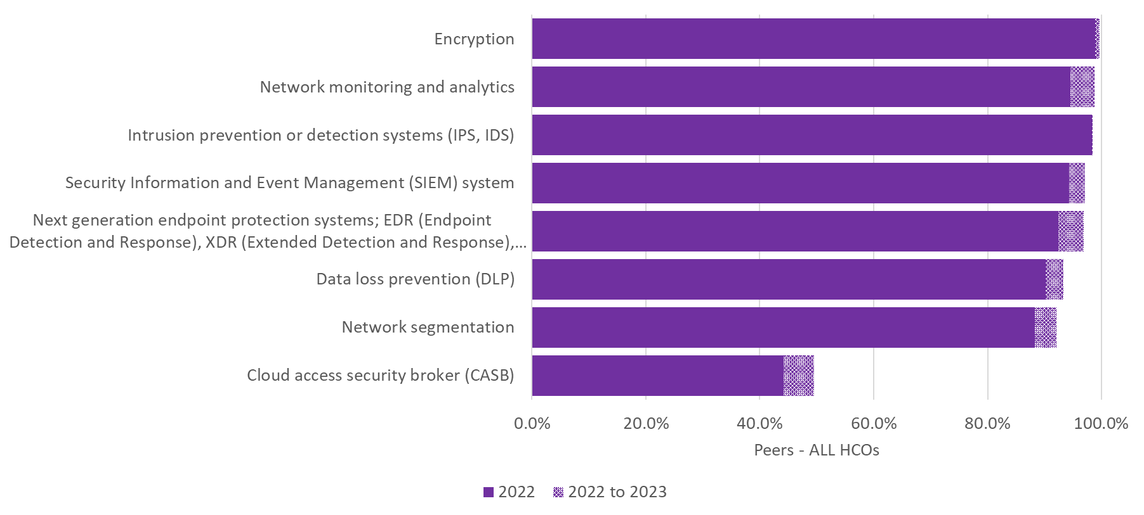
Q20. Which of the following capabilities has your organization implemented and used as part of your organization’s security processes?

Slide 18
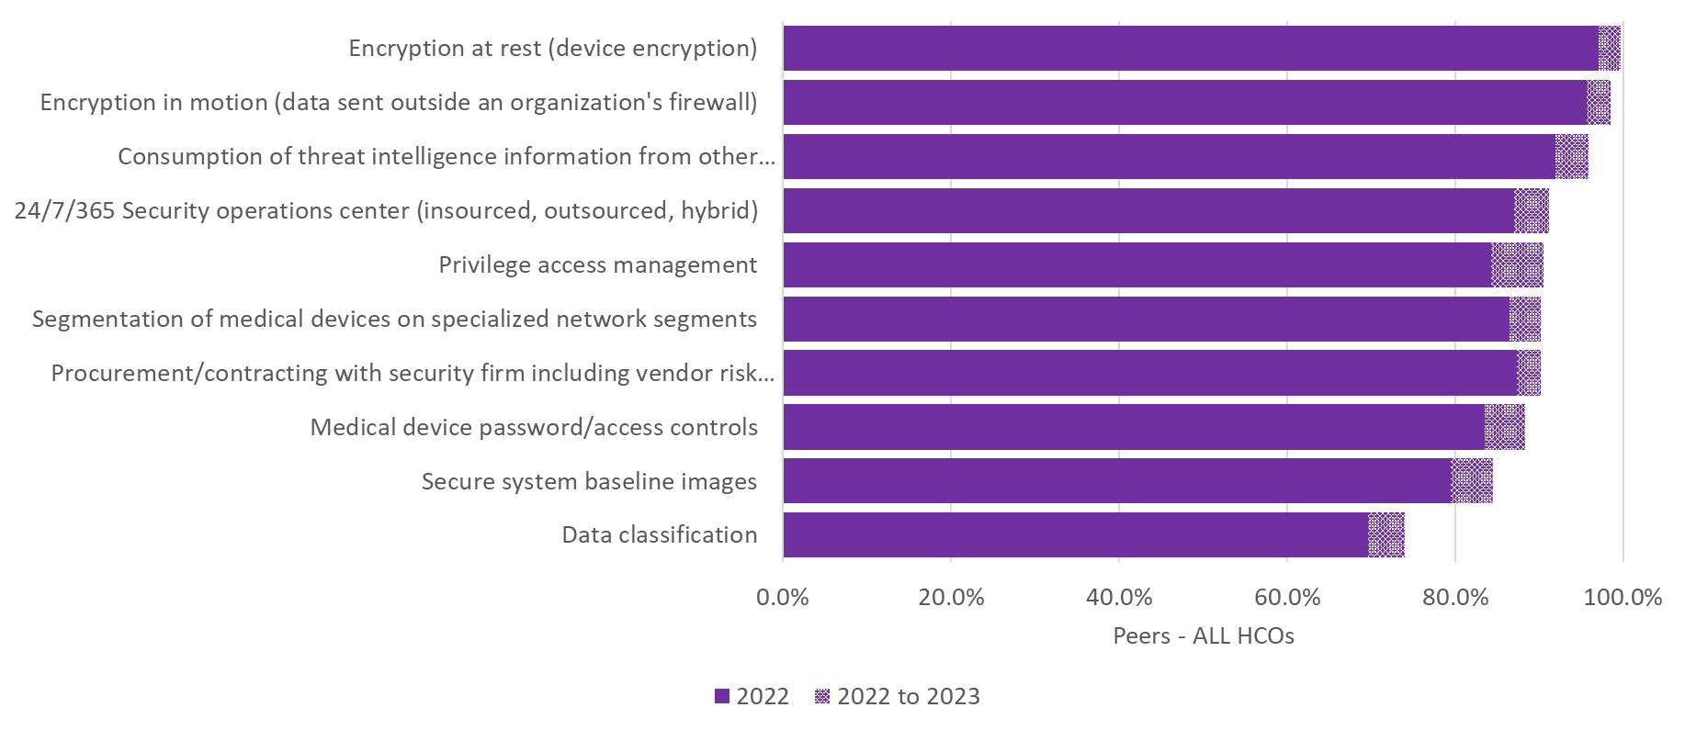
Q21. Which of the following security processes does your organization currently use to safeguard information?

Slide 19
Security Insurance

Slide 20
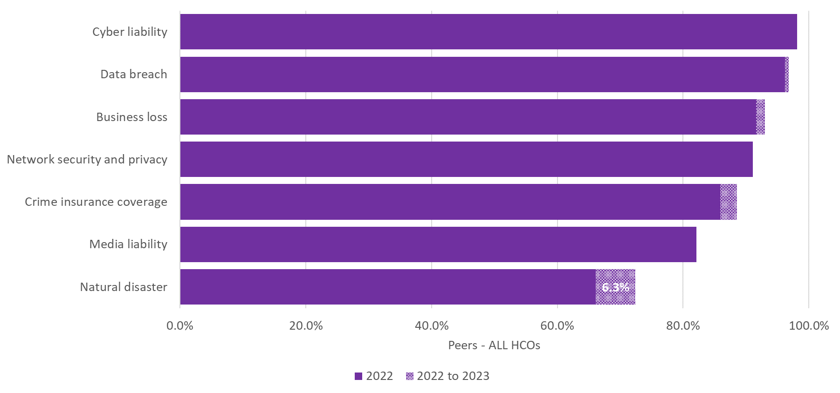
Q22. Which of the following cybersecurity related insurance coverages does your organization currently carry?

