Slide 1
Topics - Infrastructure
Infrastructure Support
Infrastructure Governance
Infrastructure Monitoring Practices
Infrastructure Performance

Slide 2
Infrastructure Support

Slide 3
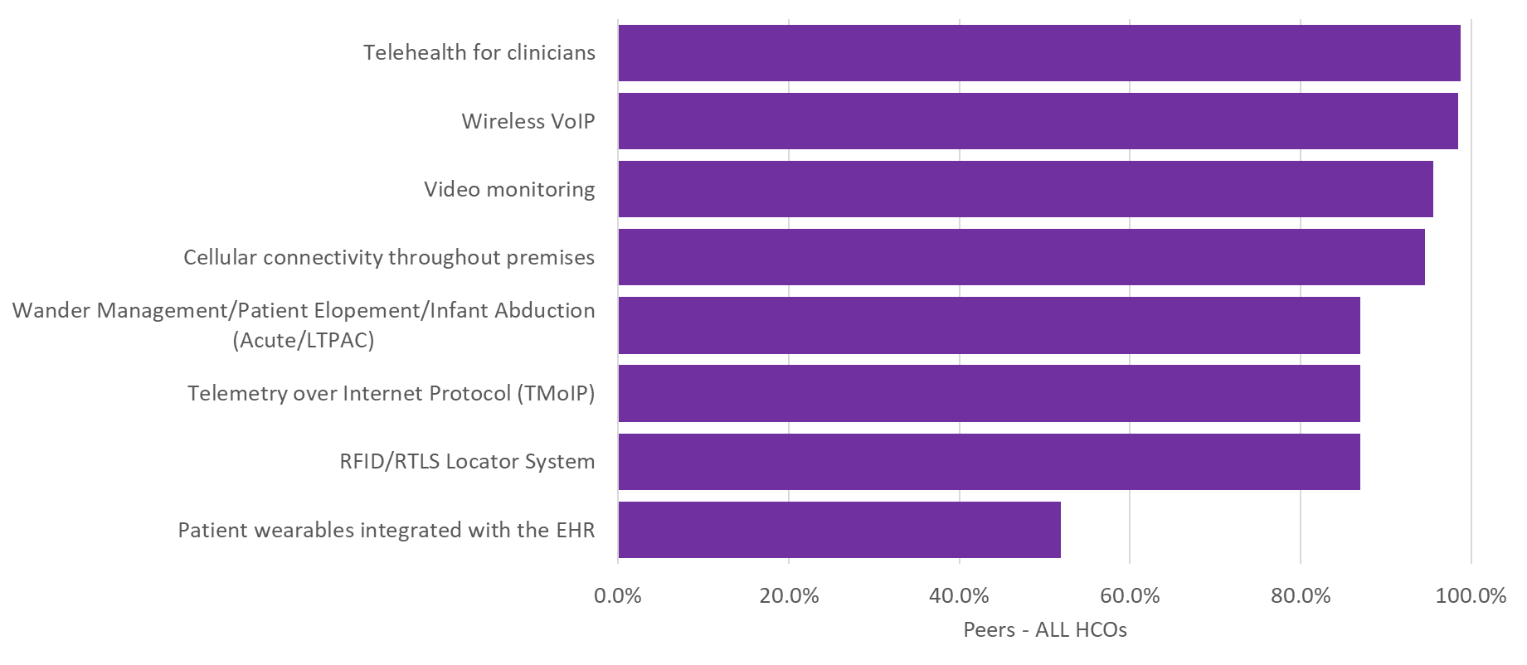
Q2. Which of the following wireless applications and/or technologies does your organization(s) support?

Slide 4
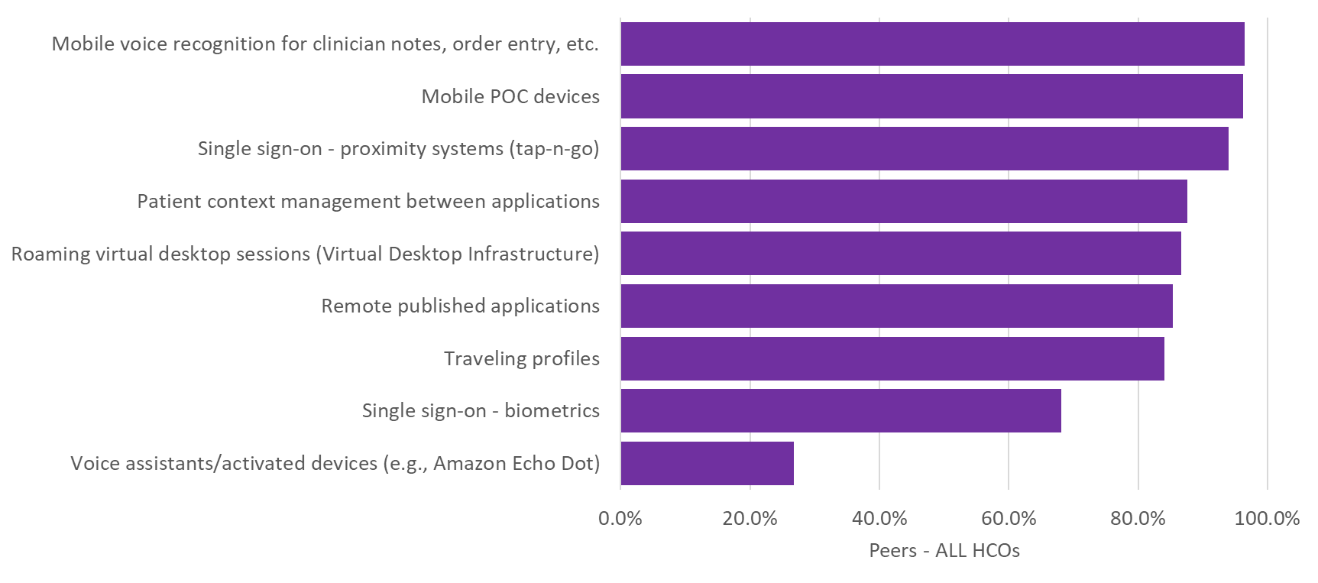
Q3. Which of the following technologies does your organization utilize to improve caregiver workflow?

Slide 5
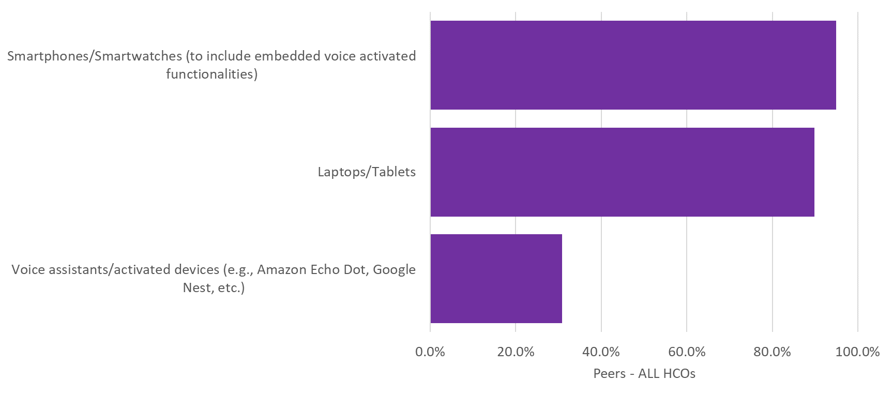
Q4. Which of the following types of employee-owned devices are your clinical staff allowed to use in the care of your patients?

Slide 6
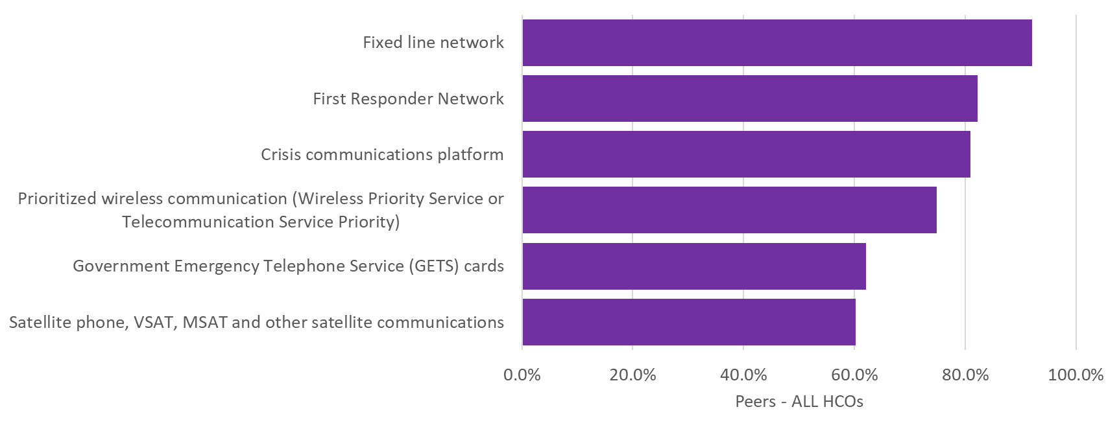
Q7. Which of the following communication equipment and services could your staff potentially use in the event of an emergency?

Slide 7
Infrastructure Governance

Slide 8
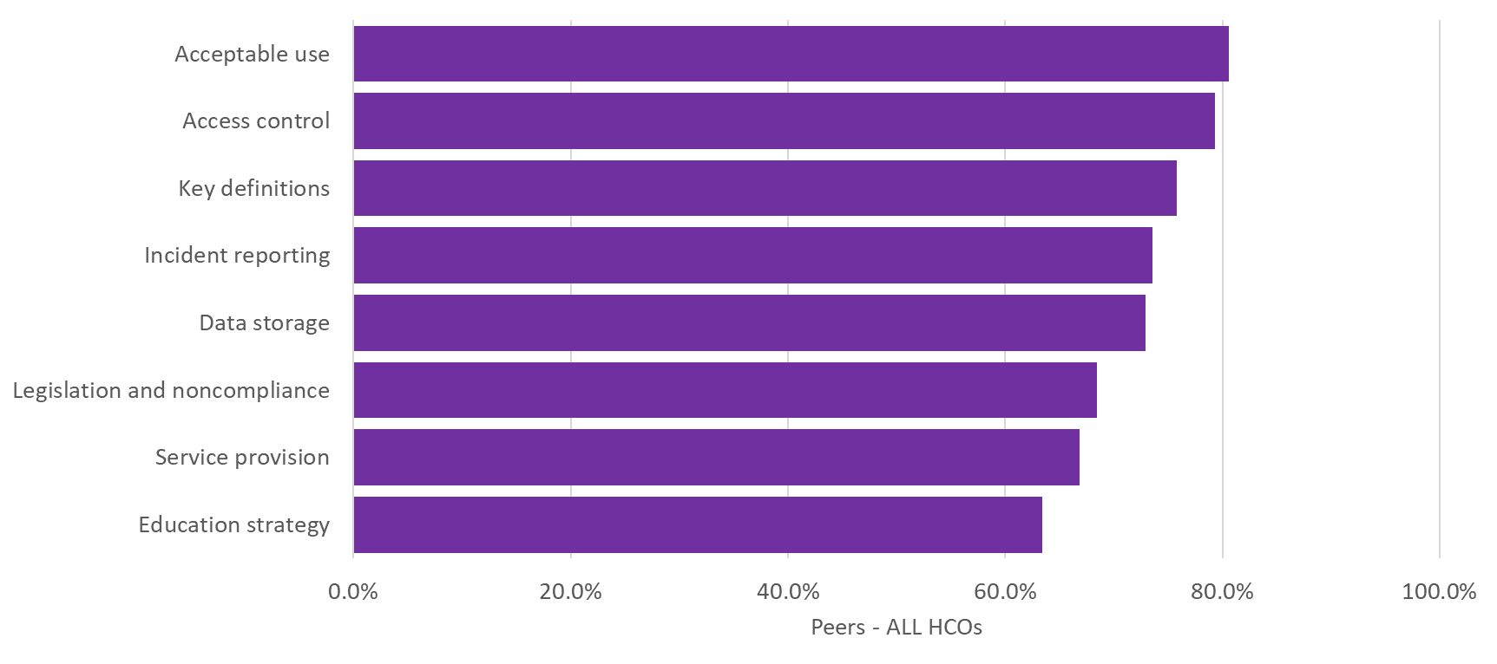
Q5. Which of the following elements are included in your organization’s bring-your-own-device (BYOD) policy?

Slide 9
Infrastructure Monitoring Practices

Slide 10
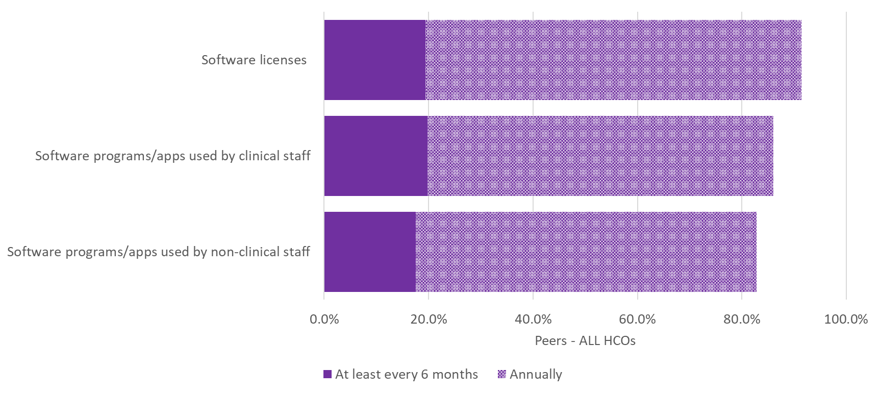
Q8. How often does your organization conduct a regularly scheduled inventory audit of the following?

Slide 11
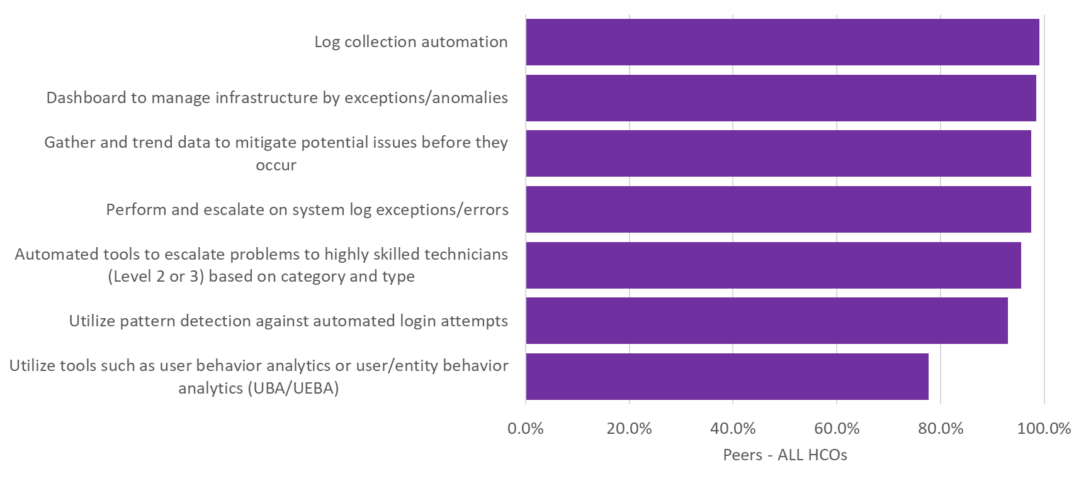
Q1. Which of the following methods does your organization use to monitor your IT systems?

Slide 12
Infrastructure Performance

Slide 13
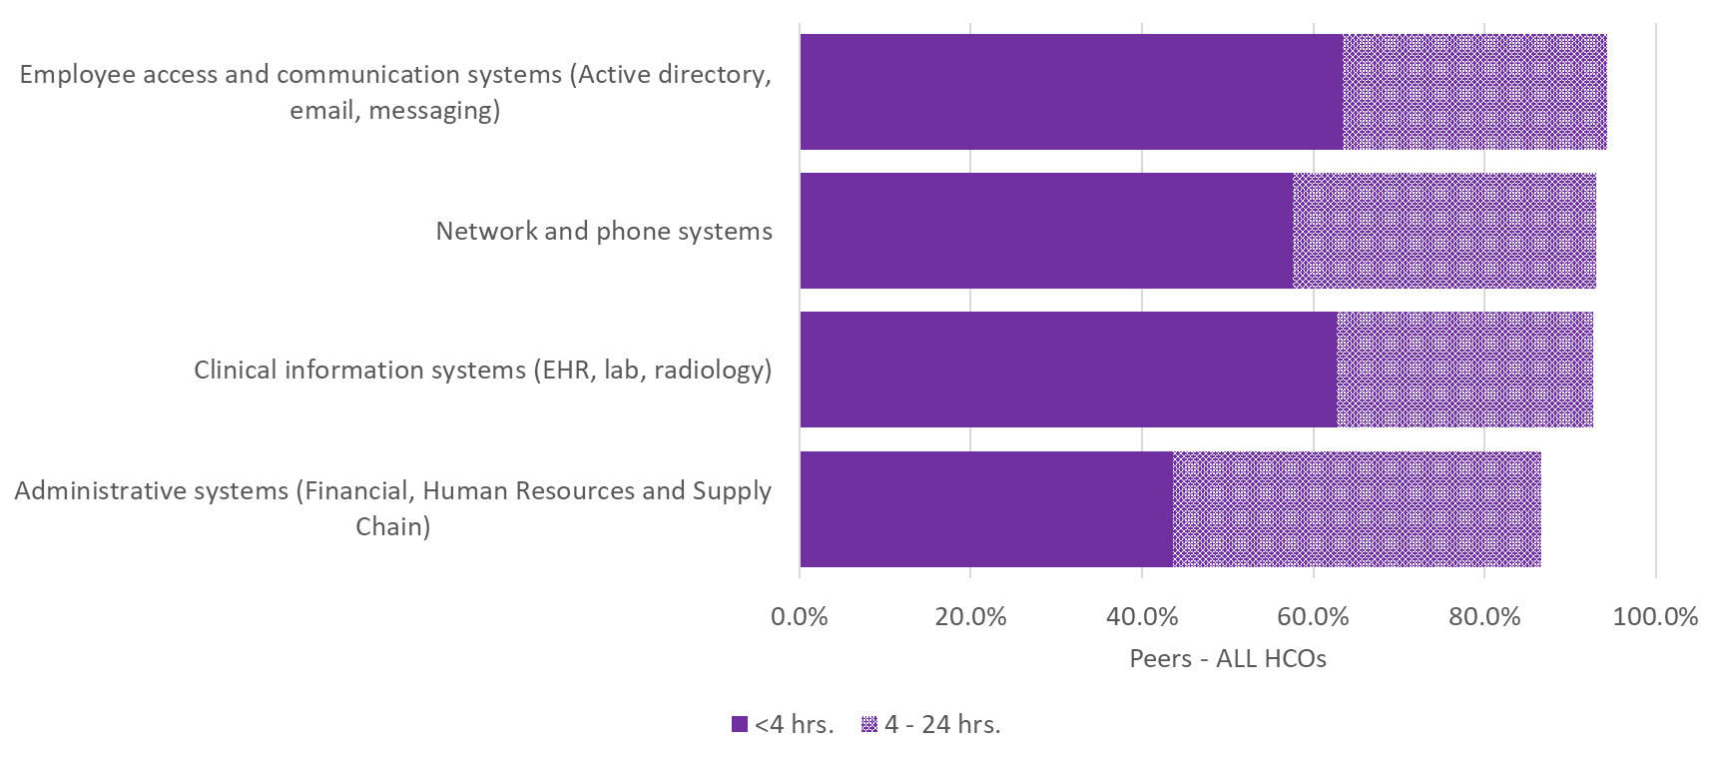
Q6. How quickly can your organization restore mission critical operations should a disaster cause the complete loss of your organization’s primary data center?

